Slide 1
Malsl Subiness
Puspliers
Tuscomres
Unscramble the key words above

Slide 2
Small Business
Suppliers
Customers

Slide 3
Starter Activity
Complete the worksheet provided by your teacher!

Slide 4
Topic 1.1: Businesses
Unit 1: Introduction to Small Businesses

Slide 5
Learning Objectives
To understand the following key terms (AO1):
Supplier
Customer
Consumer
Market
To apply how production, suppliers, customers and markets work in a small business. (AO2)
To evaluate THREE difficulties to starting a small business. (AO3)
What are we learning today? By the end of the lesson you should be able...

Slide 6
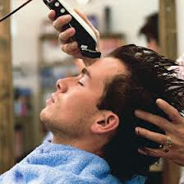
Businesses
Businesses exist to make ‘Goods’ and provide
‘Services’ to their customers.
The majority of UK businesses are services.
Goods: Are physical items. E.g.
Smart Phones
Food
Petrol
Services: Are non-physical items. E.g.
A Haircut
A Bus Journey
Doctors Appointment
Now add two more examples of goods and services you have paid for this week

Slide 7
Production
Businesses make ‘Goods’ and ‘Services’. To do this they purchase raw materials, labour and machines to make the products.
Raw Materials: Cocoa, sugar etc.
Labour: Employees to operate machinery
Machines: Make the products

Slide 8
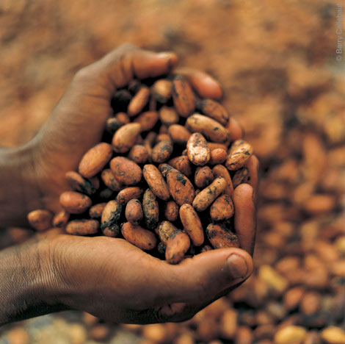
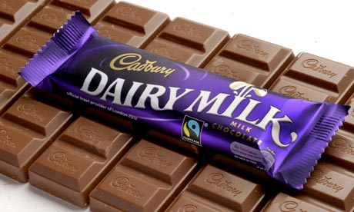
Suppliers
Supplier: A business which sells products to another business. For Cadbury their suppliers will provide them with cocoa to manufacture the chocolate.
Cocoa farmer in Ghana Cadbury’s factory in Birmingham

Slide 9
Markets
Market: Where buyers and sellers meet to exchange ‘Goods’ and ‘Services’.
Local
National
Global
Shopping Centre
Supermarket
Online

Slide 10
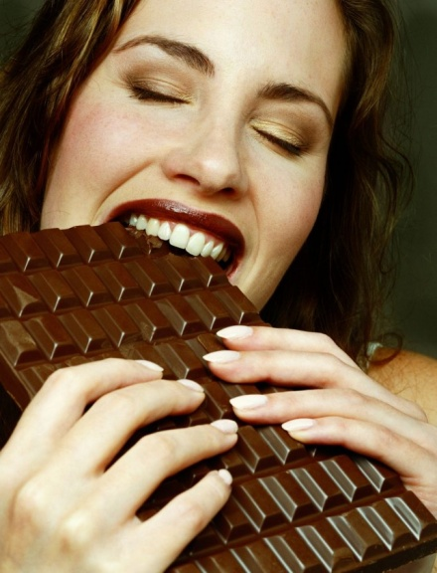
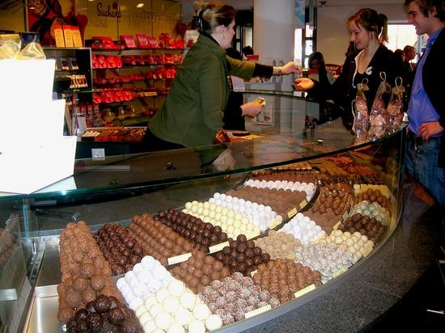
Customer or Consumer?
Customer: Any person or organisation which buys or is supplied with a product by the business.
Consumer: The person who ultimately uses (or consumes) a product.
What is the difference?

Slide 11
The relationship of production, suppliers, customers and consumers
Draw a flow diagram to show the relationship of production, suppliers, customers and consumer.
SUPPLIER Cotton farmer
PRODUCTION Nike clothes factory
CUSTOMER JD Sports, Brent X
CONSUMER Mr Pujara

Slide 12
Activity
Complete the worksheet provided by your teacher!

Slide 13
Plenary
Before you can leave the room each table must answer at least one question.
Why do businesses exist?
Why do we need businesses?
What is a consumer?
What is a customer?
What is a market?
What do you need to produce products?
What are the difficulties starting a business?
What is the difference between a good and a service?

