Slide 1
Starter Activity
Complete the worksheet provided by your teacher!

Slide 2
Topic 3.1: Marketing
Unit 3: Building a Business

Slide 3
Learning Objectives
To understand the following key terms (AO1):
Marketing
Market Research
Primary Data
Secondary Data
To apply how large businesses use market research. (AO2)
To evaluate the uses and limitations of using market research. (AO3)
What are we learning today? By the end of the lesson you should be able...

Slide 4
What is Marketing?
Marketing: The management process that is responsible for anticipating, identifying and satisfying customer needs profitably.

Slide 5
Why is marketing so important?

Slide 6
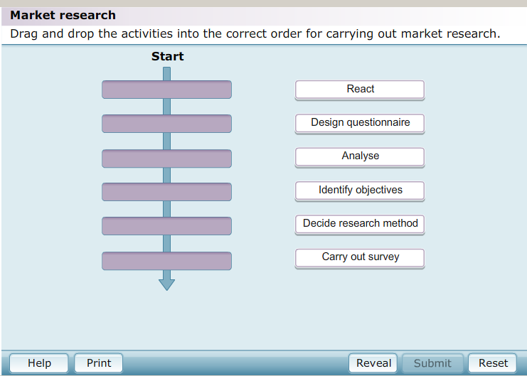
Activity
As a class we are going to complete the following:

Slide 7
Stages
There are THREE main stages:
Designing the Research
Undertaking the Research
Analysing the Information

Slide 8
Sampling
Sample: A small group out of the total population which is selected to take part in a survey.
There are four types of sampling:
Random Sample
Systematic Sample
Quota Sample
Stratified Random Sample

Slide 9
Random Sample
Random Sample: When every potential respondent has an equal chance of being selected.

Slide 10
Systematic Sample
Systematic Sample: This is when respondents are selected in pre-set intervals (E.g. Every 10th person).

Slide 11
Quota Sample
Quota Sample: When the sample is broken down into specific segments (E.g. Males aged 16-24)

Slide 12
Stratified Random Sample
Stratified Random Sample: Like a quota sample but respondents are selected at random.

Slide 13
Activity
Complete the worksheet provided by your teacher!

Slide 14
Peer Assessment
Complete the worksheet provided by your teacher!

Slide 15
Plenary: Post It
Using the Post-It notes provided answer the following 4 questions and then stick it onto the sugar paper.
What have I learnt?
What have I found easy?
What have I found difficult?
What do I want to know now?
3 Minutes
Are you now more confident in your understanding of the learning objectives?

