Slide 1
Starter Activity
Complete the worksheet provided by your teacher!

Slide 2
Topic 3.2: Product Trial and Repurchase
Unit 3: Building a Business

Slide 3
Learning Objectives
To understand the following key terms (AO1):
Customer Loyalty
Repeat Purchase
To apply how large businesses use repeat purchase strategies. (AO2)
To evaluate the uses and limitations of repeat purchase strategies. (AO3)
What are we learning today? By the end of the lesson you should be able...

Slide 4
Activity
As a class we are going to watch a video on Tesco. Write down how their Clubcard helps them encourage repeat purchase.

Slide 5
Repeat Purchase
Repeat Purchase: When a customer buys a product more than once.
Benefits to the business:
More profit
Word of mouth
Brand image
Knowledge of customers

Slide 6
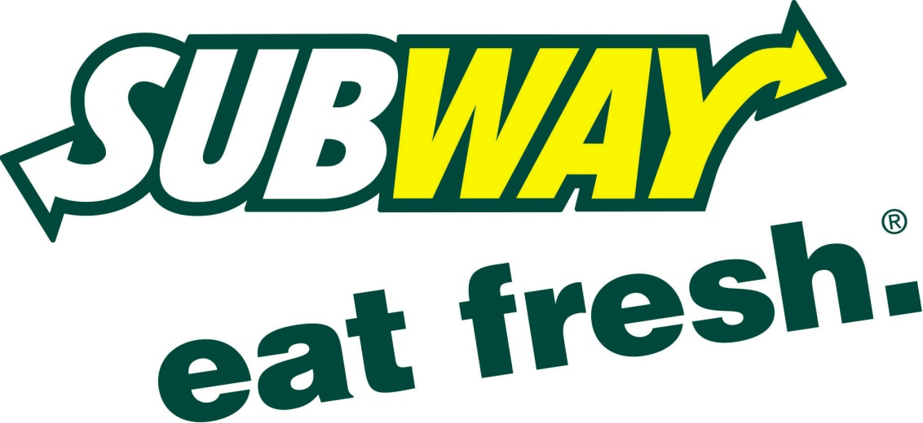
Customer Loyalty
Customer Loyalty: The willingness of buyers to make repeated purchases of a product or from a business.
How do businesses encourage customer loyalty?

Slide 7
Repeat Purchase
Customer Loyalty: The willingness of buyers to make repeated purchases of a product or from a business.
How do businesses encourage customer loyalty?
Product | Place | Price | Promotion
Update products | Always available | Special offers | Advertising
New technology | Online | Low prices | Personal selling
Different from the competition. | Convenient | Cheaper than the competition | Public relations

Slide 8
Activity
Complete the worksheet provided by your teacher!

Slide 9
Plenary
Customer Loyalty | Quantitative Data | Market Segment | Penetration Pricing
Market Research | Qualitative Data | Product Trial | Trade Buyers
Primary Data | Survey | Public Relations | Wholesalers
Repeat Purchase | Respondents | Viral Marketing | Retailers

