Slide 1
Starter Activity
Complete the worksheet provided by your teacher!

Slide 2
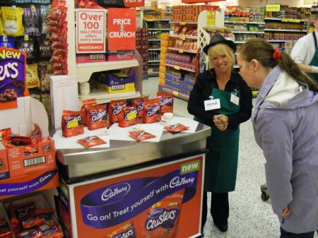
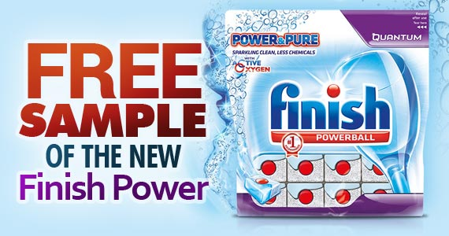

Slide 3
Topic 3.2: Product Trial and Repurchase
Unit 3: Building a Business

Slide 4
Learning Objectives
To understand the following key terms (AO1):
Product Trial
Public Relations
Viral Marketing
Penetration Pricing
To apply how large businesses use product trials and repeat purchase. (AO2)
To evaluate the uses and limitations of product trails and repeat purchase. (AO3)
What are we learning today? By the end of the lesson you should be able...

Slide 5
Product Trial
Product Trial: When consumers buy a good for the first time and assess whether or not they want to buy it again.
Targeting Trade Buyers, Wholesalers and Retailers
Advertising
Free Publicity (Public Relations & Viral Marketing)
Free Samples
User Testing
Low Trial Prices (Penetration Pricing)

Slide 6
Read page
Create a mind map to show the 6 ways to get customers to try a new product : P14 & 15
Advertising
Targeting trade buyers
Free Publicity
Product Trial
Low trial prices
Free samples
User testing
EXTENSION : Describe instances when you have tried a product or received a free sample

Slide 7
How would you get people to try your product or service ?
Name of your product
Description
What methods you will use and explanation.

Slide 8
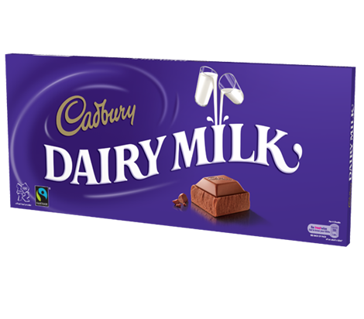
Repeat Purchase p.15&16
Stick in your photo of a Dairy Milk bar, then write notes on the different ways Cadburys encourage repeat purchases:
Promotion
Price
Product
Place

Slide 9
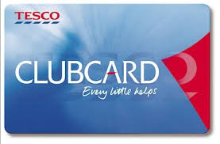
Customer Loyalty
As a class we are going to watch a video on Tesco. Write down how their Clubcard helps them encourage repeat purchase.

