Slide 1
Meeting Customer Needs Nocaltion Lavue rof Nomey Dropuct Ganre Gihh Tualiqy Suctomer Resvice

Slide 2
Meeting Customer Needs Location Value for Money Product Range High Quality Customer Service

Slide 3
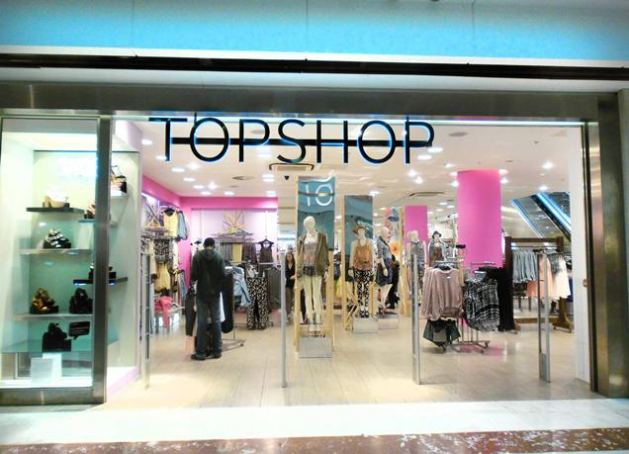
Customer Needs: The wants and desires of buyers of a product.

Slide 4
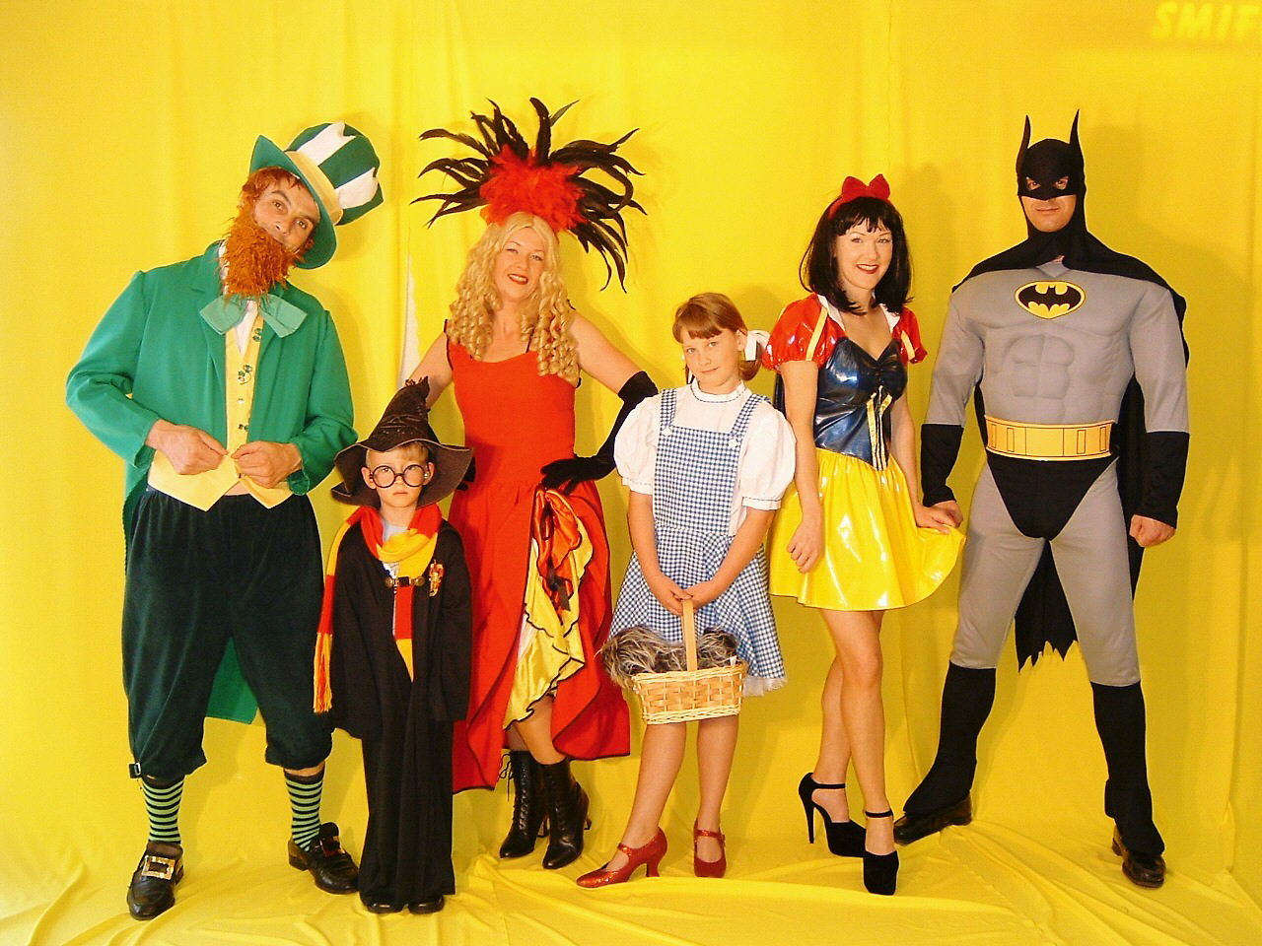
My Survey
CUSTOMER NEEDS
You have two minutes to suggest what are the customer needs of a fancy dress shop.
Read page 12 with your partner
Learning Objectives
To understand the following key terms (AO1):
Market Research
Primary Research
Customer Needs
To apply how a business uses a variety of primary research methods. (AO2)

Slide 5
My Survey
CUSTOMER NEEDS
You have two minutes to suggest what are the customer needs of a fancy dress shop.
Read page 12 with your partner
Market Research:
The process of gaining information about customers, competitors and market trends through collecting primary and secondary data KEY TERMS
Primary Research
The gathering of new information - primary data, which has not been collected before. KEY TERMS
market research

Slide 6
Primary Research
Read page 12 and then write notes about :
Survey/ Questionnaire
Focus Group
Observation
Experiments/prototypes

Slide 7
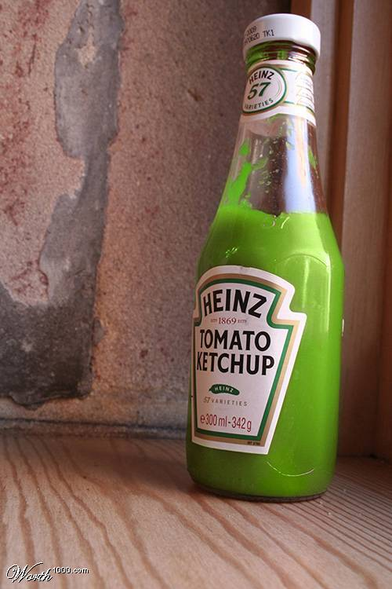
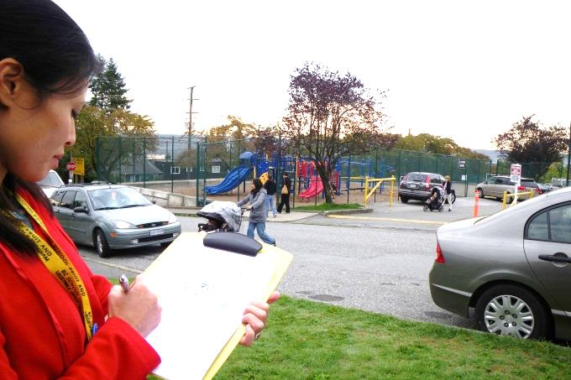
Focus Group
Experiments/prototypes
Observation
Survey/ Questionnaire

Slide 8
What are the positives and negatives of
primary research methods
 | Advantages | Disadvantages
Questionnaires/ surveys
Focus Groups
Observation

Slide 9
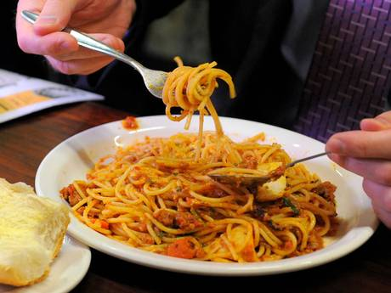
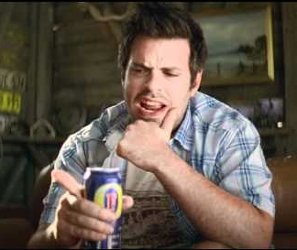
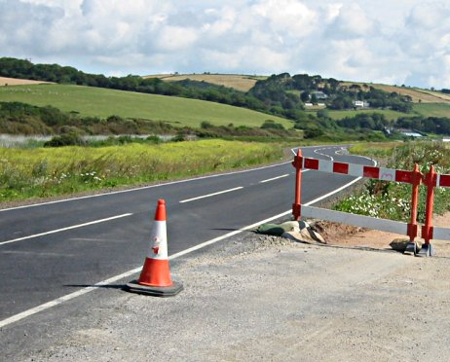
What kind of primary research methods would you use to find out ..
A: Public’s view on new lime flavoured Cola
B: Viewers opinions on New Fosters TV Advert
C: Students opinions on school dinners
D: Amount and type of traffic on new road
E: Shoppers reaction to new Hollister store design
For each one suggest what kind of information you would like to find/ questions to ask

Slide 10
Secondary research
In pairs spend 5 minutes to read page 14.
Now close the textbook and A tells B what they have just read

Slide 11
Secondary research
Secondary Research: The process of gathering secondary data, information that has already been gathered. KEY TERMS
Companies will use ___________from within their business e.g. sales records or national data from ___________ statistics. They will also look at _________habits and trends and events in their market using _____ articles or reports. Increasingly businesses go online using the _________to see what their ____________ are doing.
consumer government news information
Internet competitors

Slide 12
Secondary research
Secondary Research: The process of gathering secondary data, which is information that has already been gathered. KEY TERMS
Companies will use information from within their business e.g. sales records or national data from government statistics. They will also look at consumer habits and trends and events in their market using news articles or reports. Increasingly businesses go on line using the internet to see what their competitors are doing.

Slide 13
Types of Data
Quantitative Data: Data that can be expressed as numbers and can be statistically analysed - quantities
e.g. 27 % of people like chips
Qualitative Data: Information about opinions, judgements and attitudes – qualities.
I think chips are delicious

Slide 15
activity
Complete the activity sheet

Slide 16
Plenary
Business | Services | Market Research | Observation
Market | Goods | Primary Research | Survey
Production | Supplier | Customer Needs | Experiment
Customer | Consumer | Raw Materials | Focus Group

