Slide 1
ANALYSING THE "MARKET"?
LESSON OBJECTIVES
To understand the following key terms (AO1):
Market Segment
Price Sensitive
Market Map
Gap in the Market
To apply how businesses can identify market segments. (AO2)
To analyse the use of a market map to identify gaps in the market. (AO3)

Slide 2
Activity
Think of as many variables as possible that make these people different. E.g. Age.

Slide 3
MARKET SEGMENTATION
Can anybody think of how we might “segment” or divide up the market?
Market segmentation is the process of dividing a market up into different groups of customers, in order to create different products to meet their specific needs.

Slide 4
MARKET SEGMENTS
Age – Different age groups will buy different products
Gender – male and females will often (but not always) buy different products
Income – People with higher levels of income will want particular products
Region – consumers living in different tastes and needs
Interests – different people have different hobbies and interests. This will mean that a range of products is needed to satisfy all tastes.

Slide 5
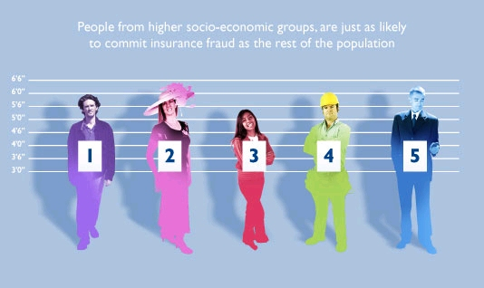
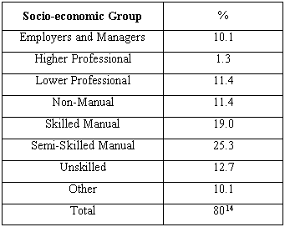
SOCIO-ECONOMIC GROUPS
Groups based on the income of the person and their level of education

Slide 6
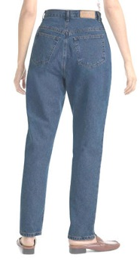
JEANS

Slide 7
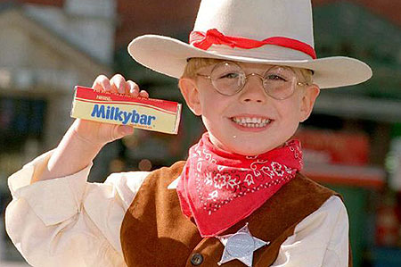
Segmenting the chocolate market

Slide 8
TASK1
For each of the five categories give examples of Cadbury’s products for each and who you think their target market is (provide age & sex)
EXAMPLE | TARGET MARKET
Dairy milk Flake
Soft mints Chewing gum | Young Males & females
Multipacks – Cadburys Mini’s | Families
Cadburys crème egg
Buttons Freddo
Can you think of the target market for Cadbury’s Roses?

Slide 9
Niche Market products are aimed at a small group of people, with products being very specialised and usually expensive.
Niche Market products

Slide 10
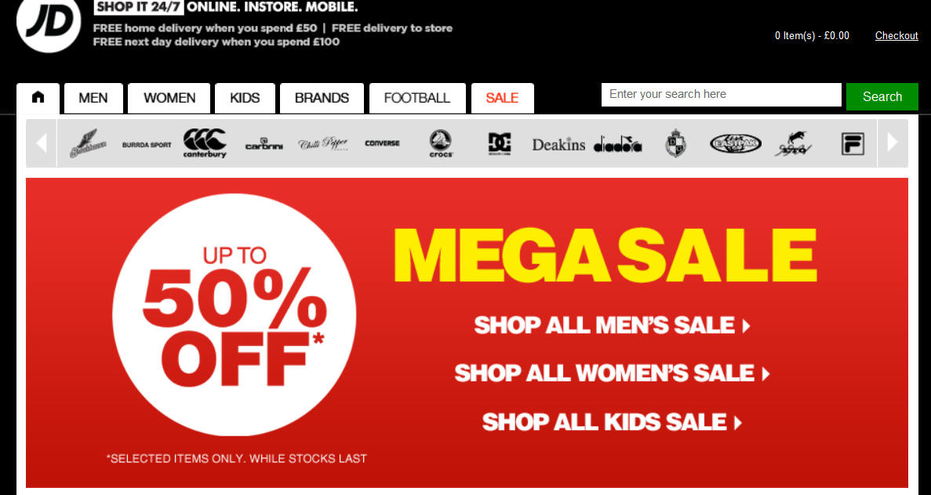
Price Sensitive
Price Sensitive: When the price is very important in the decision about whether or not to buy.

Slide 11
Market Map
Market Map: A diagram that shows the range of possible positions for two features of a product, such as low to high price and low to high quality.
High Price
Low Quality
High Quality
Low Price

Slide 12
Gap in the Market
Gap in the Market: Occurs when no business is currently serving the needs of customers for a particular product.
High Price
X
X
X
Low Quality
High Quality
X
X
X
X
X
X
Low Price

