Slide 1
Starter Activity
Complete the worksheet provided by your teacher!

Slide 2
Topic 1.3: Product Life Cycle
Unit 3: Building a Business

Slide 3
Learning Objectives
To understand the following key terms (AO1):
Product Portfolio
Product Portfolio Analysis
Boston Matrix
To apply how large businesses use product portfolio analysis. (AO2)
To evaluate the uses and limitations of product portfolio analysis. (AO3)
What are we learning today? By the end of the lesson you should be able...

Slide 4
Product Life Cycle
Product Life Cycle: The stages through which a product passes from its development to being withdrawn from sales.
Extension Strategy

Slide 5
Product Portfolio
Product Portfolio: The combination or range of products that a business sells.
Product Portfolio Analysis: Investigation of the combination of products sold by a business.
Unscramble the names of these Cadbury’s chocolate brands
BOSOT
CUYRL WRLUY
CHIRNUCE
FAKEL

Slide 6
Product Portfolio
Product Portfolio: The combination or range of products that a business sells.
Product Portfolio Analysis: Investigation of the combination of products sold by a business.
Boost
Bournville
Brunch Chocolate Chip
Chomp
Crispello Double Choc
Crunchie
Curly Wurly
Dairy Milk ( 28 varieties)
Double Decker
Dream
Flake
Fudge
Picnic
Starbar
Time Out
Twirl
Wispa

Slide 7
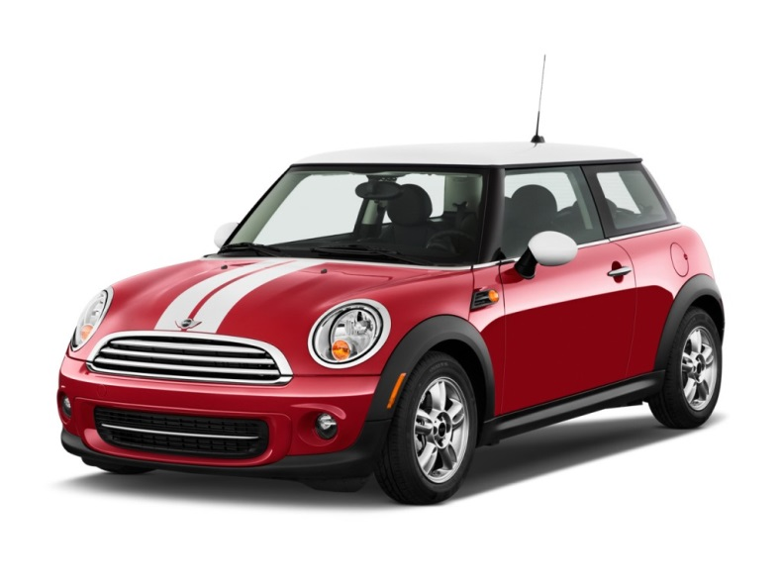
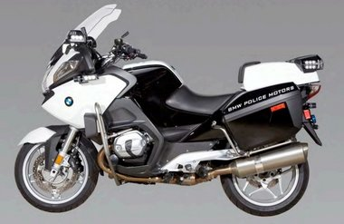
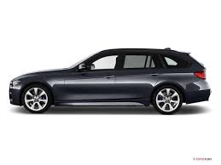
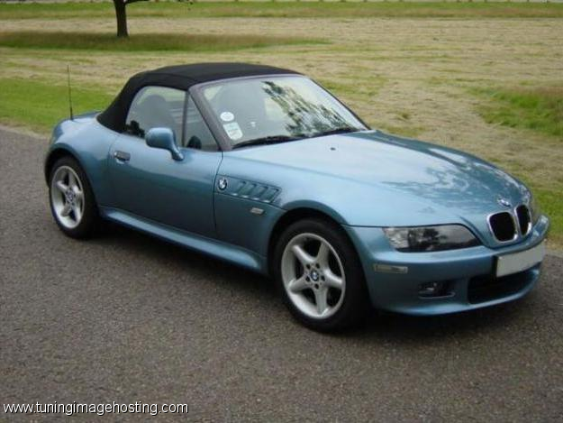
What is BMWs product range
2 types of Motorbike
3 types of Mini
3 types of Mini
5 types of Saloon cars
2 types of Sports cars

Slide 8
To keep up your sales, businesses update their product portfolios
Launch a new product or new variation on an existing product
Product 1 : Mini One
Product 2 : Mini Cooper
Product 3 : Mini Countryman
Copy the title/ diagram
and name of the products

Slide 9
Boston Matrix
Boston Matrix: A model which analyses a product portfolio according to the growth rate of the whole market and the relative market of a product within that market.

Slide 10
Star
Product Life Cycle: Growth
High sales and profits
Can require high spending
E.g. iphone 6 – The whole
market for smart phones is
growing and Apple iphone has
a large share
Market Share | Market Growth
High | High

Slide 11
Problem Children
Product Life Cycle: Launch
Low sales and profits
May need new investment
Market Share | Market Growth
Low | High

Slide 12
Star
Product Life Cycle: Growth
High sales and profits
Can require high spending
Market Share | Market Growth
High | High

Slide 13
Cash Cow
Product Life Cycle: Maturity
High sales and profits
May need new investment
Market Share | Market Growth
High | Low

Slide 14
Dog
Product Life Cycle: Decline
Low sales and profits
May be an ending market
Market Share | Market Growth
Low | Low

Slide 15
Activity
Complete the worksheet provided by your teacher!

Slide 16
Plenary
Complete the worksheet provided by your teacher!

