Slide 1
Starter Activity
Complete the worksheet provided by your teacher!

Slide 2
Topic 1.4: Branding and Differentiation
Unit 3: Building a Business

Slide 3
Learning Objectives
To understand the following key terms (AO1):
Brand
Generic Product
Own Brand
Product Differentiation
Premium Price
To apply how large businesses use Branding. (AO2)
To evaluate the uses and limitations of Branding Strategies. (AO3)
What are we learning today? By the end of the lesson you should be able...

Slide 4
Activity (2 Minutes)
Can you name the top 10 brands in the world? Make a list! Below are 11-20.

Slide 5
Top 10 Brands
How many did you get? These are the top 10 in the world as of 2013.
Electronics
Internet
Computers
Computer
Retail
Electronics
Electronics
Soft Drinks
Phones
Online retail

Slide 6
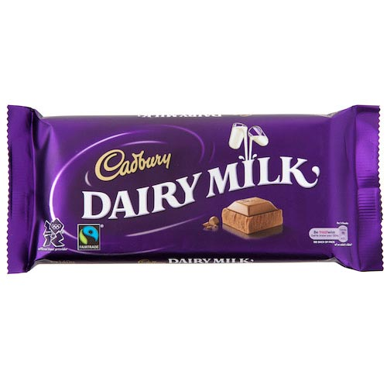
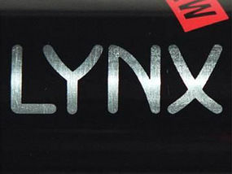
Brand
Brand: A named product which consumers see as being different from other products and which they can associate and identify with.
Can you think of any products that are ‘Brands’?

Slide 7
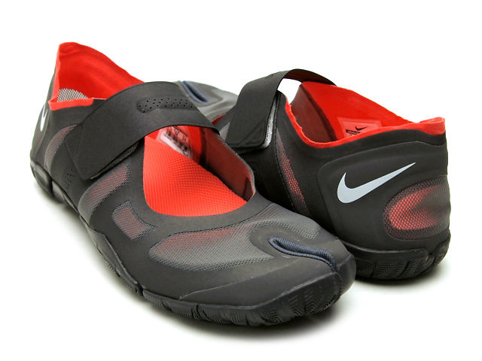
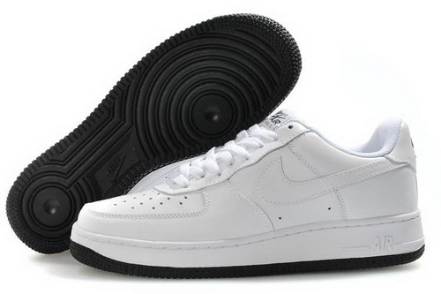
Product Differentiation
Making one product different from another in some way ie quality of the product / design/ packaging/ advertising.
What makes white Nike trainers different from a plain pair of trainers from a local shoe shop
Nike logo – the tick brand associated with successful sports celebrities – Tiger Woods/Wayne Rooney
Product quality – Air Max sole
Advertising – High quality TV ads using celebrities
Design – new inventions

Slide 8
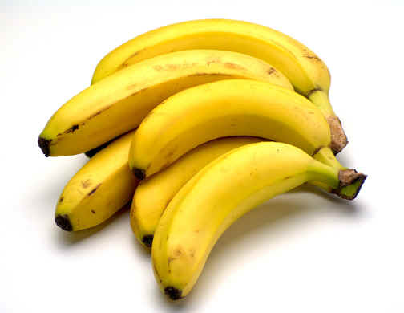
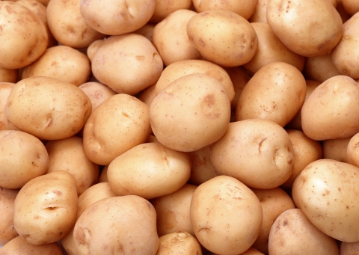
Generic Product:
Generic Product: A product which has no brand. Ie basic foods like fruit. Customers see no difference between the products.
Can you think of any products that are ‘Generic Products’?

Slide 9
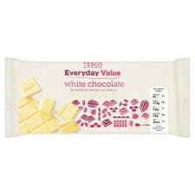
Own Brand:
Own Brand: A product which is sold under the brand name of a supermarket chain or other retailer rather than under the name of a business which manufactures the product.
Can you think of any products that are ‘Own Brands’?

Slide 10
Activity
Read pages 24-27 in pairs : 5 mins
Complete the worksheet provided 20 mins
High level extension : Copy the Market map and explain the link between brands and market maps

Slide 11
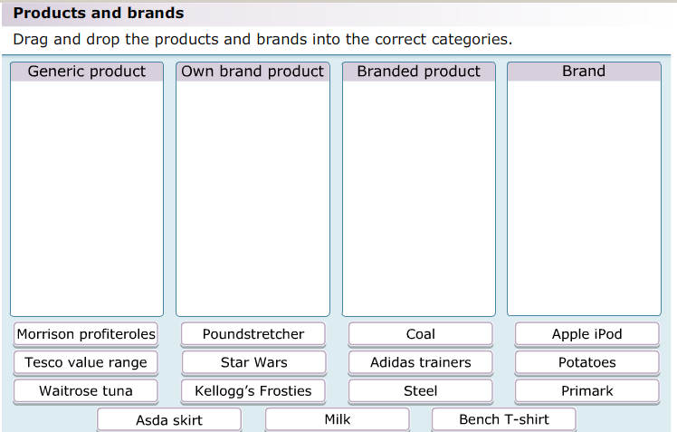
Plenary
As a class we are going to complete the following activity:

