Slide 2
Topic 1.4: Competition
Unit 1: Introduction to Small Business

Slide 3
Learning Objectives
To understand the following key terms (AO1):
Competition
Product Range
Brand
Brand Image
To apply the impact of gaining knowledge about competition. (AO2)
To analyse how businesses can spot opportunities by identifying business offerings. (AO3)
What are we learning today? By the end of the lesson you should be able...

Slide 4
With your partner come up with your own definition of COMPETITION
Competition occurs when people can choose from a range of similar goods.
It can apply to finished products, raw materials and services.

Slide 5
Starter Activity
Complete ‘Task 1’ on the worksheet provided by your teacher!
Higher level Extension
Suggest 2 other variables Nandos should consider

Slide 6
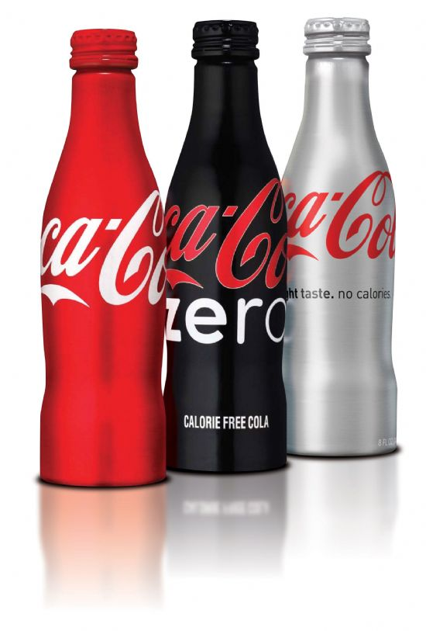
Competition
Competition is one of the reasons why so many businesses go bust. A business must be aware of their competitors to adjust their product offering.
Product Range
Quality
Design
Selling Experience
After-Sales Service
Price
Brand Image
Suppliers

Slide 7
Product Range
Product Range: A group of similar products made by a business, like a number of different soap powders.
Amazon sell hundreds of thousands of products, whereas Coca Cola have very few.

Slide 8
Brand
Brand: A named product which customers see as being different from other products and which they can associate with.
Brand Image: The idea/ impression/ image that customers have in their minds about the brand.

Slide 9
Activity
Write down in order what you believe are currently the top ten brands in the world.
Number | Brand
1
2
3
4
5
6
7
8
9
10

Slide 10
The World’s Top 10 Brands
Write down in order what you believe are currently the top ten brands in the world.
Number | Brand
1 | Apple
2 | Microsoft
3 | Coca-Cola
4 | IBM
5 | Google
6 | McDonald’s
7 | GE
8 | Intel
9 | Samsung
10 | Louis Vitton

Slide 11
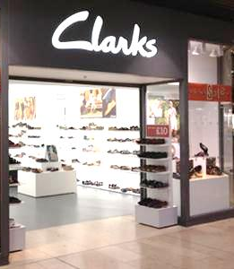
In pairs read pages 20-22
Complete the worksheet provided

Slide 12
Homework
Please complete the Market mapping section of homework booklet
Also use the Internet to find out what the term ‘Added Value’ means.

