Slide 1
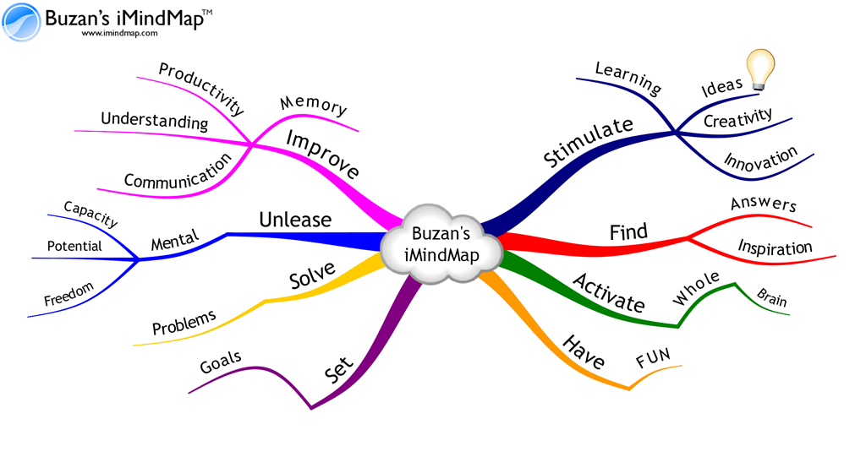
Starter Activity
Conduct a Mindmap of the key content (At least 15 minimum) of the topics we have covered so far:
1.1 Marketing
1.2 Product Trial and Repeat Purchase
1.3 Product Life Cycle
1.4 Branding and Differentiation

Slide 2
Topic 1.5: Building a Successful Marketing Mix
Unit 3: Building a Business

Slide 3
Learning Objectives
To understand the following key term (AO1):
Marketing Mix
To apply how large businesses builds a successful marketing mix. (AO2)
To evaluate the uses and limitations of a business’s marketing mix. (AO3)
What are we learning today? By the end of the lesson you should be able...

Slide 4
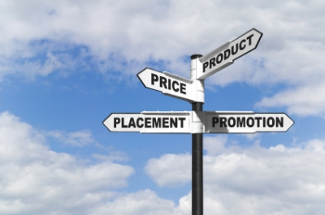
Marketing Mix
Marketing Mix: A combination of factors which help a business take into account customer needs when selling a product, usually summarised as the 4P’s
Product
Price
Place
Promotion

Slide 5
Product:
You must customer needs. The public likes exciting car chase movies and Vin Diesel as an actor. Take a successful formula (there have been 5 successful Fast & Furious films) and make another one.
For packaging . Film posters are the product image so keep the same logo and make sure you have the key features – tough guys and fast cars

Slide 6
Promotion:
Fast and Furious 6 promoting through a variety of promotion methods.
Who did they aim at? How did they promote the film?
Promotion | Type
Google | Adwords
IMDb | Review online
iTunes | Stream film online
Youtube | Preview video

Slide 7
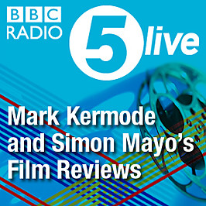
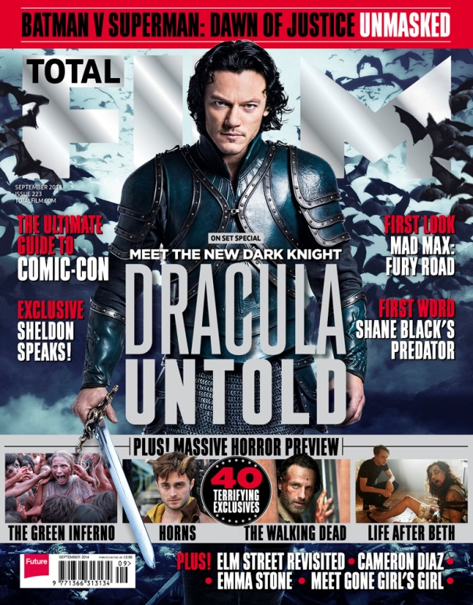
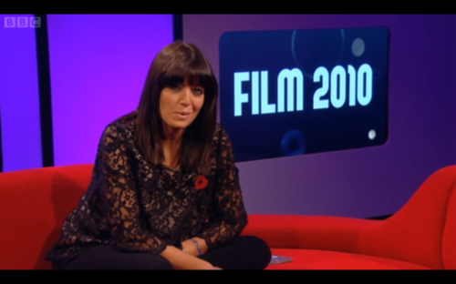
Promotion:
They will get the film reviewed in magazines/ online/ TV/ radio and advertise in newspapers

Slide 8
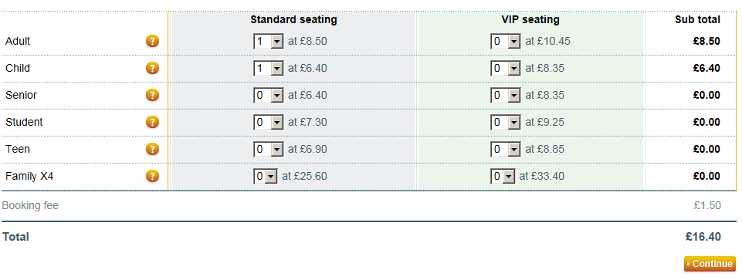
Price
Cinemas decide on the price of film entry but when Fast and Furious 6 is on DVD they may charge a higher premium price as it is a successful film.
They may add extras to the DVD to add value so they can charge more.

Slide 9
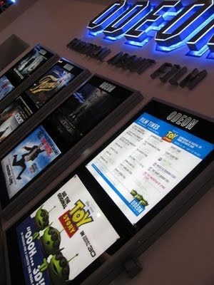
Place:
The film studio must get the film into national cinema chains like Vue and Odean so their product can be seen. Likewise when on DVD they need it to be available online in Amazon and in the high street in HMV etc.

Slide 10
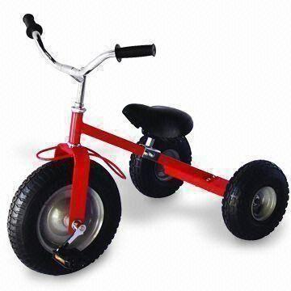
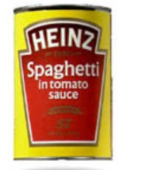
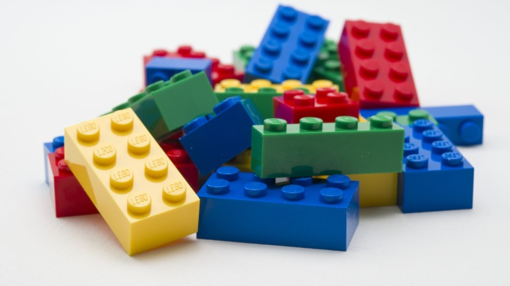
Writing a marketing plan
You’ve just been appointed as Marketing Manager at £65,000 a year and have been asked to come up with a Marketing Plan to refresh/ renew a well know product (it could be a product extension) using the 4 Ps
Choose one of the products below and write a detailed plan
Target Market – age / gender / wealth
Product –will you change it / new features
Promotion – how / where / why ?
Price – any difference – if so why?
Place – where will you sell it and are their new opportunties/ places?

Slide 11
Timed question
You have 20 minutes to read
Over To You on page 33 and
answer the 4 questions.
For the last 8 mark question – choose
Two or three elements of the
Marketing mix and explain what they must do e.g. PRICE – must have a similar or lower price than competitors or use price promotions

Slide 12
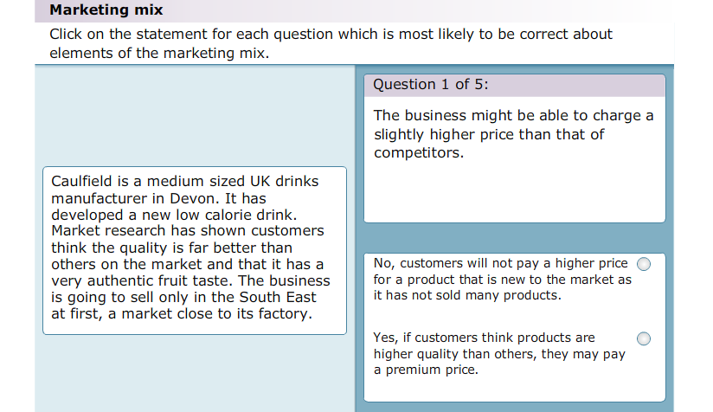
Plenary
As a class we are going to complete the following activity:

