Slide 1
Starter Activity
Complete the worksheet provided by your teacher!

Slide 2
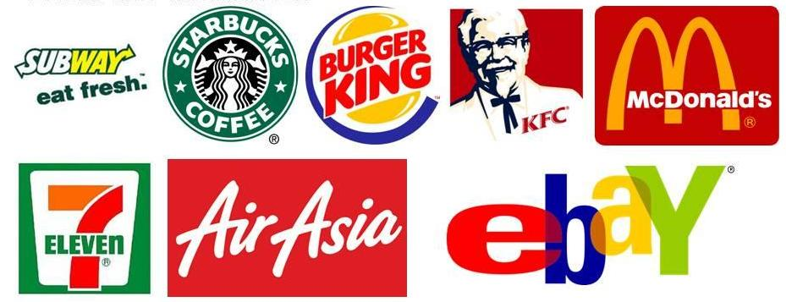
What do these businesses have in common?

Slide 3
Topic 1.6: Franchising
Unit 1: Introduction to Small Business

Slide 4
Learning Objectives
To understand the following key terms (AO1):
Franchise
Franchisee
Franchisor
To apply the principles of franchising to small business start ups. (AO2)
To analyse the consequences of a small business operating as a franchise. (AO3)
What are we learning today? By the end of the lesson you should be able...

Slide 5
Franchising
Franchise: The right given by one business to another to sell goods or services using its name.
Royalty Fee
Equipment Package
Franchise Fee

Slide 6
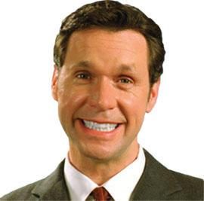
Franchising
Franchisee: a business that agrees to manufacture, distribute or provide a branded product, under licence by a franchisor.
Franchisor: The business that gives franchisees the right to sell its product, in return for a fixed sum of money or a royalty payment.
Franchisee
Franchisor

Slide 7
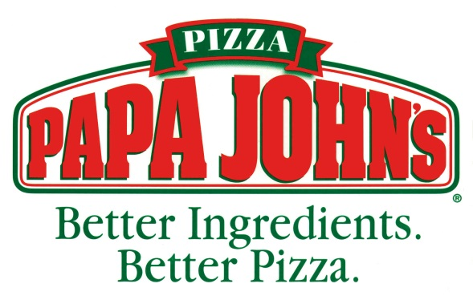
Papa John’s Activity
1. What is it Papa John’s need to do to expand?
2. How do Papa John’s stay competitive?
3. How much does the franchisee have to pay to open their own Papa John’s?
4. What is the total % weekly amount in fees the franchisee must pay?
Notes:
Stop at 0.26 – ext – What do they get once they reach 200 stores?
Stop at 1m 21s
Stop at 1m 41s – ext – How much is Domino’s? (£250,000 on average)
Stop at 2m 12s – ext – Net or Gross? Explain differences between these.

Slide 8
Doing the rounds
McDonald’s Case Study
You will be given a number.
If you are labelled a ‘1’, you must find and write down the adv/disadv for the Franchisor, if you are a ‘2’, you must find the adv/disadv the Franchisee.
When the timer rings, find your partner and swap your findings.

Slide 9
Franchisor
Strengths: | Weaknesses:
Growth | Poor Performance (Less span of control)
Customer Awareness | Damaged reputation
Less risky due to the spread of costs | Lengthy application process
Long Term Income – EC’s of scale

Slide 10
Franchisee
Strengths: | Weaknesses:
Brand name | Franchise Fee
Clearly defined start-up costs | Royalty Fee
Training provided | Lack of Flexibility
Extensive marketing campaign

Slide 11
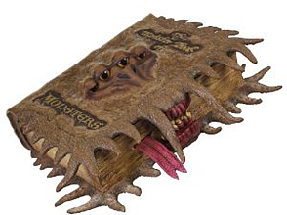
Activity
Complete the ‘Over to You’ case study on page 31!

Slide 12
Plenary
Complete the worksheet provided by your teacher!

