Slide 1
Starter Activity
Think of THREE products. Write down what makes them different from other products in terms of the following:
Function
Cost
Appearance

Slide 2
Topic 2.1: Design and Research Development
Unit 3: Building a Business

Slide 3
Learning Objectives
To understand the following key terms (AO1):
Design Mix
To apply how businesses can create a ‘Design Mix’. (AO2)
To evaluate the uses and limitations of a business’s ‘Design Mix’. (AO3)
What are we learning today? By the end of the lesson you should be able...

Slide 4
Read Below:

Slide 5
Design and Product Differentiation
Design helps a product stand out from its competitors. It is very important form of ‘Product Differentiation’.

Slide 6
Design Mix
Design Mix: The range of variables which contribute to successful design: they are Appearance, Function and Cost.
You could remember this as Arsenal FC

Slide 7
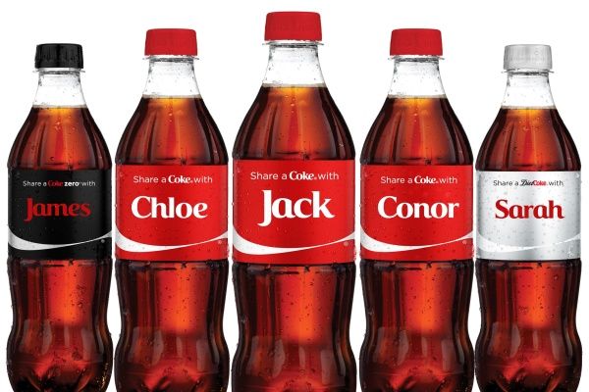
Activity (2 Minutes)
Explain using the ‘Design Mix’ how the product below has a successful design.
APPEARANCE FUNCTION COST

Slide 8
Scientific Research
Scientific research is at the base of the majority of products made today. A lot of ‘Research and Development’ is carried out.
Dyson created over 5,000 prototypes before putting their products on the market.
.

Slide 9
Activity
Complete the worksheet provided by your teacher!

Slide 10
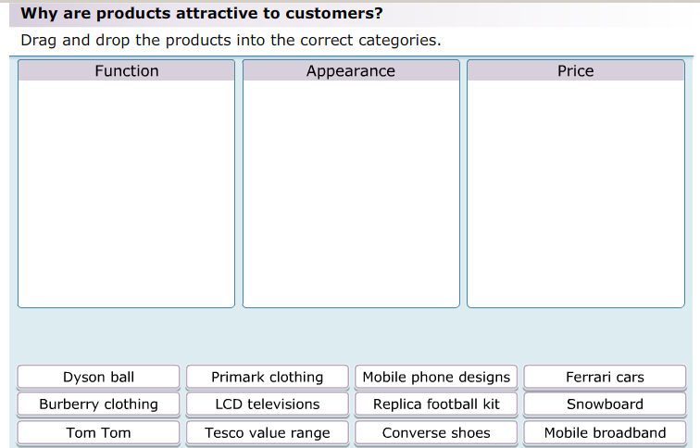
Plenary
As a class we are going to complete the following activity.

