Slide 1
Starter Activity
Complete the worksheet provided by your teacher!

Slide 2
Topic 2.2: Managing Stock
Unit 3: Building a Business

Slide 3
Learning Objectives
To understand the following key terms (AO1):
Stocks
Maximum Stock Level
Re-Order Level
Buffer Stock Level
Just in Time
To apply how businesses manage stock. (AO2)
To evaluate the uses and limitations of a managing stock strategies. (AO3)
What are we learning today? By the end of the lesson you should be able...

Slide 4
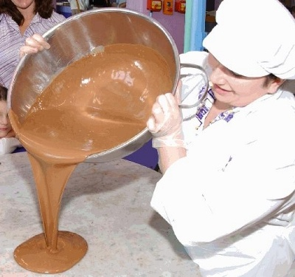
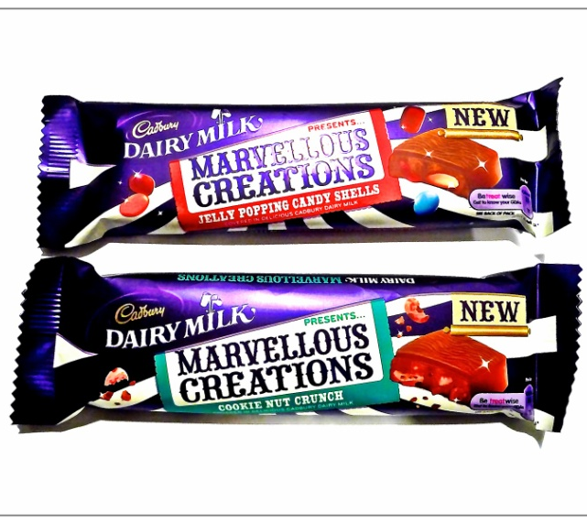
Stocks
Stocks: Materials that a business holds. Some could be materials waiting to be used in the production process and some could be finished stock waiting to be delivered to the customers.

Slide 5
Stock Control
It is imperative that businesses maintain ‘Stock’ levels for a variety of reasons.

Slide 6
Just in Time (JIT)
Just in Time: A stock management system where stocks are only delivered when they are needed by the production system, and so no stocks are kept by a business.

Slide 7
Activity (5 Minutes)
Write down the advantages and disadvantages of having high stock levels.
Advantages | Disadvantages
Meeting Demand | Cost
Discounts | Storage
 | Life Span

Slide 8
Activity
Complete the worksheet provided by your teacher!

Slide 9
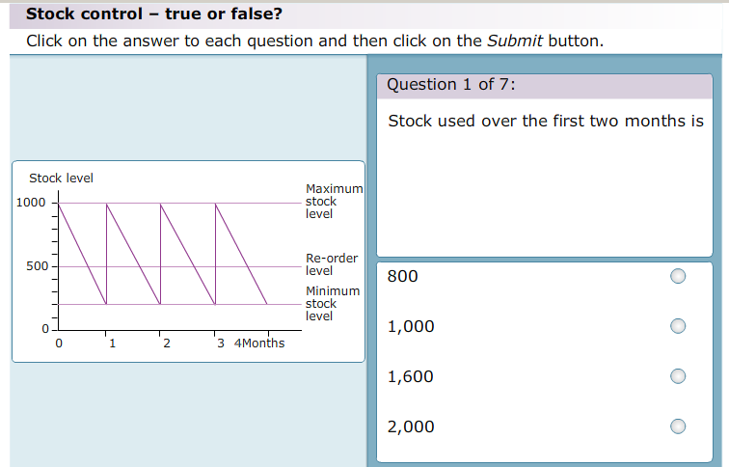
Plenary
As a class we are going to complete the following activity.

