Slide 1
Starter Activity
Complete the worksheet provided by your teacher!

Slide 2
Topic 2.2: Thinking Creatively
Unit 2: Showing Enterprise

Slide 3
Learning Objectives
To understand the following key terms (AO1):
Blue Skies Thinking
Deliberate Creativity
Lateral Thinking
Competitive advantage
To apply how thinking creatively can develop business ideas. (AO2)
To analyse how thinking creatively can provide a competitive advantage. (AO3)
What are we learning today? By the end of the lesson you should be able...

Slide 4
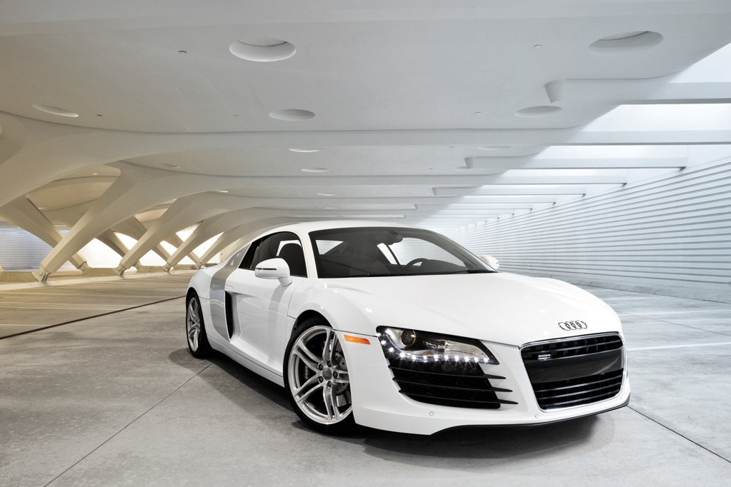
Deliberate Creativity
Deliberate Creativity: The intentional creation of new ideas through recognised and accepted techniques.

Slide 5
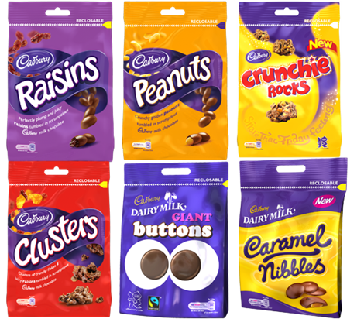
Lateral Thinking
Lateral Thinking: Thinking differently to try and find new and unexpected ideas.

Slide 6
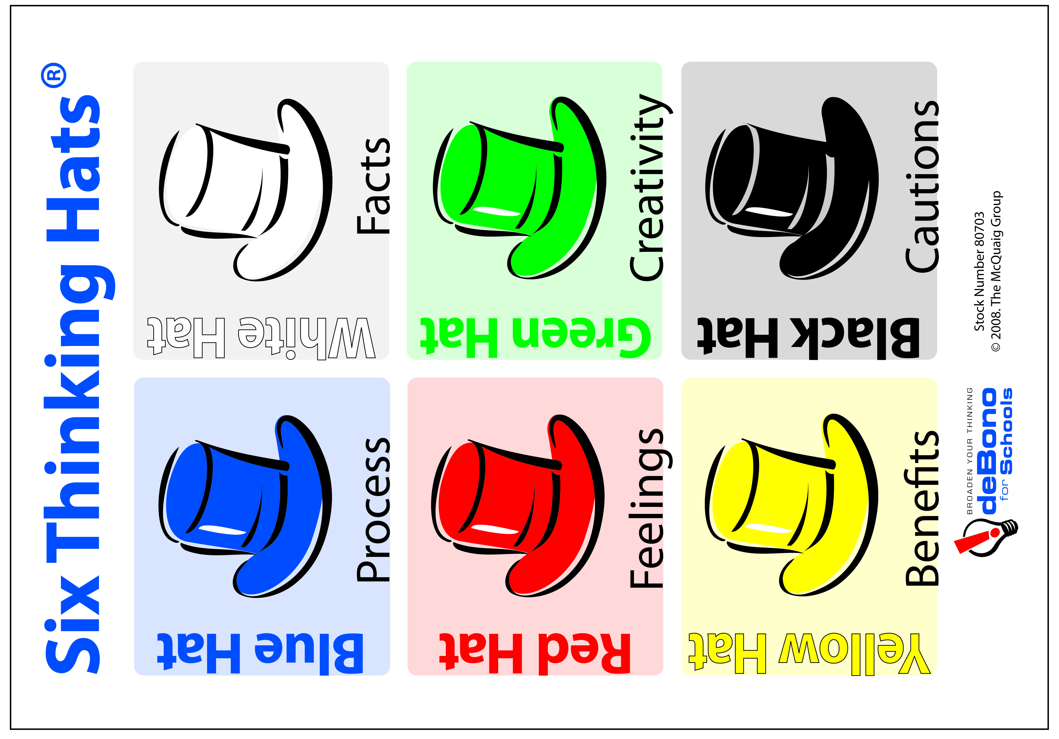
Six Thinking Hats
Six Thinking Hats: Looking at different ways to solve a problem. Think about the issue, think of ideas and use the different hats to analyse these ideas

Slide 7
Blue Skies Thinking
Blue Skies Thinking: A technique of creative thinking where participants are encouraged to think of as many ideas as possible about an issue or a problem.

Slide 8
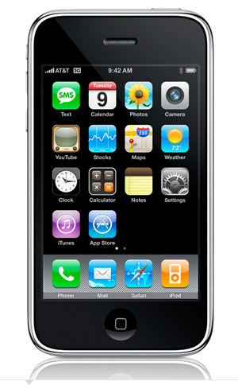
Competitive Advantage
Competitive Advantage: An advantage a business has that enables it to perform better than its rivals in the market and which is both distinctive and defensible.

Slide 9
Activity
Complete the worksheet provided by your teacher!

Slide 10
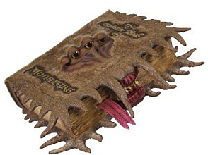
Activity
Complete the ‘Over to You’ case study on page 43!

Slide 11
Plenary
To understand the following key terms (AO1):
Blue Skies Thinking
Lateral Thinking
Competitive advantage
To apply how thinking creatively can develop business ideas. (AO2)
To analyse how thinking creatively can provide a competitive advantage. (AO3)
Are you now more confident in your understanding of the learning objectives?

