Slide 1
Starter Activity
Complete the worksheet provided by your teacher!

Slide 2
Topic 2.3: Questions to be Asked
Unit 2: Showing Enterprise

Slide 3
Learning Objectives
To understand the following key terms (AO1):
Thinking Creatively
To apply THREE questions an entrepreneur can ask about their products. (AO2)
To analyse the importance of judging a business’s product offering. (AO3)
What are we learning today? By the end of the lesson you should be able...

Slide 4
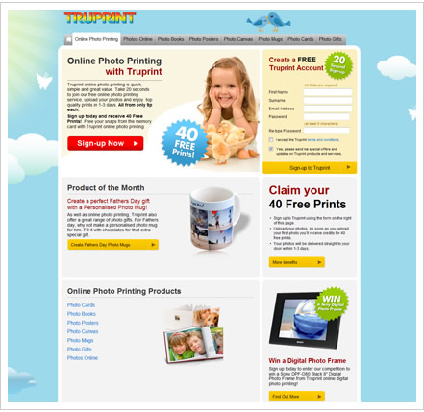
Thinking Creatively
Thinking Creatively: Coming up with new and unique ideas.

Slide 5
Questions to be Asked?
If a entrepreneur is looking to start a business that sells sandwiches what questions might we ask?
How might asking questions give you a competitive advantage?

Slide 6
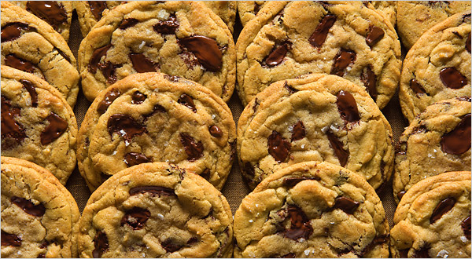
Activity
Read pages 44 & 45
An entrepreneur is thinking about creating a company selling cookies.
What are the questions that
Why?
Why not?
What?
How?
Where?
When?

Slide 7
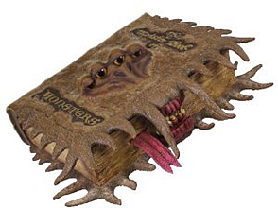
Activity
Complete the ‘Over to You’ case study on page 47!

Slide 8
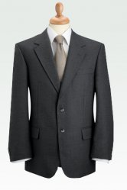
Plenary
An entrepreneur is thinking about creating a company selling clothes. What questions would you ask?

Slide 9
Why not?
Why?
What if?
What questions
do entrepreneurs
ask?
Thinking
creatively
Showing
Enterprise
Invention and
innovation
Other
important
enterprise
skills
What is
enterprise?
Taking a
calculated
risk
Notes:
9

Slide 10
Typical questions you could ask?
Why do I want to set up my own business?
Who are my competitors?
What do they sell?
What makes them good?
How will I make my product?
How much will I charge?
Where will I sell it?
Why shouldn’t I expand my business in the next 3 years?

