Slide 1
Starter Activity
Complete the worksheet provided by your teacher!

Slide 2
Mini test : Marks and Grades
A* 50
A 44
B 39
C 34
D 28
E 23

Slide 3
Topic 2.4: Cost Effective Operations and Effectiveness

Slide 4
Learning Objectives
To understand the following key terms (AO1):
Productivity
To apply how businesses manage operations and competitiveness. (AO2)
To evaluate the uses and limitations of a managing operations and competitiveness. (AO3)
What are we learning today? By the end of the lesson you should be able...

Slide 5
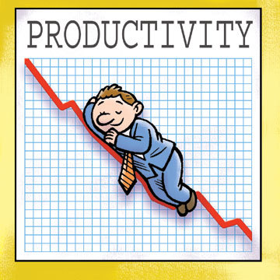
Productivity
Productivity: Productivity is output per worker. It measures how much each worker produces over a period of time.

Slide 6
Activity
Calculate the total productivity per worker below.
Business | Total Output | Number of Workers | Productivity
A | 500 | 100
B | 1,500 | 150
C | 30,000 | 400
D | 11,000 | 300
E | 850,000 | 20,000
F | 100,000 | 3,500
G | 500,000 | 8,000
H | 2,000 |  | 200
I | 1,670,889 | 2541

Slide 7
Answers
Calculate the total productivity per worker below.
Business | Total Output | Number of Workers | Productivity
A | 500 | 100 | 5
B | 1,500 | 150 | 10
C | 30,000 | 400 | 75
D | 11,000 | 300 | 36
E | 850,000 | 20,000 | 42
F | 100,000 | 3,500 | 28
G | 500,000 | 8,000 | 62
H | 2,000 | 10 | 200
I | 1,670,889 | 2,541 | 657

Slide 8
Activity (5 Minutes)
You should now be aware of what ‘Productivity’ is and how it is calculated. For the next 5 minutes write down a MINIMUM of THREE ways in which you can improve a workers ‘Productivity’.
Training
Better equipment
More effective work practices
Performance related pay
Increase motivation
Use page 50 & 51 to write two sentence for each of the above ways of improving Productivity

Slide 9
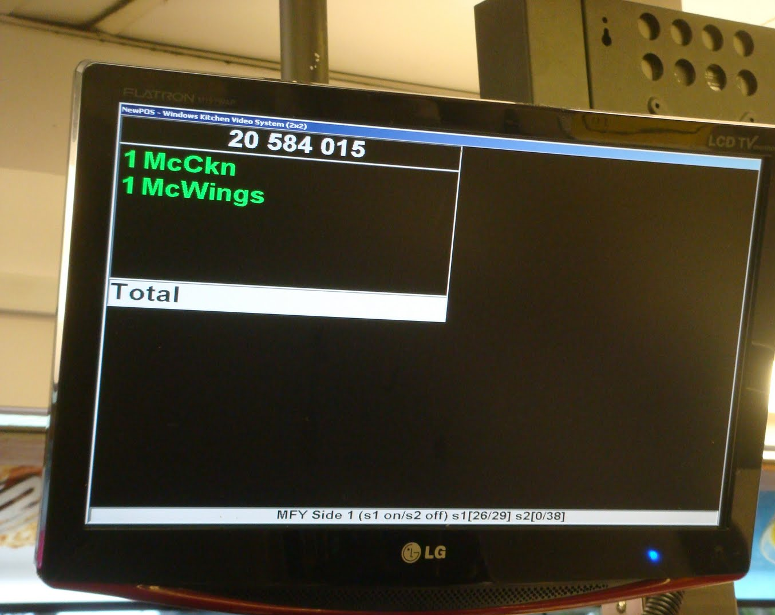
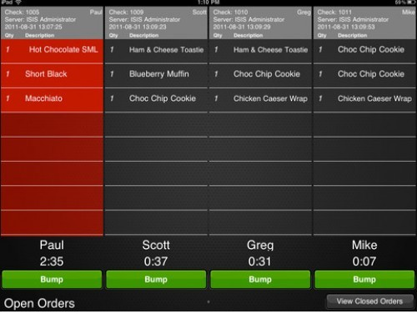
How have MacDonalds used technology to improve productivity
Watch the video and look at these photos . List the ways in which MacDonalds have improved productivity
Macdonalds Made for You

Slide 10
How have MacDonalds used technology to improve productivity
Till connected to order screen for each member of staff
High speed toaster – 11 seconds to toast a bun
Mayannoise gun delivers exact amount
Assembly line so minimal movement
Heated holding cabinets to store burgers
PC monitors and predicts orders for best selling items so buffer stock is made
PC monitors staff productivity
PC routes orders to free staff
Whole process from order to food delivered is 15 seconds

Slide 11
Reducing Costs
You should now be aware of what ‘Productivity’ is and how it is calculated. For the next 5 minutes write down a MINIMUM of THREE ways in which you can reduce costs.
Improved purchasing
Relocation
Better design
Cutting overheads

Slide 12
Activity
Complete the worksheet provided by your teacher!

Slide 13
Over to you Answers
1. (a) Explain, using an example, what is meant by labour productivity. (3)
Labour productivity is defined as output per worker per period of time
The time period can be represented as per hour, day, week, etc.
For example, worker A fits eight headlights per hour, or worker B installs 36 radios per day

Slide 14
Over to you Answers
(b) Explain why productivity is likely to be higher on larger container ships than on smaller container ships? (3)
More containers carried per journey
More containers carried in proportion to the fuel used (less fuel per container)
Smaller increase in staff needed compared to the increase in containers carried

Slide 15
Over to you Answers
2. Analyse how RHZ Containers is cutting costs to cope with a slump in demand. (6)
Use of the case study evidence and students’ own knowledge should be used to access top marks.
Slower speeds save fuel
Use least efficient ships as little as possible
Use modern ships often
Reduce number of crew
Cut head office workforce (30%)
Cancel future investment

Slide 16
Discuss whether cutting costs now will make RHZ Containers more competitive in the short term and in the long term. Justify your answer. (8)
Short term:
+ Save money now will help day-to-day running costs
+ Cutting costs can allow RHZ to keep prices competitive
+ Short-term cost reduction means survival in the immediate future
- May give the business a poor image and reputation (laying-off staff)
Long term:
+ Survival means that some competitors may collapse and give RHZ easier access to the market
+ Business cycle may pick up and more people will need container shipping again
+ Cutting costs may lead to more efficient working practices to use in the future

Slide 17
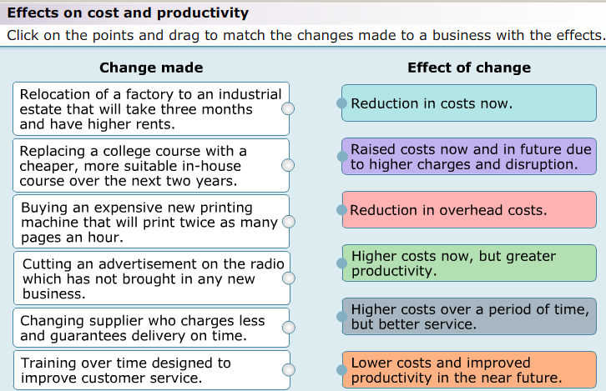
Activity
As a class we are going to complete the following activity.

Slide 18
Blockbusters Plenary:
A
I
Q
E
M
B
J
R
F
N
C
K
S
G
O
D
L
T
H
P

