Slide 1
Starter Activity
On the lined paper provided answer the following:
What does it mean by innovation? Provide 3 examples.
What does it mean by invention? Provide 3 examples.
How do new product ideas comes about?

Slide 2
Topic 2.4: Invention and Innovation
Unit 2: Showing Enterprise

Slide 3
Learning Objectives
To understand the following key terms (AO1):
Patent
Trademarks
Copyright
To apply how a business can protect their ideas. (AO2)
To analyse the impact of a business protecting their ideas. (AO3)
What are we learning today? By the end of the lesson you should be able...

Slide 4
Activity
Complete the worksheet provided by your teacher!

Slide 5
Patents
Patents: Right of ownership of an invention or process when it is registered with the government.

Slide 6
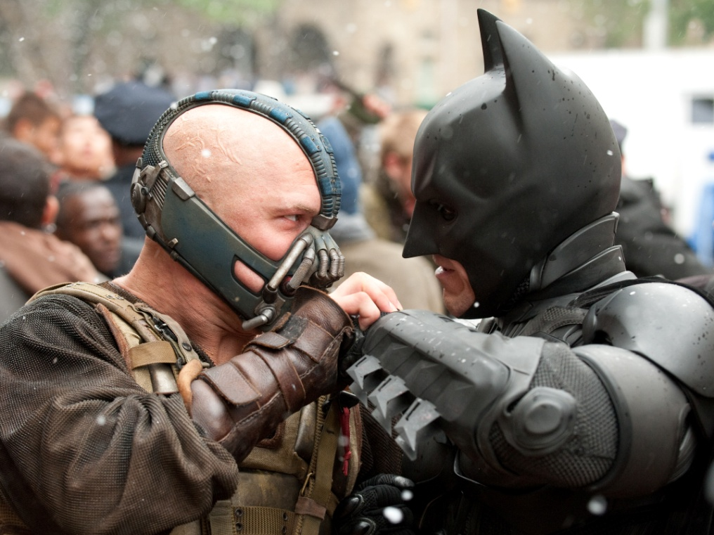
Copyright
Copyright: Legal ownership of material such as books, music and films which prevents these being copied by others.

Slide 7
Trademarks
Trademarks: The symbol, sign, or other features of a product or business that can be protected in law.

Slide 8
Activity: Word Scramble!
elatalr
vnnonatioi
yitccorph
yreivcitat
envnnitio
lebu sesik
silence
krdemtara
petant

Slide 9
Activity
Complete the worksheet provided by your teacher!

Slide 10
Plenary: Post It
Using the Post-It notes provided answer the following 4 questions and then stick it onto the sugar paper.
What have I learnt?
What have I found easy?
What have I found difficult?
What do I want to know now?
3 Minutes
Are you now more confident in your understanding of the learning objectives?

