Slide 1
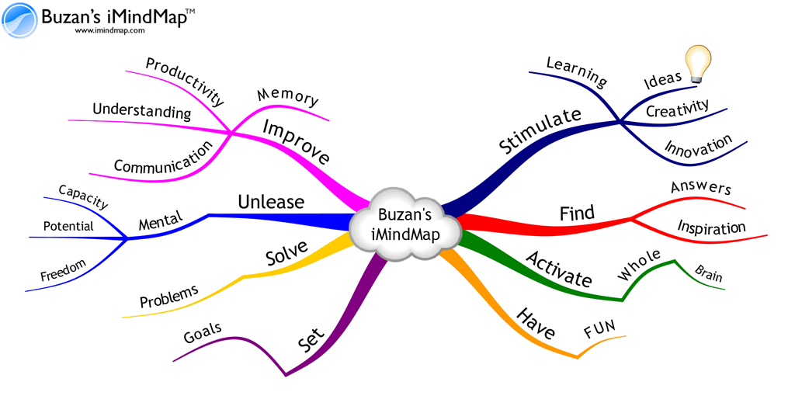
Starter Activity
Conduct a Mindmap of the key content (At least 15 minimum) of the topics we have covered so far:
2.1 Design and Research Development
2.2 Managing Stock
2.3 Quality
2.4 Cost Effective Operations and Competitiveness

Slide 2
Topic 2.5: Effective Customer Service
Unit 3: Building a Business

Slide 3
Learning Objectives
To understand the following key terms (AO1):
Customer Service
Innovation
To apply how businesses create effective customer service. (AO2)
To evaluate the uses and limitations of customer service levels. (AO3)
What are we learning today? By the end of the lesson you should be able...

Slide 4
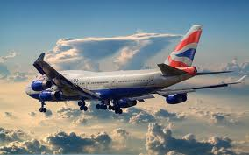
Activity (3 Minutes)
Write down FIVE things you would expect when travelling with British Airways.

Slide 5
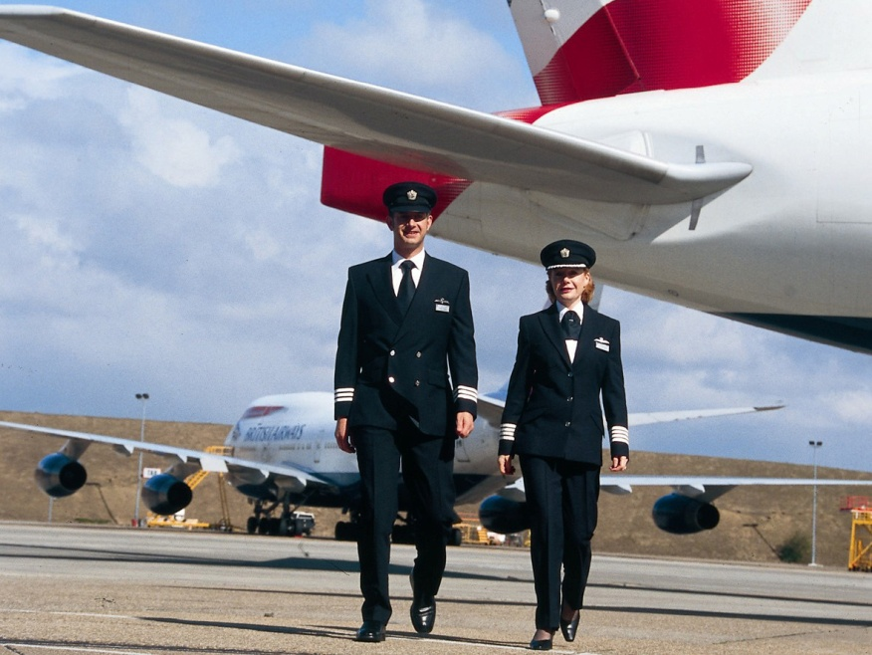
Customer Service
Customer Service: The experience that a customer gets when dealing with a business and the extent to which that experience meets and exceeds customer needs and expectations.

Slide 6
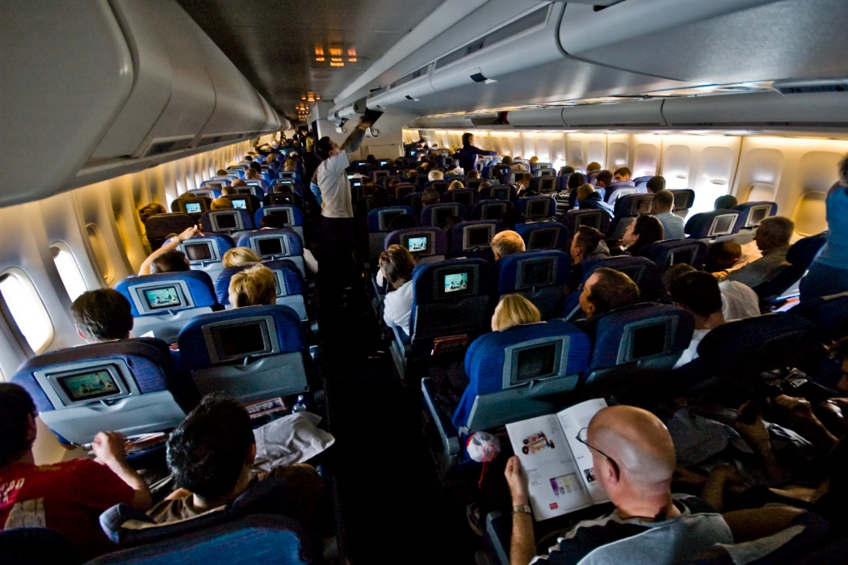
Effective Customer Service
These are some of examples of effective Customer Service:
Good signage
Helpful staff
Value for money
Clean
Reliable
Quality products

Slide 7
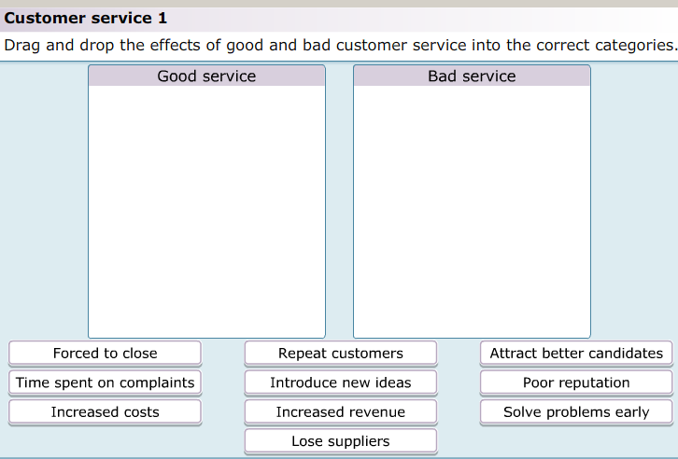
Activity
As a class we are going to complete the following activity.

Slide 8
Activity
Complete the worksheet provided by your teacher!

Slide 9
Blockbusters Plenary:
A
I
Q
E
M
B
J
R
F
N
C
K
S
G
O
D
L
T
H
P

