Slide 1
Starter Activity
Complete the worksheet provided by your teacher!

Slide 2
What is our topic today?

Slide 3
Topic 2.6 Meeting Consumer Protection Law
What laws are there to protect consumers ?
The law - consumer rights and protection

Slide 4
Learning Objectives
To understand the following key terms (AO1):
Sales of Goods Legislation
Trade Descriptions Legislation
To apply how businesses are affected by consumer protection laws. (AO2)
To evaluate the uses and limitations of consumer protection laws on businesses. (AO3)
What are we learning today? By the end of the lesson you should be able...

Slide 5
Protecting the Consumer
An ‘Act’ is an Act of Parliament. Members of Parliament create new laws and change existing ones. There are two main laws (also known as civil law) to protect consumers:
The Sales of Goods Act
The Trade Description Act

Slide 6
Unit 1 : 25% of Final mark
Grade boundaries are very high as it’s multiple choice . Maximum 40 marks
A* 39
A 38
B 34
C 31
D 26
E 22
F 18

Slide 7
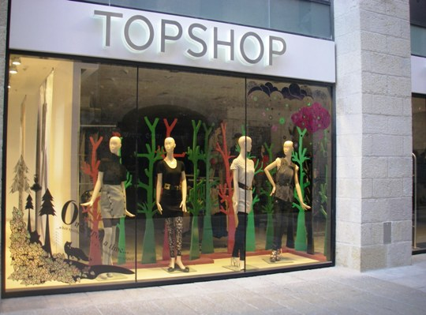
Sales of Goods Act
Sales of Goods Legislation: Gives consumers rights to compensation if a product they buy is not merchantable quality, not as described or not fit for purpose.

Slide 8
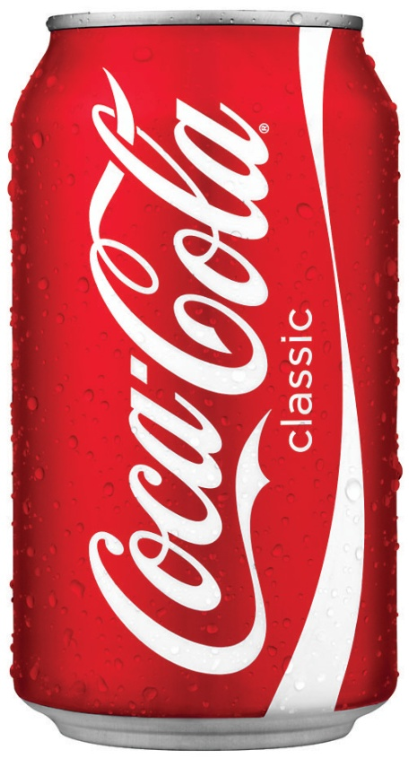
Trade Description and Consumer Protection Act
Trade Description Legislation: Makes businesses liable for prosecution and fines if products are sold in a misleading way.

Slide 9
Which law has been broken – Sale of Goods Act or Trade Description and Consumer Protection Act?
Pair of shoes where the sole falls off after 3 weeks
Sale of Goods Act
Pair of Levi jeans where the zip doesn’t work
Sale of Goods Act
Furniture ‘made in Italy’ actually made in Taiwan
Sale of Goods Act
A garage sells a car without telling the customer that it has been in a major accident and repaired
Trade Description and consumer protection act
A electrical shop sells Kettles as 30% off when they have never been on sale at a higher price
Trade Description and consumer protection act

Slide 10
Activity : 20 mins
Complete the worksheet

Slide 11
Think about how the law has been broken – underline key sentences

Slide 12
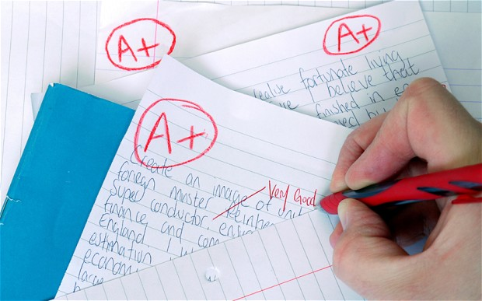
Mark your partner’s work using the mark scheme

