Slide 1
TOPIC 3
EFFECTIVE
FINANCIAL MANAGEMENT

Slide 2
Learning Objectives
To understand the following key terms (AO1):
Cash Flow
Financial Management
De-Stocking
Trade Credit
To apply how businesses can improve cash flow. (AO2)
To evaluate how a business manages cash flow. (AO3)
What are we learning today? By the end of the lesson you should be able...

Slide 3
What are payments in and out of a business?
5 payments a business would make ? CASH OUTFLOWS
2 sources of income for a business ? CASH INFLOWS

Slide 4
Starter Activity

Slide 5
Cash Flow
Cash Flow: The flow of cash into and out of a business.
Cash Flow Forecast: A prediction of how cash will flow through a business in a period of time in the future.
‘In the red’: means you are in DEFICIT – a negative cash flow
(£) | Jan | Feb | Mar | Apr | May | Jun
Receipts | 2,400 | 2,400 | 3,000 | 3,400 | 4,500 | 5,000
Payments | 2,200 | 2,500 | 3,400 | 4,000 | 4,200 | 4,200
Net Cash Flow | 200 | (100) | (400) | (600) | 300 | 800
Opening Balance | 0 | 200 | 100 | (300) | (900) | (600)
Closing Balance | 200 | 100 | (300) | (900) | (600) | 200

Slide 6
Improving Cash Flow
Cash Inflow | Cash Outflow
Increasing sales revenues | Delay paying invoices
Reducing trade credit | Leasing equipment rather than buying
Issue new shares to raise more investment | ‘Just in time’ stock management
Sell assets/ equipment | Redundancies
Bank loan | Reduce orders
De-stocking

Slide 7
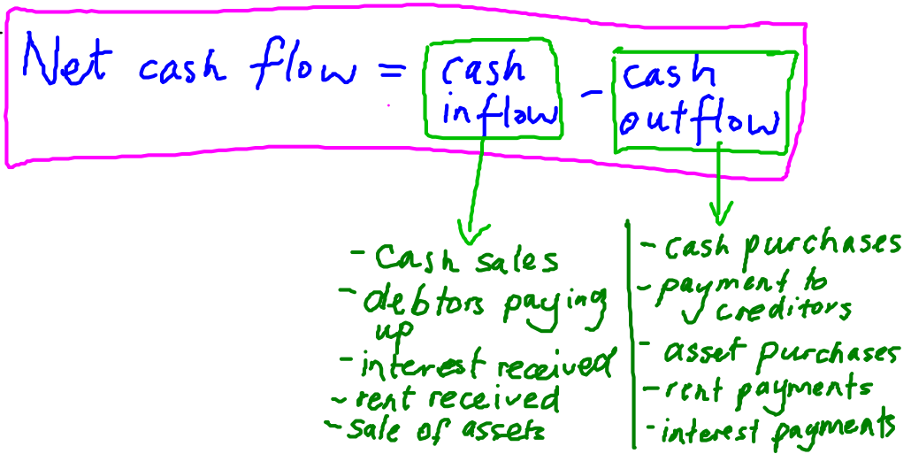
Topic 3.1: How to Improve Cash Flow
Cash Flow forecasting

Slide 8
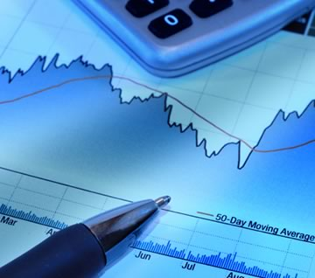
Financial Management
Financial Management: Deliberately changing monetary variables like cash flows to achieve financial objectives such as improved cash flows.
Why do you feel that financial management is important?

Slide 9
Activity
Complete the worksheet identifying where there is a problem with a companies cash flow.
Page 2 of the sheet you need to read page 67 & 68 to find out how a business can improve it’s cashflow

Slide 10
Assessment
1) Answer TEST YOURSELF on page 68 ALL
2) Answer OVER TO YOU on page 69 Q1,2,3 ALL
Q1,2,3,4 SOME
Q1,2,3,4,5 FEW

Slide 11
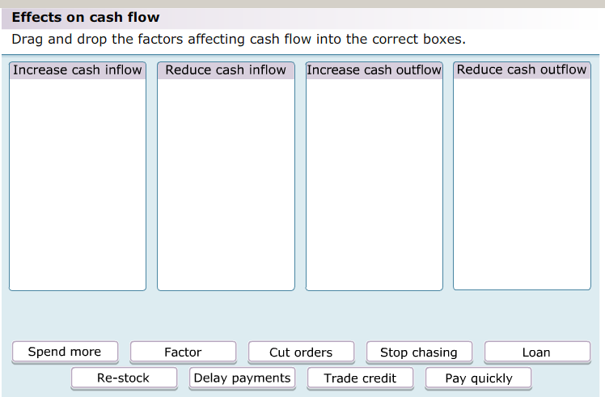
Plenary
As a class we are going to complete the following activity.

