Slide 1
Starter Activity
Draw a Mindmap of the different financial and non-financial objectives of a business. Also explain how these objectives can be achieved.

Slide 2
Topic 3.2: The Qualities Shown by Entrepreneurs
Unit 3: Putting a Business Idea into Practice

Slide 3
Learning Objectives
To understand the entrepreneurial key terms (AO1):
To apply THREE qualities shown by entrepreneurs. (AO2)
To analyse the importance of entrepreneurial skills for a business. (AO3)
What are we learning today? By the end of the lesson you should be able...

Slide 4
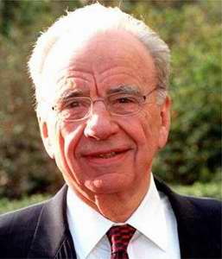
Entrepreneurial Qualities
An entrepreneur might exhibit the following qualities:
Determination
Initiative
Taking Risks
Making Decisions
Planning
Persuasion
Showing Leadership
Luck

Slide 5
Activity
Complete the worksheet provided by your teacher!

Slide 6
Plenary
To understand the following key terms (AO1):
All previous key terms
To apply THREE qualities shown by entrepreneurs. (AO2)
To analyse the importance of entrepreneurial skills for a business. (AO3)
Are you now more confident in your understanding of the learning objectives?

