Slide 1
Starter Activity
Complete the worksheet provided by your teacher!

Slide 2
Topic 3.3: Break Even Charts and Break Even Analysis
Unit 3: Building a Business

Slide 3
Learning Objectives
To understand the following key terms (AO1):
Break Even Point
Total Revenue
Total Costs
Fixed Costs
Variable Costs
To calculate the break even point. (AO2)
To evaluate the financial performance in a break even chart. (AO3)
What are we learning today? By the end of the lesson you should be able...

Slide 4
Break Even Point
Break Even Point: The level of output where total revenues are equal to total costs; this is where neither a profit or loss is being made.

Slide 5
Break Even Point
A credit stamp sells for £2
Fixed costs of production equipment are £120,000
Variable costs are 50p per stamp
At what number of sales does
Total Revenues = Total costs ?

Slide 6
Break Even Chart
Unit Price £2 A 50p per unit B A - B
Unit Sales | Total Revenue | Total Fixed Cost | Total Variable Cost | Total Cost | Profit/ Loss
20,000 | £40,000 | £120,000 | £10,000 | £130,000
40,000 | £80,000 | £120,000 | £20,000 | £140,000
60,000 | £120,000 | £120,000 | £30,000 | £150,000
80,000 | £160,000 | £120,000 | £40,000 | £160,000
100,000 | £200,000 | £120,000 | £50,000 | £170,000

Slide 7
Break Even Chart
A B A - B
Unit Sales | Total Revenue | Total Fixed Cost | Total Variable Cost | Total Cost | Profit/ Loss
20,000 | £40,000 | £120,000 | £10,000 | £130,000 | (£90,000)
40,000 | £80,000 | £120,000 | £20,000 | £140,000
60,000 | £120,000 | £120,000 | £30,000 | £150,000
80,000 | £160,000 | £120,000 | £40,000 | £160,000
100,000 | £200,000 | £120,000 | £50,000 | £170,000

Slide 8
Break Even Chart
A B A - B
Unit Sales | Total Revenue | Total Fixed Cost | Total Variable Cost | Total Cost | Profit/ Loss
20,000 | £40,000 | £120,000 | £10,000 | £130,000 | (£90,000)
40,000 | £80,000 | £120,000 | £20,000 | £140,000 | (£60,000)
60,000 | £120,000 | £120,000 | £30,000 | £150,000
80,000 | £160,000 | £120,000 | £40,000 | £160,000
100,000 | £200,000 | £120,000 | £50,000 | £170,000

Slide 9
Break Even Chart
A B A - B
Unit Sales | Total Revenue | Total Fixed Cost | Total Variable Cost | Total Cost | Profit/ Loss
20,000 | £40,000 | £120,000 | £10,000 | £130,000 | (£90,000)
40,000 | £80,000 | £120,000 | £20,000 | £140,000 | (£60,000)
60,000 | £120,000 | £120,000 | £30,000 | £150,000 | (£30,000)
80,000 | £160,000 | £120,000 | £40,000 | £160,000
100,000 | £200,000 | £120,000 | £50,000 | £170,000

Slide 10
Break Even Chart
A B A - B
Unit Sales | Total Revenue | Total Fixed Cost | Total Variable Cost | Total Cost | Profit/ Loss
20,000 | £40,000 | £120,000 | £10,000 | £130,000 | (£90,000)
40,000 | £80,000 | £120,000 | £20,000 | £140,000 | (£60,000)
60,000 | £120,000 | £120,000 | £30,000 | £150,000 | (£30,000)
80,000 | £160,000 | £120,000 | £40,000 | £160,000 | 0
100,000 | £200,000 | £120,000 | £50,000 | £170,000
The break even point is sales of 80,000 units where revenue of £160,000 = total costs of £160,000

Slide 11
Break Even Chart
A B A - B
Unit Sales | Total Revenue | Total Fixed Cost | Total Variable Cost | Total Cost | Profit/ Loss
20,000 | £40,000 | £120,000 | £10,000 | £130,000 | (£90,000)
40,000 | £80,000 | £120,000 | £20,000 | £140,000 | (£60,000)
60,000 | £120,000 | £120,000 | £30,000 | £150,000 | (£30,000)
80,000 | £160,000 | £120,000 | £40,000 | £160,000
100,000 | £200,000 | £120,000 | £50,000 | £170,000 | £30,000
The break even point is sales of 80,000 units where revenue of £160,000 = total costs of £160,000

Slide 12
Drawing a break-even chart
Draw a graph, label the x axis 0-120 (in multiples of 10) and draw the y axis 0-200 (in multiples of 20)
Draw a line in 1 colour for your fixed costs and label it on the side
Draw a line in a different colour for your variable costs and label it on the side (you wouldn’t normally include this on your graph)
Draw a line in a third colour for your total costs and label it on the side
Draw a line in a fourth colour for your total revenue and label it on the side
Draw a dotted line across and down from your graph where total costs = total revenue (where these lines meet, label it as your break even point)

Slide 13
Break Even Point by Graph
Break Even point is when Total Costs = Revenue
Revenue
Revenue / Costs £
B.E.P
Total Costs
Fixed Costs
Variable
Costs
Units in thousands

Slide 14
Break Even Point by Graph
Break Even point is when
Total Costs £160,000 = Revenue of £160,000
Revenue
Revenue / Costs £
B.E.P
200,000
Total Costs
Fixed Costs
100,000
Variable
Costs
20 40 60 80 100 Units in thousands

Slide 15
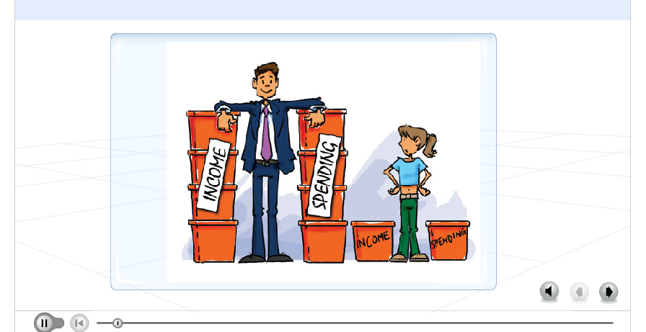
Activity
We are going to watch the following video.

Slide 16
Activity
Complete the worksheet provided by your teacher!

Slide 17
Activity 2
Read pages 76 -77 and answer the following questions in your book
What is the Margin of Safety?
What happens to the BEP when costs rise?
What happens to the BEP when costs fall?
What is Contribution analysis and how can you calculate it?
Answer the TEST YOURSELF questions on p.78

Slide 18
Break Even Point
FORMULA
= TOTAL FIXED COST
SELLING PRICE – VARIABLE COST

Slide 19
EXAMPLE
A business selling T-shirts has a fixed cost of £100,000 and sells each T-shirt for £10.
Its variable cost per T-shirt is £5.
What is the Breakeven point?
B.E.P = Fixed Costs
selling price – variable cost
= 100,000 100,000 = 20,000
£10 - £5 £5
= 20,000 t-shirts

Slide 20
Revise what we’ve learnt using BBC GCSE Bitesize

