Slide 1
Starter Activity
Complete the worksheet provided by your teacher!

Slide 2
Topic 3.3: Estimating Revenues, Costs and Profits
Unit 3: Putting a Business Idea into Practice

Slide 3
Learning Objectives
To understand the following key terms (AO1):
Revenue
Sales Volume
Fixed Costs
Total Costs
Variable Costs
To apply how businesses work out total cost. (AO2)
To analyse and calculate whether a business has made a profit. (AO3)
What are we learning today? By the end of the lesson you should be able...

Slide 4
Fixed Costs
Fixed Costs: These are costs which do not vary with the number of sales made. These include:
Rent
Insurance
Electricity
Administration
Advertising
Salaries

Slide 5
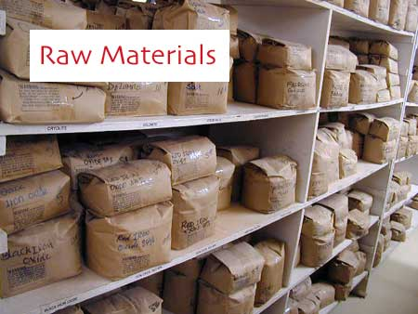
Variable Costs
Variable Costs: These are costs which change directly with the number of products sold. These include:
Raw Materials
Overtime Wages
Deliveries

Slide 6
Calculating Profit or Loss
What is the profit or loss for this business?
What is Revenue = £100
Fixed Cost = £20
Variable Cost = £35
Profit/Loss = Revenues – Total Cost (Fixed + Variable Cost)

Slide 7
Calculating Total Revenue
Total Revenue = Selling Price x Sales Volume
Selling Price | Sales Volume | Total Revenue
£100 | 10 | £1,000
£100 | 20
£150 | 20
£200 | 20
£200 | 10

Slide 8
Activity
Complete the worksheet provided by your teacher!

Slide 9
Plenary
To understand the following key terms (AO1):
Revenue
Sales Volume
Fixed Costs
Total Costs
Variable Costs
To apply how businesses work out total cost. (AO2)
To analyse and calculate whether a business has made a profit. (AO3)
Are you now more confident in your understanding of the learning objectives?

