Slide 1
Starter Activity
Complete the worksheet provided by your teacher!

Slide 2
Topic 4.2: Motivation Theory
Unit 3: Building a Business

Slide 3
Learning Objectives
To understand the following key terms (AO1):
Motivation
Hierarchy of Needs
To apply how businesses motivate staff. (AO2)
To evaluate the effectiveness staff motivation using Maslow’s Hierarchy of Needs. (AO3)
What are we learning today? By the end of the lesson you should be able...

Slide 4
Activity
Write down 8 things that motivate you to work.

Slide 5
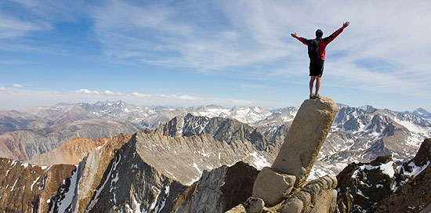
Motivation
Motivation: In work, the desire to complete a task. If an employee is motivated it leads to:
Less absenteeism
Less labour turnover
Higher productivity
Higher quality of work

Slide 6
Maslow’s Hierarchy of Needs
Hierarchy of Needs: Placing needs in an order of importance, starting with basic needs.

Slide 7
Maslow’s Principles
Theory of motivation where employees have 5 human needs.
Everyone has the same needs.
Can’t achieve higher needs (social, esteem, and self-actualisation) if lower ones (physiological and safety) are not met.

Slide 8
Activity
You have 10 minute to identify how Tesco can motivate its store manager using Maslow’s ‘Hierarchy of Needs’.

Slide 9
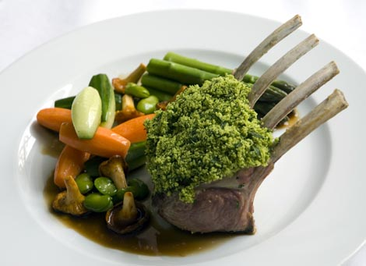
Physiological Needs
These are basic needs such as shelter, warmth, sleep and food.
Lower level needs.

Slide 10
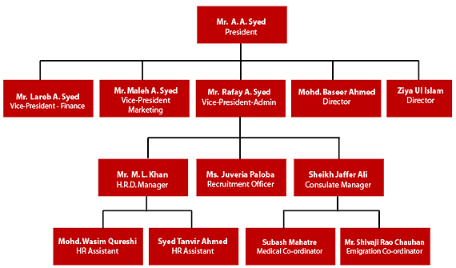
Safety Needs
The need to work in a stable, structured and healthy environment.
Lower level needs.

Slide 11
Love and Belonging Needs
The need to have relationships with colleagues and a sense of belonging.
Higher Level Needs

Slide 12
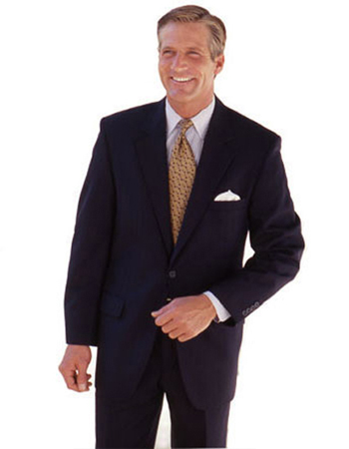
Self Esteem Needs
The need to have recognition, confidence and reputation.
Higher Level Needs.

Slide 13
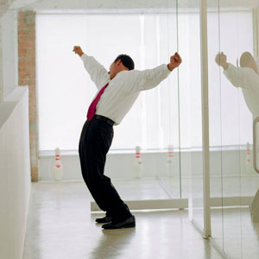
Self Actualisation Needs
The need to reach full potential, having complete personal fulfilment.
Needs have to be maintained.
Higher Level Needs.

Slide 14
Activity
Complete the worksheet provided by your teacher!

Slide 15
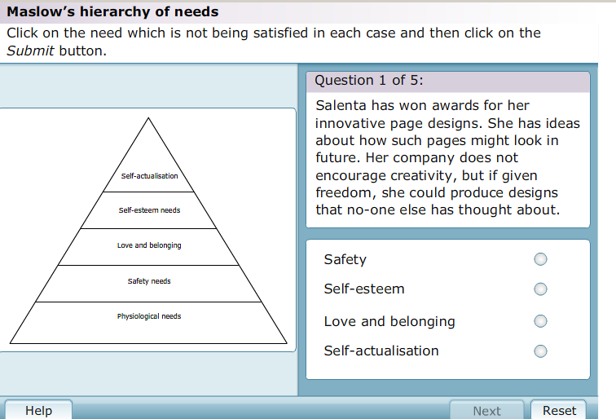
Plenary
Complete the worksheet provided by your teacher!

