Slide 1
Adding value

Slide 2
Adding value
This section covers the following:
What is added value?
How to add value?
What is a unique selling point?
Why added value is important

Slide 3
Key words
Added value
Adding a feature that makes a product or service stand out above its rivals
Unique selling point (USP)
An original feature of a product that rivals aren’t offering
Branding
Giving a product or service ‘personality’, with a name and logo that makes it stand out

Slide 4
What is added value?
Added value is the difference between the cost of materials and the selling price of a product.
  e.g. to make a mobile phone there are materials such as a battery, screen and software – the cost.
  By building the parts into a phone and giving it features such as being able to make calls or listen to music the phone manufacturer makes the phone stand out and can charge a price for the product that is greater than the cost of the parts.
The more valuable the product to the customer, the greater the price that can be charged.

Slide 5
Unique selling points
A unique selling point (USP) can be used to create something different about a product.
Customers demand products that are different.
Different products that meet customer needs and wants can add value due to this demand.
For example, virtual reality headsets provide a different way of playing games and allow for greater added value.

Slide 6
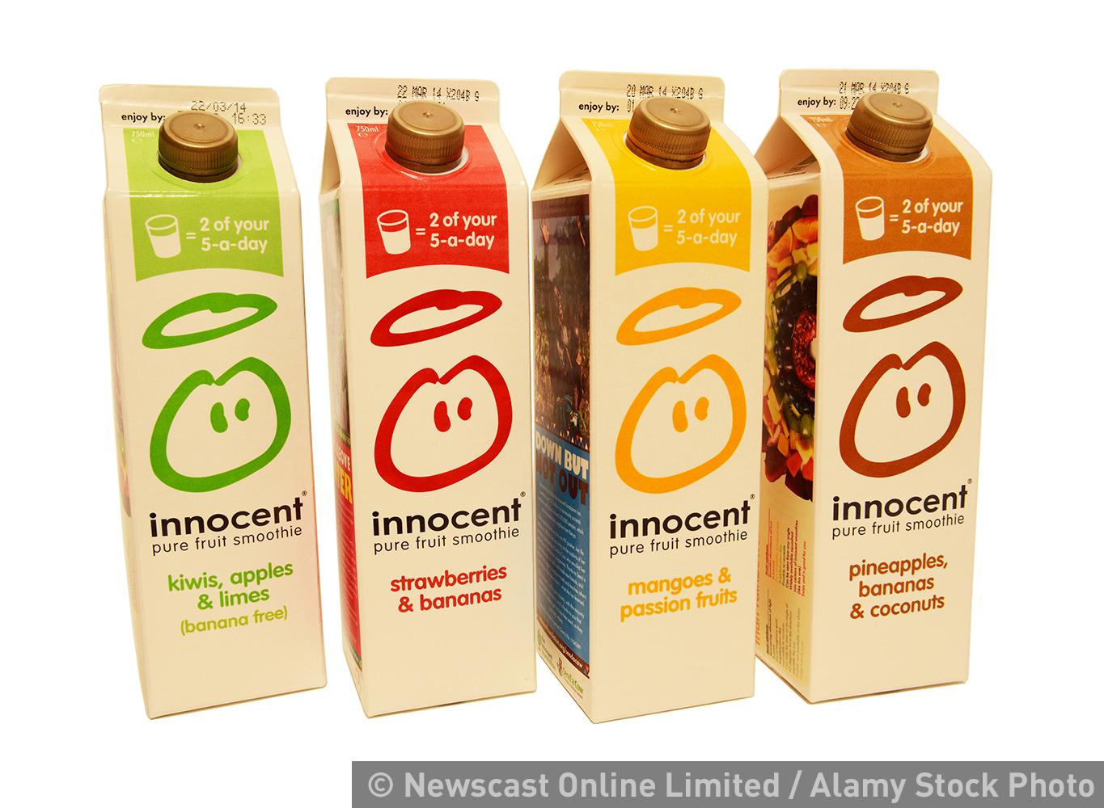
How do businesses add value?
Convenience and speed, e.g. take away subway sandwiches cost much more than homemade
Good design, e.g. Dr Beats compared to a normal set of headphones
High quality manufacture or service, e.g. 2D cinema compared to 3D cinema
Brand name is the way a business identifies its products distinctively from others of the same type e.g. the Nike swoosh on trainers
Innocent is a well-known maker of fresh smoothies

Slide 7
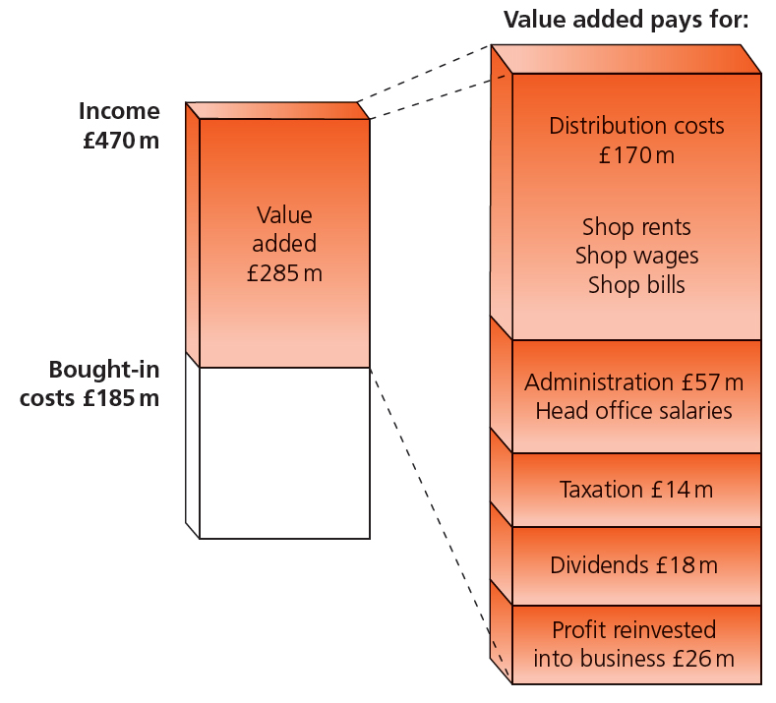
Why is value added important?
Businesses have to pay for costs such as electricity or any waste materials.
These costs must be taken from added value.
The greater the costs the more important it is to have a high value added.
The bar on the right of the diagram shows how added value pays for all Ted Baker’s costs.
Added value must be more than these costs to make a profit.
What the value added pays for

Slide 8
Summary questions
Write down on lined paper the answers to these questions.
Give an example of a well-known brand.
Why do think this brand is well know?
What is a unique selling point?
Give one reason why a unique selling point is important to a business.
Give one example of how Samsung add value to a mobile phone.
Give one benefit to a business of adding value.

