Slide 1
Business aims and objectives

Slide 2
Business aims and objectives
This section covers the following:
What business aims are
What business objectives are
Why aims and objectives are different between businesses
Financial objectives
Non-financial objectives

Slide 3
Key words
Aims
A general statement of where you’re heading, for example ‘to get to university’

Slide 4
Business aims
Aims are the broad targets that a business wishes to achieve.
Example: Aston Martin, the luxury sports car manufacturer, aims to broaden its product range to appeal to younger and female customers.
Notice the aim does not say how this will be achieved in any detail.
Aston Martin article

Slide 5
Key words
Objectives
A clear, measurable goal, so success or failure is clear to see

Slide 6
Business objectives
Objectives are specific targets that the businesses can create to help achieve their aims.
A good business objective should be SMART:
Specific
Measurable
Achievable
Realistic
Time-bound (has a time scale)

Slide 7
Key words
SMART objectives
Targets that are specific, measurable, achievable, realistic, and time-bound

Slide 8
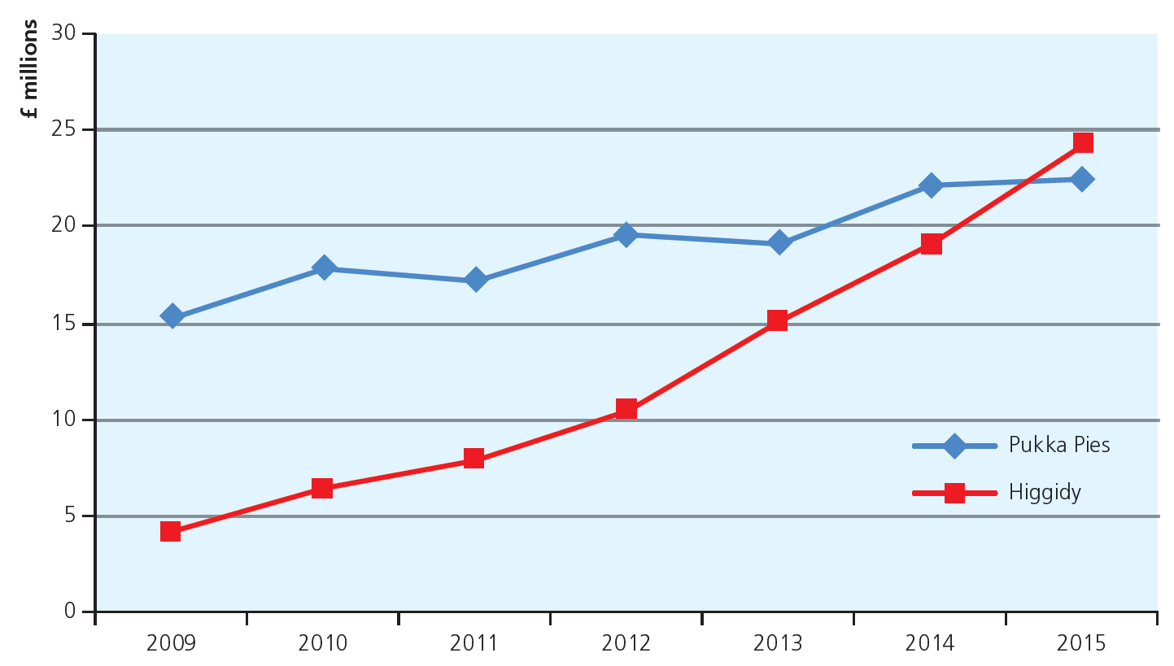
SMART business objectives
SMART objectives help all parts of the business have a clear idea what they have to achieve, e.g. staff, managers.
They also help senior managers with decision making.
Example: Higgidy was a business set up to make posh pies.
Their objective was to reach everyone with posh pies.
The chart shows they are well on their way to achieving their objective of overtaking Pukka pies.
Giddy growth for Higgidy

Slide 9

Differing aims and objectives
Aims and objectives differ because business owners want different things from their business.
Examples: To make money, to make a product no one offers, to offer a service, to be the best.
Business objective example: James Dyson started in business to make a bagless vacuum cleaner.
Business as a social objective: The Body Shop was set up to create environmentally friendly cosmetics.
James Dyson

Slide 10
Financial objectives – survival
The most important thing for a new business is survival
Out of new businesses in 2016, 91% survive 1 year
But only 40% are still trading after 5 years.
Just to keep trading is very important.
Small business failures

Slide 11
Key words
Survival
Keeping the business going, which ultimately depends on determination and cash

Slide 12
What are financial objectives?
Profit – making enough money to pay bills or satisfy shareholders
Sales – gaining as many customer purchases as possible –common approach among online businesses such as Facebook
Market share – claiming as many loyal customers as possible, giving a business power in a market.
Key term – market share
The percentage of a market held by one company or brand
Example: iPhones captured 48% of the UK mobile market – shops want to stock it as they are guaranteed to sell
Financial security – having enough money to ensure the long-term success of a business – e.g. profit that is kept to invest in future products or expansions

Slide 13
What are non-financial objectives?
These are targets that are not expressed in monetary terms
Social objectives – aiming to help a particular area of the community or group of people
Personal satisfaction – wanting to feel a sense of achievement through what your business does
Challenge – being motivated by being stretched and pushed by the challenges that your business faces
Independence – Wanting to be your own boss and ‘go it alone’
Control – Wanting control over your business, not wanting other people to tell you what to do or let other people or businesses dictate what your business does

Slide 14
Summary questions
Write down or discuss the answers to these questions.
Give an aim for your favourite sports club or pop star.
What do the letters SMART stand for?
Give an example of a SMART objective for Spotify, the music streaming service.
Give an example of a financial objective for new business.
Give an example of a non-financial objective for starting a business.

