Slide 1
9.3 Assessing internationalisation
Bartlett and Ghoshal Matrix and risks of international development

Slide 2
Risks to business of developing internationally
Operational risk – the manufacturing quality may not be consistent through several countries.
Political risk – the political will to allow import/export and the regulations which are put in place may be to onerous.
Technological risk – emerging markets may not have the technological capability to manufacture to the quality the business requires.
Environmental risk – because of poor environmental controls abroad the environmental damage could be considerable.
Economic risk – exchange rate fluctuations, boom and bust cycles may be different.
Financial risk – could lose considerable money if setting up a new factory in a volatile state.
Terrorism risk – local people may not be keen on foreign investment.
Customer satisfaction risk – quality of the product could be compromised or customers may not like products being made abroad.
Mismanagement risks – without sufficient management controls in place, mismanagement is a possible problem.

Slide 3
Learning outcomes
You should be able to understand:
How businesses can manage internationally

Slide 4
Overview of key concepts
Growing a business by entering international countries can give a business access to new customers and new markets.
However, an international business is fraught with risks, both in terms of reputation and finance.

Slide 5
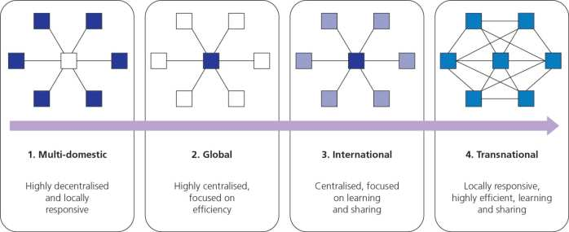
Bartlett and Ghoshal’s model
The different ways in which a business can operate abroad were identified by Bartlett and Ghoshal as:
Multinational or multi-domestic – operating in multiple countries, each with their own local management
Global – business operations are centralised
International – operations are centralised but there is learning, benchmarking and sharing
Transnational – a mixture of multinational and international.
Which one is chosen will depend on the organisation’s management style, structure and culture.

Slide 7
Low Pressure for cost reduction High
Low Pressure for local responsiveness High

Slide 12
Bartlett and Ghoshal’s model
Organisational characteristics | Multinational | Global | International | Transnational
Assets and culture | Decentralised and national, self-sufficient | Centralised and globally scaled up | Core values centralised but others are decentralised | Dispersed, interdependent and specialised for each country
Role of overseas operations | Exploiting local opportunities and strategies | Parent company core values replicated | Adaption of parent company values but used locally | Contributions recognised and integrated worldwide
Development and use of knowledge | Each unit develops and maintains its knowledge | Knowledge and development retained in the centre | Knowledge developed centrally and transferred aboard | Knowledge developed jointly and shared worldwide

Slide 13
Summary

Slide 14
Advantages and disadvantages of each strategy

Slide 15
Exam Question
Discuss Bartlett and Ghoshal’s view that if multinational companies are to remain successful over time, they are likely to have to develop a transnational strategy. (16 marks)

