Slide 1
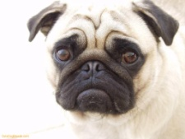
Stars are products that have a big share of a fast-growth market, like the Apple iPhone. Hey are products doing well in an attractive market. Businesses need to keep improving and promoting stars with the aim of turning them into cash cows of the future.
What stars can you think of?
Question marks can also be called problem children. They have a small share of a fast growing market. An example is a new brand in the computer games market. They could turn out to be very successful, and it is an attractive market but the business cannot be sure if it will succeed.
Businesses need to spend money promoting these products to ensure they are successful – this could come from the money of cash cows.
What question marks can you think of?
Cash cows are products that are doing well and have a high share of the market, but the market isn’t growing very fast. An example is Heinz tomato ketchup. These products are well known and shops want to stock them. Customers buy them in large quantities.
Profits from these products are good and earn businesses lots of money. This money should be used to develop products for the future.
What cash cows can you think of?
Dogs are products that have a low share of a low-growth market. They are not doing well and the market isn’t growing very fast. They are not much good to a business and the business an either get rid of them of try to improve them. Tango and Lucozade used to be like this.
What dogs can you think of?

