Slide 1
The role of marketing
Branding
What is branding?

Slide 2
Can you name famous brand?

Slide 4
Coca-Cola
Ranked the best brand 10 years in a row

Slide 14
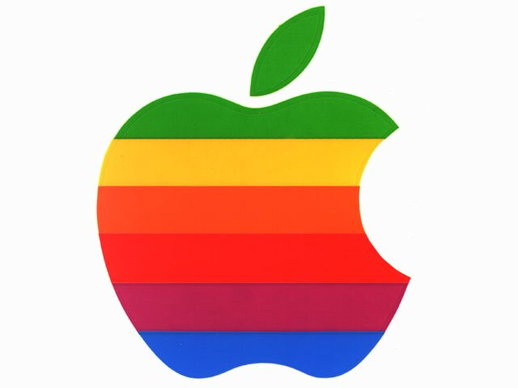

Slide 22
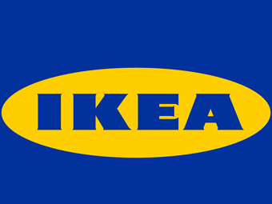

Slide 35
Brand personality and image
Brand personality is a set of characteristics that we associate with a product or service. For example, we might describe Mercedes fashion as ‘luxury’.
With this in mind, what characteristics could you use to describe Marks and Spencer? Why is this?
Brand image is the impression we have of a product or service. A strong brand image is one we instantly recognise.
How many brand images have you seen today?
Notes:
If you want to make this more challenging, remove the examples given and task learners with only finding services.

Slide 36
Implications of business size
How a business markets itself will depend on its size.
Think about and research how the following companies might market themselves:
a family-owned grocery shop
a small, local travel agency.
Now compare these with:
Aldi
Thomas Cook
Notes:
This activity involves learners undertaking research, and they will probably need to exercise some artistic licence, especially for the small business operations. They might not know what ‘artistic licence’ means so this will require explaining while you encourage them to be creative.
Alert learners, if needed, that marketing activities require flexibility and creativity, and they should model these characteristics in their presentations.
Encourage learners to record presentations and posters made and used in class (subject to obtaining necessary permissions from individuals).
Reinforce to learners the meaning of ‘implications’ (used in the heading) and the need to find both benefits and disadvantages for both types of business.
Suggest to those working at higher levels that they may wish to present arguments in favour of small businesses by thinking more laterally.

Slide 37
USP
A USP is a ‘unique selling point’.
A brand – or customer perception of a product, can allow a business to charge a higher price for its products.
Businesses know how we feel about particular products and therefore know that our perception is worth something to them – e.g. A product may not actually be of higher quality compared to a rival, but if the consumer believes that it is, then a higher price can be charged.
A USP sets products apart from other competitors in the market

Slide 38
USP
You have 5 minutes to come up with as many different businesses and their USPs as possible

Slide 39
Your task
Choose a well-known business of your choice
It must have a strong brand image
You must create a poster explaining the history of its brand
You must explain:
When the business was established
How its logo was designed
The development of this company’s brand
Why its brand is so important to its success

