Slide 1
Break-even

Slide 2
Break-even
This section covers the following:
What break-even is
Drawing a break even chart
Calculating the breakeven point level of output
Calculating the margin of safety
Interpretation of break-even diagrams

Slide 3
Break-even basics
Businesses launching a product want to see at what point they will stop making a loss.
To work this out they need to forecast as accurately as possible fixed costs, such as rent for a shop.
They will also need to work out variable costs – remember these are those that change with the level of product made/sold, e.g. raw materials to make the product.
Break-even point can then be calculated.
Break-even point is the number of the product the business needs to sell to cover all the fixed and variable costs.

Slide 4
Key words
Break-even
The level of sales at which total costs are equal to total revenue, at which point the business is making neither a profit nor a loss
Break-even chart
A graph showing a company’s revenue and total costs at all possible levels of output

Slide 5
Drawing a break even chart
A break-even chart is a diagram that shows the profit or loss for every level of output of a product.
To draw a break even chart the following information is required:
variable costs
fixed costs
revenue for the product/service
maximum output of the product/service.
Write these formulae down
Total costs =
fixed costs + variable costs
Variable costs =
variable costs per unit × number of products made
Sales revenue =
selling price per unit × number of products sold

Slide 6
Example break-even chart
Tom sells wind surf sails.
Write down the following figures:
The costs for a new sale are as follows:
Fixed costs are £18,000
Variable costs per sail are £200
The maximum number of sails the factory can produce is 200.
The selling price of each sail is £450.

Slide 7
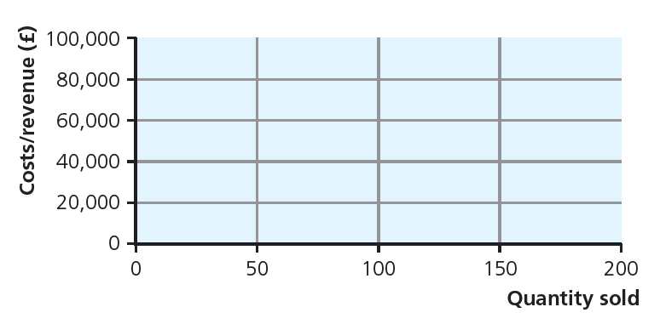
Example break-even chart: Stage 1
Look at the chart for Tom’s sails.
Across the bottom always shows the quantity sold – the maximum here is 200.
This is called the horizontal axis.
Running up the side of the chart (vertical axis) is the revenue, going up to a maximum of £100,000.
Can you work out the maximum revenue if the factory sold all 200?
Total revenue = 200 × £450 = £90,000.
Stage 1 Break-even chart

Slide 8
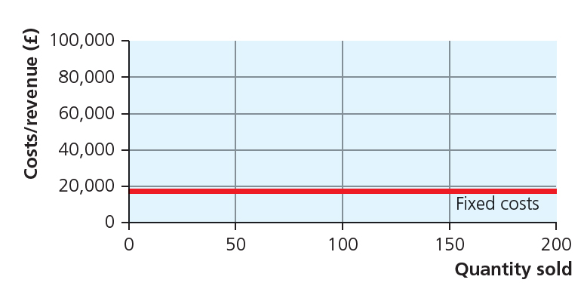
Example break-even chart: Stage 2
Tom needs to draw in fixed costs first.
Remember these do not vary regardless of whether he makes 0 sails or 200.
The chart shows a red line for the fixed costs.
How much are the fixed costs?
£18,000
Stage 2 Break-even chart

Slide 9
Example break-even chart: Stage 3
Tom now needs to show the total costs.
If Tom sells nothing there will be no variable costs.
What will the variable costs be if Tom sells 200 sails?
£40,000.
The chart shows total costs from 0 sales to 200 sales.
Notice that the gap between total and fixed costs increases as more products are made.
Stage 3 Break-even chart

Slide 10
Example break-even chart: Stage 4
Tom now needs to add a third line showing revenue, the money achieved from sales of the sails.
No sails sold means no revenue
How much would revenue be if Tom sold 200 sails?
£90,000.
As you can see from the chart sales revenue crosses the fixed costs and total costs.
Stage 4 Break-even chart

Slide 11
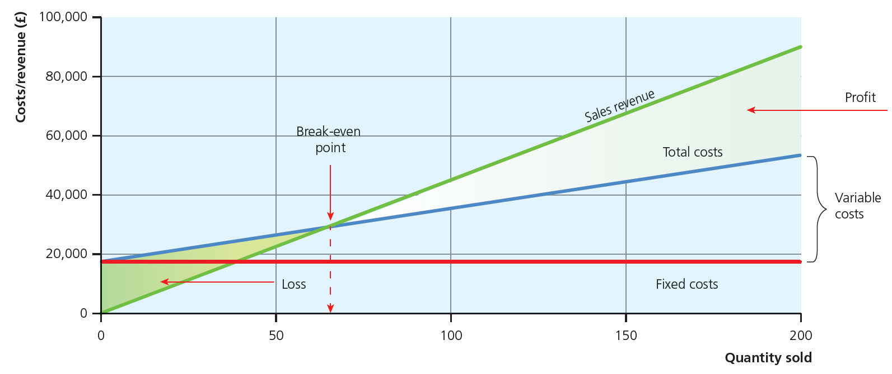
Example break-even chart: Stage 5
Now we have drawn Tom’s break-even chart we can find out when costs will equal revenue, i.e. breakeven point.
Break-even takes place where the total costs line is crossed by the revenue line.
This tells us how many sails Tom needs to sell. Here it is 72 sails or £32,400.
The shaded green area is the amount of money Tom will lose if he does not reach the breakeven point, i.e. £18,000 if he sells no sails.
Finally, Tom can make a profit, e.g. if he sells all 200 sails he can make £32,000.
Remember: This is only a forecast!
Stage 5 Break-even chart

Slide 12
Calculating break-even level of output
Instead of drawing a chart we can use a formula to work out the number of sails need to be sold to break even.
Write the formula down.
Remember we are working out the number of sails not cash.
We first work out the bottom part of the equation.
Now apply the whole formula. Remember, fixed costs are £18,000.
Break-even = fixed costs
(price – variable costs per unit)
= £450(price) – £200 (variable costs per unit)
= ????
= £250
Break-even = £18,000
£250
Break-even = ?????
Break-even = 72 sails

Slide 13
Key words
Margin of safety
The amount by which demand can fall before the business starts making losses

Slide 14
Margin of safety
The margin of safety is the gap between sales and the break-even point.
The wider the margin the less risks the business will need to take in selling the product.
Write down the margin of safety formula.
Calculate Tom’s margin of safety if he sold all 200 sails.
Margin of safety = sales (in units) – breakeven point
Margin of safety = 200 (sales in units) – 72 (breakeven point)
Margin of safety = 128

Slide 15
Interpreting break-even diagrams
Break even diagrams allow a business to look at revenue and costs to help make better business decisions.
Business can look at what happens to break even if the selling price is raised or lowered.
It also helps a business look at fixed and variable costs to see if they are reasonable compared to the selling price.
The table summarises the type of questions that can be answered by break even
Questions break-even can help answer | Impact on the break-even chart
Our landlord has increased our rent by 40 per cent. What will this do to our profitability? | Fixed costs line will rise, pushing the total cost line closer to the revenue line, i.e., cutting profits
The recession has cut demand for our organic eggs by 20 per cent. What will be the impact? | No lines on the chart will change, but the 20 per cent sales fall will reduce the margin of safety, or perhaps wipe it out
Is it right to cut our prices by 10 per cent? Will it increase or cut our profits? | The revenue line will rise less steeply, pushing it down towards total costs; profits can only rise if the sales volume leaps ahead
How break-even helps answer business questions

Slide 16
Summary questions
Write down or discuss the answers to these questions.
What is break-even?
Give one way break-even can help a business.
What is meant by break-even point?
What is the margin of safety?
Name one risk to a business of using break even.

