Slide 1
Business location
This section covers the following:
Why location is important for a business
Factors influencing business location
The nature of the business activity
The impact of the internet on location
Making a location decision

Slide 2
Key words
Fixed premises
Buildings that have to be where they are (for example, the high street); e-commerce buildings can be located anywhere
Proximity
Nearness; whether or not a business wants to be close to a factor such as ‘materials’.

Slide 3
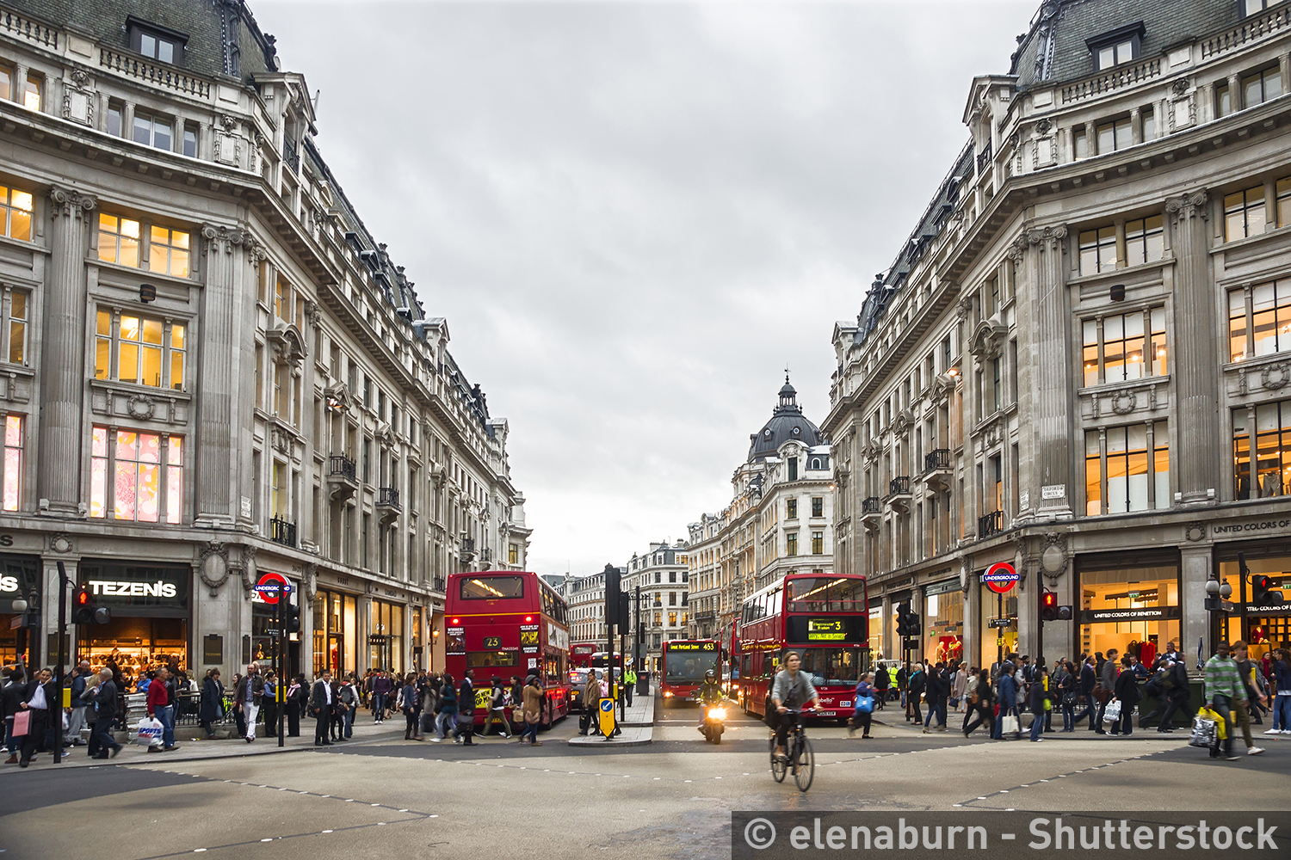
Why is business location important?
Business location is the place the business decides to locate its operations.
Location is often a trade-off between cost and convenience to customers.
Example: A business wanting to set up in London will look to rent a shop.
Rents are very expensive. The picture shows Oxford Street, which costs a lot of money to rent on. This means huge sales are need to cover this cost.

Slide 4
Factors influencing business location
Proximity to market: the nearer a business is to its customers, the more likely it is to sell products.
However, shops with more customers attract more rent and more costs.
Look at the table – which is the cheapest annual rent? Why?
London shop locations | Shop size (sq ft) | Annual rent (2016) | Cost per sq ft | Notes
Bermondsey | 492 | £12,000 | £24 | Residential area
Shoreditch | 1,060 | £50,000 | £47 | Close to trendy Hoxton Square
Knightsbridge | 650 | £128,000 | £197 | Nearly half the space is basement
The Strand | 290 | £78,000 | £269 | Continuous footfall from Covent Garden
Oxford Street | 530 | £535,000 | £1,010 | Basement space not included; location is opposite Selfridges

Slide 5
Factors influencing business location
Proximity to materials: If the business manufactures a product then costs reduce if they are located close to the raw material, e.g. car production near steel plants.
Proximity to labour: A business needs to take into account how accessible it is to hire a workforce.
This can include access to skills. For example, to make Formula 1 cars employees need high levels of engineering skills, so a business needs to be based in the West Midlands, where other teams are.
Or it can include looking at how cheap it would be for the workforce to relocate to the area.
Proximity to competitors: Some businesses would be better setting up where there is little competition.
Other businesses cannot avoid competition. Restaurants need a lot of customers which tends to be in high streets with other restaurants.

Slide 6
The nature of business activity
Manufacturers tend to want to be near raw materials, good road networks for transporting finished products and any specialist workers or suppliers.
Shops need to be near customers who buy their products.
Service industries, such as car insurance companies, tend to want access to workers with the right skills for a call centre and cheap offices to rent.

Slide 7
The impact of the internet on location
Shopping for many goods and services is increasingly moving to the internet.
Primark still has many physical shops on high streets, but these cost a lot to rent, heat and staff.
ASOS, on the other hand, sell clothes online and have no physical shops – potentially huge cost savings.
The table shows how the internet can affect the location decisions of businesses such as ASOS and Primark.
Can you think of another business that is based only online?
 | E-commerce business, such as ASOS | High street retail business, such as Primark
Head office location | Can be anywhere | Can be anywhere
Product display | On a single website, allowing heavy investment in quality photos and customer interaction | In-store, therefore carrying high property and staff costs in multiple locations (and with too few design experts)
Stock range | Can keep every size and colour in stock, so customer disappointments should be rare | Space constraints in many store locations may mean restricted choice of colours and sizes
Customer services location | Can be anywhere; having a single location keeps costs down | In-store, therefore carrying high property and staff costs in multiple locations
Delivery to customer | Critical to have efficient deliveries; may be hard in crowded cities | Not a problem

Slide 8
Making a location decision
Businesses must weigh up several factors before deciding location.
Potential revenue vs costs are particularly important.
Look at the table for Manchester shop locations, predicted costs and profits.
If you were a new business, would you choose the Arndale Centre or Oldham Street? Explain why.
 | Arndale Centre, Manchester | Oldham Street, Manchester
Annual sales revenue | £600,000 | £300,000
Annual rent on 950 sq ft shop | £102,000 | £36,000
Other fixed costs | £56,000 | £44,000
Variable costs | £360,000 | £180,000
Total costs | £518,000 | £260,000
Profit | £82,000 | £40,000

Slide 9
Summary questions
Write down or discuss the answers to these questions.
Why might proximity to customers be important for a clothes shop?
What type of business might want to be located close to a steel manufacturer?
Give one benefit of being located only on the internet.
Give one drawback of being located only on the internet.

