Slide 1
8.2 Strategic positioning: Choosing how to compete

Slide 2
Learning outcomes
Strategic positioning
What you need to know:
How to compete in terms of benefit and price
Porter’s generic strategies
Bowman’s strategic clock
Influences on the choice of positioning strategy
The value of different strategic positioning strategies
The benefits of having a competitive advantage
The difficulties of maintaining a competitive advantage

Slide 3
Starter discussion questions: strategic positioning
In small groups/pairs discuss the following companies’ recent struggles or failure.
Decide on what you think were the biggest reasons for their strategic failures.
JJB Sports
Tesco
Clintons Cards
Sony

Slide 4
Strategic positioning: answers
Decide on what you think were the biggest reasons for their strategic failures.
JJB Sports – Failed UK sport retailer. Fell behind more fashionable rival JD Sport and cheaper rival Sports Direct. With no clear position in the market consumers went to rivals.
Tesco – Not the best quality retailer (Waitorse, M&S) nor the cheapest (Aldi, Lidl). Lost focus on their core UK market with their attempts to expand internationally.
Clintons Cards – Did not adapt to their external environment. Failed to keep up with more innovative technological rivals (Moonpig). Lost market share to cheaper supermarkets entering their market.
Sony – Loss making electronics giant. Lost market share to more innovative rivals with cutting edge products (Apple and Sony) and cheaper cost leaders, e.g. LG, HTC. They used to be market leaders but haven't brought out a market changing product for years.
Summary: Many of these companies failed due to having a poor strategic positioning and failing to adapt to a changing market after previously having success. They were either not competitive on price compared to cheaper rivals or failed to offer sufficiently differentiated products from other companies in their market.

Slide 5
Strategy
Strategy - A long term plan to achieve a firm’s aims and objectives.
It is a key role for the executives and senior management of a company and will determine their success.
Strategic decisions are long term and have implications for all functions/departments of the business.
They often require significant investment of finance and resources.
An important element of strategy involves developing a competitive advantage.
Competitive advantage is an advantage over competitors gained by offering consumers greater value, either through lower prices or by providing greater perceived benefits to justify charging a premium price.

Slide 6
Strategic positioning
The strategic positioning of a business refers to how it is perceived by customers compared with similar businesses in the market.
Part of this positioning involves deciding what the firm’s proposition will be to customers, including how they will compete on price and the perceived value the product/service will bring to the consumer.
Managers will decide where in the market they want the business to be, how it will stand out (differentiated) and what type of consumer it will appeal to.
Strategic positioning can be analysed using two key pieces of theory – Porter’s generic strategies and Bowman’s strategic clock.

Slide 7
Porter’s generic strategies
Michael Porter is a leading authority on competitive strategy and a world renowned business consultant.
In 1980 he developed his generic strategies model, also known as Porter’s low cost, differentiation and focus strategies.
The main focus of the model involves giving firms strategic options based on the markets they operate in and the strategic advantage they offer.
His theory states that to develop a sustainable competitive advantage and earn high profits firms must adopt one of two possible strategic positions: cost leadership and differentiation.
Businesses need to offer something different to customers and must do this either in a mass or niche market. Those that choose one of these two strategic positions in a niche market are said to pursue a focus strategy.

Slide 8
Porter’s generic strategies
Michael Porter analysed three different strategies that businesses might adopt to develop a sustainable competitive advantage.
What does the firm have as an advantage – low costs, or provides a high quality good?
What type of target market – a particular segment or whole market?
Strategic advantage
Low cost
Differentiation
Strategic
Target
(Scope)
Broad Target
(Mass Market)
1. Cost leadership
e.g. Primark, EasyJet
2. Differentiation
e.g. Apple
Narrow target
(Niche
Market)
3a. Cost focus
e.g. local discount retailer
3b. Differentiation focus
e.g. Ferrari

Slide 9
Porter’s generic strategies
Successful firms build a highly distinctive product offering a clear strategic position.
Many firms’ struggles and failure to be profitable can be attributed to not choosing a clear strategic position from Porter’s generic strategies.
Examples include M&S clothing, Sony, Nokia, Tesco, JJB and Clintons Cards. They have struggled in their respective markets because they were seen neither as the best in their industry, offering high added value (differentiation), nor as the lowest priced (cost leadership).
Porter described this as being 'stuck in the middle'.
Strategic advantage
Low cost
Differentiation
Strategic
target
(scope)
Broad target
(Mass market)
1. Cost leadership
2. Differentiation
Stuck in the middle
Narrow target
(Niche
market)
3a. Cost focus
3b. Differentiation focus

Slide 10
Porter’s generic strategies
Strategic options:
In simple terms, according to Porter businesses must either be the best at something or the cheapest to develop sustainable competitive advantage.
https://www.youtube.com/watch?v=i66HWNCwUTs

Slide 11
Low Cost/Cost Leadership
Cost leadership – Businesses aim to be a low cost producer through tight control of labour costs, supplier prices, distribution, manufacturing costs, using technology (automation), etc. to achieve economies of scale. These firms will reduce costs in order to charge low prices as a way of standing out in a market and a means of creating high sales but low profit margins, e.g. Primark, Ryanair.

Slide 13
Differentiation
Differentiation – Businesses compete on product/service rather than price. They will aim to offer a unique selling point to stand out from rivals and therefore create loyalty. They may allow higher prices to be charged (premium prices) with higher profit margins due to the higher added value perceived by consumers, e.g. Apple, Jaguar Land Rover

Slide 14
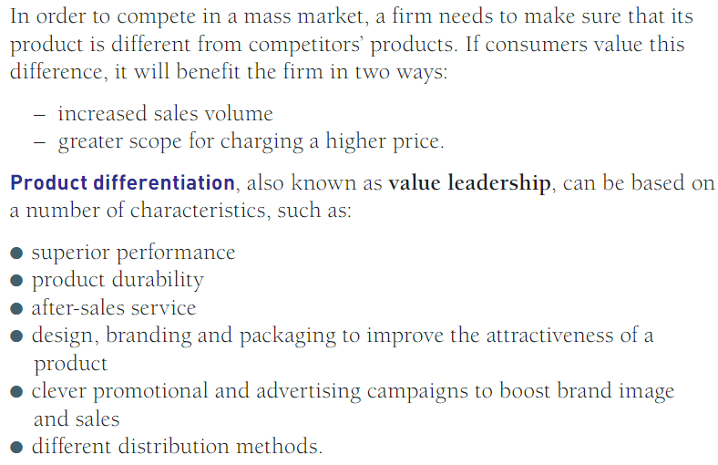

Slide 15
Focus
Focus – A firm may pursue cost leadership of differentiation but in a niche market aiming at a smaller target audience, e.g. Porsche targeting wealthy consumers.

Slide 17
Discussion points
Porter suggested that being ‘stuck in the middle’ of the generic strategies model is likely to lead to failure.
Questions:
Why do you think this is?
What reasons might influence a firm in choosing one of Porter’s strategic positions over another?
What enables a business to retain a competitive advantage over time?
Discuss these questions in pairs/small groups.
Give example companies to support your arguments.

Slide 18
Bowman’s strategic clock
In 1996, Cliff Bowman and David Faulkner looked at Porter's generic strategies model in a different way to develop their own theory: Bowman's strategic clock. This model offers more strategic options.
This model looks at strategic positions a firm may take in relation to two variables expressed on a 'clock face’:
Varying levels of price charged to the customer
Perceived value to the customer or expected benefits gained of the good/service (added value)
This model shows the potential strategic positions a firm may take by demonstrating the different combinations of value and price.
It also identifies those strategies which are competitive and those which are not. Therefore showing the likelihood of success for each strategic option.
It can be used to plan what strategic position a business may hope to have in the future.
The strategic 'clock' presents many different ways a company may position itself in the market to be competitive.

Slide 19
Bowman’s Strategic Clock
https://www.youtube.com/watch?v=hsV1mraa4AI

Slide 20
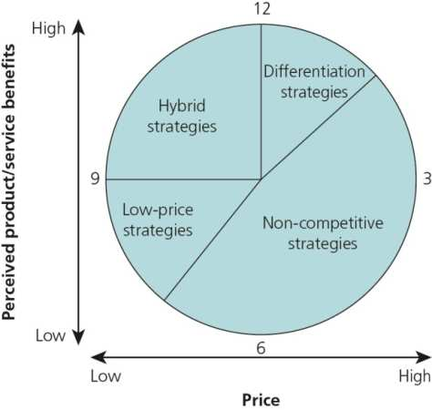
Bowman’s strategic clock
This model extends Porter’s generic strategies to present eight different strategic options a firm could pursue.
It classifies them by different combinations of two factors:
Varying levels of price charged
Perceived value to the customer
These combinations of perceived customer value and price are not competitive and unlikely strategic options. These are shown by the shaded area. For example, a mid- or high-priced product with low perceived benefits will only result in firms losing market share. Charging a high price with low perceived value may only be possible without eventual business failure with a monopoly.

Slide 21
Bowman’s strategic clock: options
Differentiation while not charging a premium (high) price may be used to create interest, sales and build market share.
Differentiation and charging a premium price is an ideal scenario for a firm and will help to increase profit margins.
Hybrid strategies are usually short-term strategies to boost sales or create awareness. Often used when entering new markets. Prices are lower than the perceived added value, to attract consumer interest and sales.
Focused differentiation is an option for very high-quality products aimed at consumers on high incomes, e.g. Sunseeker yachts. More likely to be possible in niche markets.
These combinations of added value and price are not viable (3–6 o’clock). A basic product with a premium price is unlikely to attract sales. Customers will not purchase these products and will switch brands unless the product is in a monopoly market.
Low-price strategy, selling at a price lower than perceived value. These companies push prices down to a minimum, meaning very low profit margins but very high volume.
Often used by firms that lack a USP and cater for low-income, price-sensitive consumers. Inferior goods and not a desirable strategy for many firms but can still be very successful, e.g. Poundland, Ryanair. Low profit margins, high volume sales, low customer loyalty.

Slide 22
Discussion points
What is the most desirable strategic position on Bowman’s clock?
Does it matter what strategic position you pick?
Can you think of examples of real firms at each viable strategic position?

Slide 23
Bowman’s strategic clock
Different strategies can be competitive with the right combination of added value and price charged.
A business can only charge a high price if it offers a high level of added value in the customer’s opinion, e.g. luxury clothing brands, five-star hotels.
A firm that has low added value can only charge a low price but can still be very competitive, e.g. supermarket own brands, budget airlines, fast food restaurants.
Some combinations of price charged and perceived value will not be possible and are not competitive, e.g. charging a high price for a low added value product.
In the exam, you may use this theory to explain what strategic position a firm is currently pursuing or how a firm intends to/should change its strategic position, e.g. a firm deciding to improve the quality of its product to improve its perceived value so it can charge a premium price.
It could also be used to explain why some firms’ strategies have not been successful, e.g. customers do not see enough value in the product to warrant paying the price charged.
Consider how businesses will try to increase their competitiveness, e.g. by offering more benefits at the same price or the same benefits at a lower price.

Slide 24
Influences on a firm’s choice of strategic position
Previous strategic position and existing brand image – What is the company already known for and associated with? How easy is this to change? How important is it to their success? Will low prices erode the value of the brand, making it difficult to return to higher prices?
Existing consumer perceptions – What do consumers expect from the business? How will they react to any change?
Stage of the life cycle – Is it a new or established business?
Rivals’ strategic positioning – Will firms aim to avoid direct competition by having a different proposition or will they compete directly by offering something similar?
The external environment – For example, during a recession many firms focus on lower prices to survive, due to a decrease in disposable incomes.
The firm’s key strengths, assets and competences – What does the firm do well? Does it have a distinctive USP that consumers view as having high added value?

Slide 25
The Value of Each Position
See your fact sheet

Slide 26
Competitive Advantage

Slide 27
How do the following bring a competitive advantage? What are their benefits?
Investment in new equipment and technology
Staff skills, education and training
Innovation through investment in research and development
Enterprise
The effectiveness of a business’s marketing
Improving quality
Effective HR management
Efficient operational procedures
Financial planning and control
What do you think the difficulties are attached to each of the above?

Slide 28
Example: Clintons Cards
In 2012, high street card and gift retailer Clintons Cards went into administration. Clintons’ problems can clearly be linked to Michael Porter’s generic strategies model and his concept of being 'stuck in the middle'. Clintons went into administration because of its large debts accrued from years of falling sales and poor strategic positioning.
Their initial strategy to improve their fortunes before administration did not involve adapting to market changes; instead they acquired another high street retailer, Birthdays, at great cost and also increasing their overheads.
Clintons’ main problem was its failure to stand out from rivals with a distinctive product offering. It was neither offering high added value with distinctive products (differentiation) or selling the cheapest cards on the high street.
Clintons was beaten at the top end of the market by more fashionable retailers such as Paperchase and by new, innovative, technologically advanced online retailers such as Moonpig. At the bottom of the market they were beaten on low prices by supermarkets moving into their market, like many other brands.
The core problem was a lack of focus. Clintons lost its competitive advantage and gave customers no clear selling point or reason to go there. While its main rivals focused on a clear strategic position, it became stuck in the middle.

Slide 29
Exam-style question
Analyse why Porter’s concept of being ‘stuck in the middle’ of the generic strategies model is likely to lead to failure. (9 marks)
Exam tip: Always use the case study to support your points.

Slide 30
Summary
Strategic position is vital to ensure a company can be successful and viable in the long term by offering the right kind of product/service at the right price in the right place (market).
You can use both Porter’s generic strategies and Bowman’s strategic clock to analyse a firm’s strategic position.
It is important to use these models when analysing a firm’s current position and planned strategies for the future.
A firm’s choice of strategic position is not fixed and may change over time (repositioning) to adapt to internal company pressures, rivals’ actions and changes in the market.

