Slide 1
Customer needs

Slide 2
Customer needs
This section covers the following:
The importance of customer needs
Price
Quality
Choice
Convenience
Efficiency and reliability
Great design
Identifying and understanding customers

Slide 3
Key words
Customer needs
The products or services people need to make life comfortable

Slide 4
Why are customer needs important?
For a business to be successful it needs to meet the needs of potential customers.
This can be done by solving a customer problem with a product or service.
Or even providing a product or service that meets a need the customer does not know they have yet, e.g. apps such as Twitter or Facebook.
Meet the needs before the competition and a business can be successful.

Slide 5
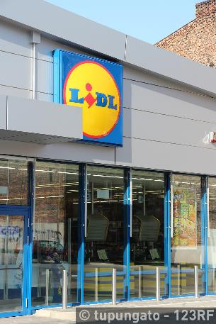
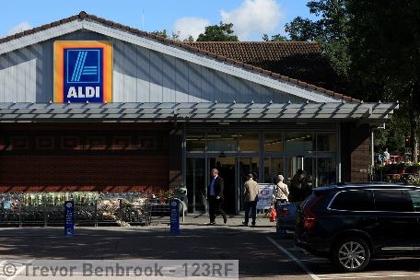
What is price?
Price is the amount the customer will pay or is willing to pay for a product or service.
Example: The price of a tablet PC can vary from very expensive to very cheap.
Establish a price that meets the needs of customers and the tablet sells.
Businesses will therefore research to see what price will satisfy customer needs and enjoy good sales.
Example: Tablets made by Apple come at varying prices for different customer budgets.

Slide 6
Quality
Quality
To a customer quality means getting what they want, or perhaps better than expected; some companies use the term ‘customer delight’

Slide 7
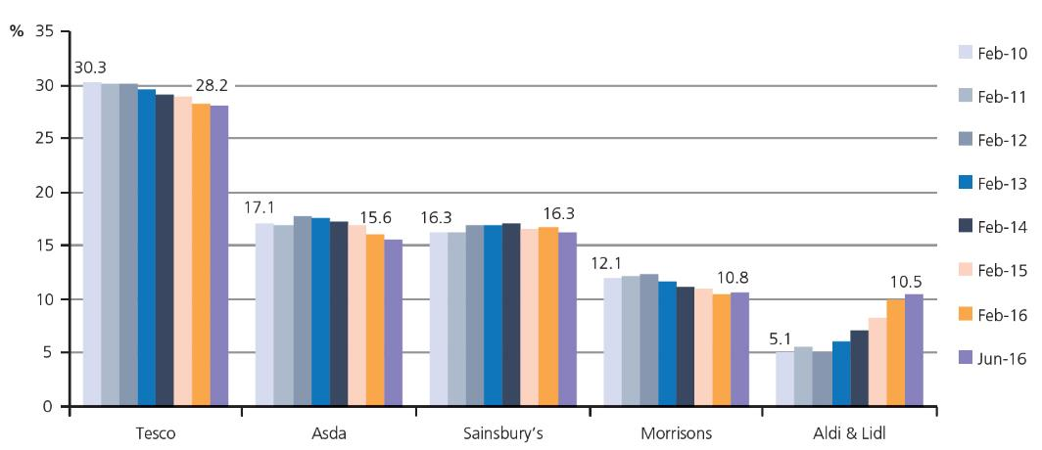
What is quality?
Quality is the features and characteristics the customer needs in the product or service.
Successful businesses provide just the right level of quality to entice customers to purchase their products, rather than go to competitors.
Example: Aldi and Lidl were the biggest winners of Own Label Quality awards in The Grocer magazine in 2015 and 2016.
Unlike Tesco, both managed to create quality products at affordable prices.
Tesco’s market share has fallen steadily to 28.2%.
Aldi and Lidl’s has doubled to 10.5% in the same period.

Slide 8
Choice
Choice
Giving customers options and increasing the chance that the product will be perfect for the tastes/habits of one type of customer

Slide 9
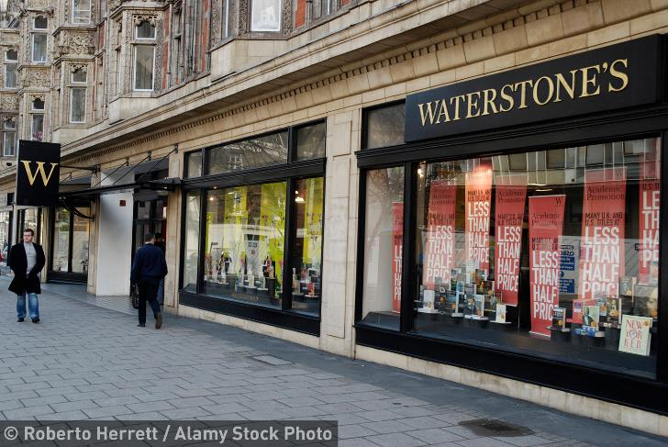
What is choice?
The more customers have the ability to pick between products the more likely they are to purchase a product
Customers can find exactly what they want.
Businesses providing products with variations will have higher costs.
Example: Tesco’s Finest Pizza and Tesco’s Value Pizza – it will cost the supermarket more to make the two products.
However, they will capture more customers by offering a quality and a value choice.

Slide 10
Convenience
Convenience
Making life easier for customers, perhaps by a great location (next to the bus stop) or a product that saves time in preparation or consumption

Slide 11
What is convenience?
Convenience is the ease with which a product or service can be obtained by the customer.
Example: The Grocer magazine runs a shop of the week column.
The main factors for winning are a full range of food, short queues at the checkout and a clearly laid out store.
For other products and businesses there will be different factors, e.g. a car show room positioned on roads leading to main roads and with very good parking.

Slide 12
Efficiency and reliability
Products or services need to be of a good standard consistently.
Careful planning and ensuring each detail is correct will ensure success.
Example: Trains in Switzerland are renowned for their punctuality and service with 88% on time in 2015.
Compare to 81% on trains from the Midlands to London for 2015.
Unreliable products or services will see customers choosing alternatives, e.g. instead of trains cars, buses or planes.
Reliability and efficiency encourage customer loyalty.

Slide 13
The importance of great design
Products that are well designed add a premium that customers are willing to pay more for.
Example: Levi jeans over Tesco jeans.
The key to success for a business is to learn what customers want and then get the right human and other resources to provide the expertise to supply them.

Slide 14
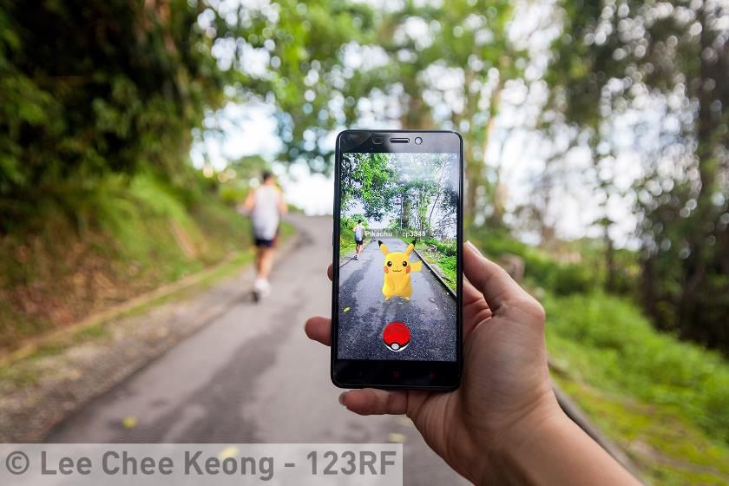
Identifying and understanding customers
Learning why customers like or want something is key to developing a winning product.
This makes it easier to meet their needs and allows a business to remain competitive.
Example: Nintendo realised Pokémon could be used to create a unique game, based on customer knowledge.
Pokémon Go became the biggest mobile download in 2016.

Slide 15
Customer need
Think of two good reasons why it’s important to meet the needs of your customer:
Repeat purchase
Word of mouth promotion – they’ll tell people how good you are

Slide 16
Summary questions
Write down on a piece of lined paper the answers to these questions.
Give an example of how Samsung mobiles compete on price.
Give an example of a product that is said to be of high quality. Explain why.
Give one reason other than price why a person would choose an Apple laptop over a Dell laptop.
Give an example of a product you think has great design. Explain why.
Give one reason why it took Nintendo so long to release the Pokémon Go app.

