Slide 1
Unit 6 Principles of Management
Motivational theories
‘Act as if what you do makes a difference. It does.’
William James, US psychologist

Slide 2
Learning outcomes
What you need to know:
The benefits of motivated and engaged employees and how to improve it
The value of motivational theories

Slide 3
Overview of key concepts
Businesses have a wide choice of tools to help them motivate their workforces.
A motivated workforce is happy at work, will be loyal (thereby reducing labour turnover) and will be more effective (thereby increasing labour productivity).
The methods used take a short- or long-term approach.

Slide 4
Why is motivation important?
A motivated workforce will work more effectively and will be more loyal.
Effective and loyal employees can help to cut costs and maintain sales in a business.

Slide 5
Motivational theories
There are several theories about what motivates a workforce:
Taylor – Scientific Management
Mayo – Human Relations Management
Maslow – Hierarchy of Human Needs
Herzberg – The Two-Factor Theory

Slide 6
Taylor: Scientific Management
Taylor was an engineer and developed his work study ideas in the late nineteenth century. Through his research Taylor decided that workers were more motivated by pay and that:
Workers are not naturally interested in work and therefore need close supervision.
Jobs should be broken down into small tasks.
Workers need training to be as efficient as possible at one of those tasks.
Workers are paid according to the number of items produced – piece-rate; workers would then be motivated to increase their productivity.

Slide 7
Problems with Taylor’s technique
The workforce did not like the principles and did not co-operate.
They only worked hard while being observed.
Taylor appointed special supervisors to stand over the workforce.
Money is not the only incentive and Taylor’s ideas relied too exclusively on motivation by money.
Despite these problems the scientific management approach lasted for a long time.

Slide 8
Mayo: Human Relations Management
In the 1920s and 1930s Elton Mayo conducted research with workers at the Hawthorne Works of the Western Electric Company in Chicago.
Initially he started applying Taylor’s principles of scientific management.
Then he went on to experiment with the effects of varying physical factors on worker productivity.
His sample was a group of ladies who experimenters watched and recorded.

Slide 9
Mayo: Human Relations Management
In all ten physical factors were varied to see how they impacted on the group – all had a positive effect on productivity (even withdrawing tea breaks!).
Each time the productivity rose.
The conclusion was that the group felt important because of the extra interest they had been paid during the research process, and this was what had increased productivity.
Mayo decided that the way people are treated affects the way they work.

Slide 10
Discussion
You can compare the Hawthorne Experiments with your own feelings.
How do you feel when you are singled out for special treatment, or ignored?
Would your prefer to risk upsetting your teacher or parents rather than be ridiculed by your peers?
The pressure of the group is an important factor in motivation.

Slide 11
Mayo’s conclusions
From his experiments Mayo believed :
Workers are motivated by better communications between the management and workforce.
Workers are motivated by greater involvement of the management in the lives of the workforce.
Working in teams in important.
This led to a more human resource style management.

Slide 12
Maslow – Hierarchy of Human Needs
The traditional view of Maslow’s hierarchy of needs
Maslow’s hierarchy is a starting point for managers when considering motivation problems.
Self actualisation
Esteem needs
Social needs
(belonging to groups)
Safety and security needs
Physiological needs

Slide 13
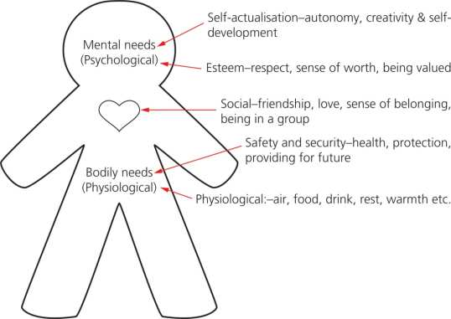
Think about how you felt the first day of 6th form – did you have friends, a sense of belonging?
Once you do not have to worry about the lower orders you can move to the higher ones.

Slide 14
Maslow in the workplace – Discussion
Consider the body on the previous slide.
How could you ensure that the workforce have their needs met at each level of Maslow’s hierarchy?

Slide 15
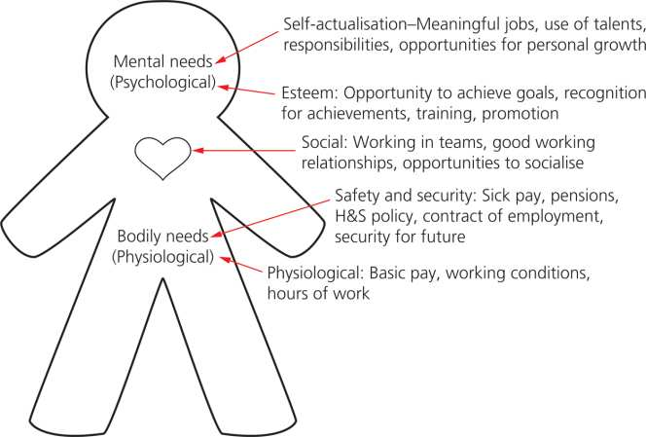

Slide 16
Herzberg: The Two-Factor Theory
Herzberg’s research was conducted in 1944. He interviewed 203 engineers and accountants in Pittsburgh, asking them what incidents made them satisfied and dissatisfied at work.
He found that the causes of dissatisfaction were markedly different from the causes of satisfaction.
He developed the idea of the two-factor theory – job satisfaction and dissatisfaction.
The motivators were factors that can act to motivate employees.
The hygiene factors or maintenance factors can reduce job dissatisfaction but can not motivate on their own.

Slide 17
Two Factors
Motivators – to give job satisfaction
Sense of achievement
Recognition for effort and achievement
The nature of the work – that it is meaningful and interesting
Responsibilities
Promotion and improvement opportunities
Personal growth and development
Hygiene factors – reduce dissatisfaction
Company policies – administration, etc.
Supervision and pay
Employee and employer relations
Working conditions

Slide 18
The influence of Herzberg
One of the main policy recommendations that was developed from Herzberg was job enrichment.
This is the attempt to motivate employees by giving them the opportunity to use their abilities, giving them authority over planning and greater independence.

Slide 19
Are these theories useful to a modern business?
A traditional manufacturing business will have a traditional authoritarian, tall hierarchy with routine monotonous work. It may find that its workforce is motivated mostly by money (Taylor’s approach) but that bringing in teamwork (Mayo’s approach) could help productivity as well.
A well-educated workforce of a modern business may have higher expectations of their employer. They will expect higher levels of recognition, autonomy and involvement (Maslow’s high-level needs and Herzberg’s motivators).

Slide 20
Management theorists 1
MASLOW
HERZBERG
Hierarchy of needs
Five levels of need
Basic needs have to be satisfied before moving to the next stage
Highest stage is self-actualisation (realising full potential)
Two factor theory
Motivators and hygiene factors
Motivators: directly motivate workers
Hygiene factors: don’t motivate but demotivate if not present
Notes:
Maslow’s hierarchy: provide learners with examples of how each level in the hierarchy could be satisfied in the workplace.
Herzberg: provide examples of motivators (the job itself; recognition, status) and hygiene factors (pay and working conditions).

Slide 21
Management theorists 2
Mayo
Taylor
Team work
Better communications with workers
Greater management interest in workers
Looking after employees’ interests (personnel management)
Pay is the main motivating factor
Workers do not enjoy work
Piece rates to increase pay and motivation
Training to improve skills and productivity
Notes:
Ask learners for their view on pay as a motivator.
Ask learners to identify the types of careers they wish to pursue – what is the main motivating factor in their choice of career?
Are learners’ views on what motivates the same?
What challenges are faced by a manager who is managing teams of individuals who are motivated by different factors?

