Slide 1
Environment and business

Slide 2
Environment and business
This section covers the following:
How environmental considerations affect business
Sustainability
Trade-off between the environment, sustainability, and profit
Pressure groups, the environment, and the marketing mix

Slide 3
Key words
Environment
The condition of the natural world that surrounds us, which is damaged when there’s pollution
Environmental considerations
Factors relating to ‘green’ issues, such as sustainability and pollution
Sustainability
Whether or not a resource will inevitably run out in the future; a sustainable resource will not

Slide 4
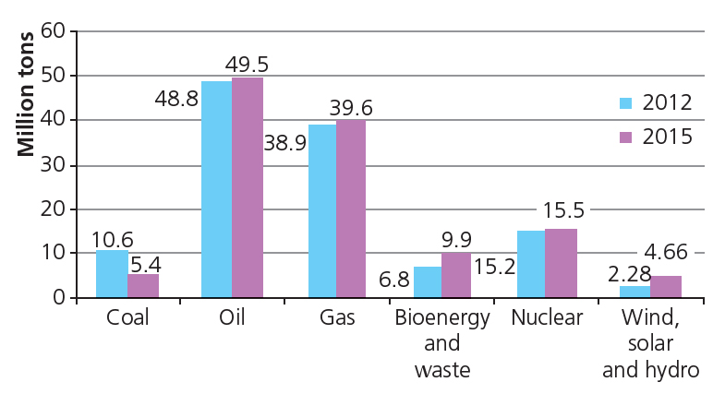
How does environment affect business?
Environment is the condition of the natural world that surrounds us.
Environmental considerations are the factors relating to ‘green’ issues, such as sustainability and pollution.
Stakeholders can value the environment as an important issue. Staff do not want work in a coal mine which is dangerous to their health.
In the long term, businesses will need to ensure they manage their impact on the world to help reduce global warming.
Example: The bar chart shows current UK energy production.
Looking at the chart, why do we still rely on fossil fuels?

Slide 5
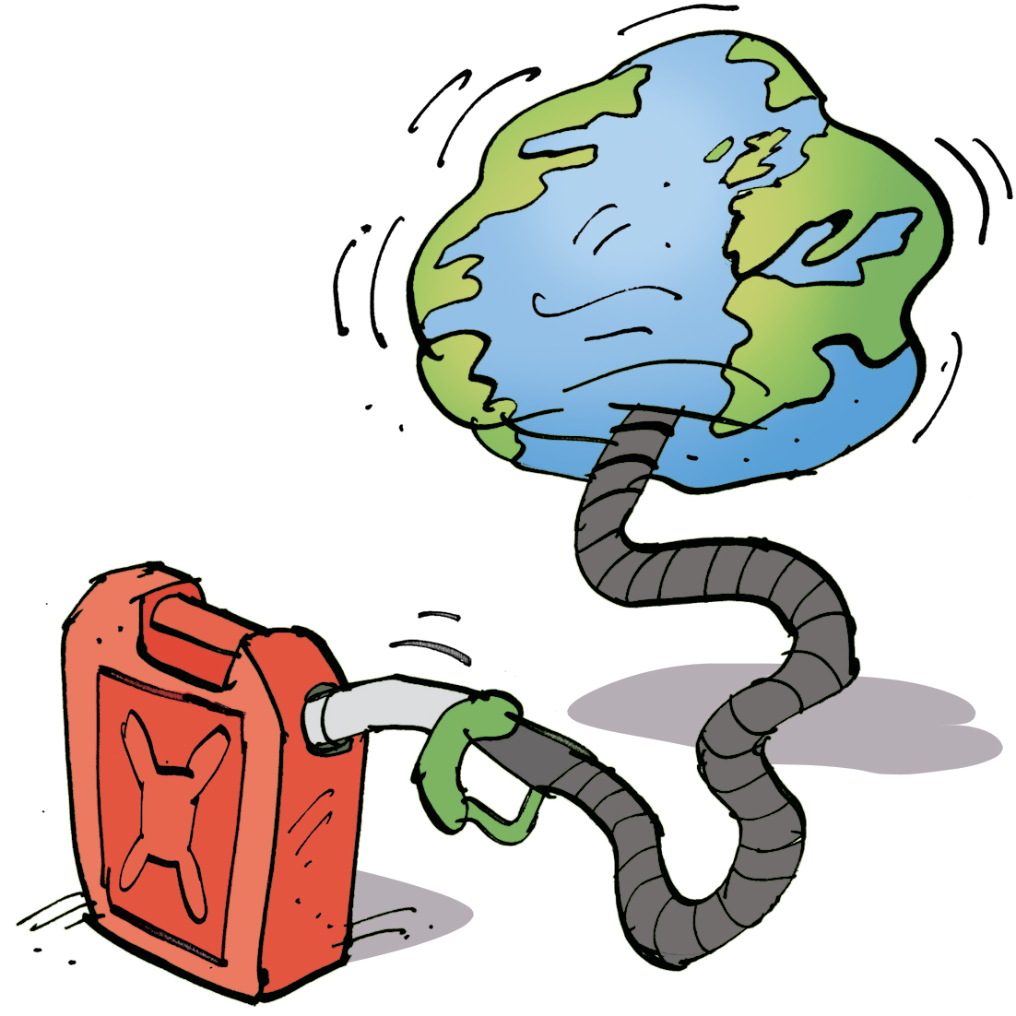
What is sustainability?
Sustainability means whether or not a resource will run out in the future; a sustainable resource will not.
Some products are based on sustainable materials. Can you think of an example?
Wood can be used and trees planted to replace each one used to make products. Under the Forest Sustainability Commission, goods with FSC are from sustainable forests.
Can you think of an example of a product that uses unsustainable resources, i.e. those that cannot be replaced?
Oil, iron ore and coal have been made over millions of years and used to create many products, e.g. plastic, cars, energy to make cars.
Recycling and making products that use sustainable or recycled materials will improve a business’s environmental image.
FSC

Slide 6
Trade-offs
Profit often comes before sustainability, as this is one of the key aims of a business.
Example: Volkswagen created software on cars that gave environmentally friendly exhaust emissions, even though the cars fell below standards for emissions.
Other businesses are based purely on environmental principles. Ecotricity is a business that makes electricity purely from renewable sources.
For most businesses, there is a trade-off between profit and environmental concerns.
Volkswagen
Ecotricity

Slide 7
Pressure groups and the marketing mix
Businesses often think carefully about how their products and services impact on the environment.
Products may be produced from sustainable materials and energy. Apple’s packaging is 99% recycled or sustainable.
Promotion: where products will convince customers they are in some way sustainable or environmentally friendly, e.g. Ecover washing up liquid markets itself as a ‘healthy world begins at home’.
Price: where premium prices can be charged to customers who believe the environment is more important than buying the cheapest product, e.g. Ecover costs £1.60 compared to £0.50 for normal washing-up liquid.
Place: where business are hesitant about selling products with a large carbon foot print, such as lots of food miles, e.g. sourcing beef from local farmers rather than Argentina.
Ecover
Food miles

Slide 8
Summary questions
Write down or discuss the answers to these questions.
What is the environment?
Give a reason why a business may want to make products that are sustainable.
Can you think of a business that may find it difficult to be kind to the environment?
Why might it be profitable for a business to use sustainable raw materials?
How might promoting a product as environmentally friendly lead to more profits?

