Slide 1
Ethics and business

Slide 2
Ethics and business
This section covers the following:
What ethics are
Profit and ethics
How ethical considerations influence business activity
Pressure groups

Slide 3
Key words
Ethics
Weighing up decisions or actions on the basis of morality, not personal gain
Ethical considerations
Thinking about ethics, which may lead to morally valid decisions or may lead to the manipulation of customer attitudes (that is, pretending to be ethical)
Fair trade
A social movement whose goal is to help producers in developing countries achieve better trading conditions and to promote sustainability
Trade-offs
How having more of one thing may force you to have less of another – for example, higher ethical standards may mean less profits

Slide 4
What are ethics?
Ethics means weighing up decisions or actions on the basis of morality, not personal gain.
Simply following the law does not necessarily mean a business is being ethical.
Example: Only paying the minimum wage in an area where living costs are very high may not be morally right as workers will struggle to get by.
Ethics are about doing the right thing in terms of many different business decisions, such as dealings with suppliers, customers and employees.

Slide 5
What about profit?
Profit is always going to be an important factor to a business.
However, increasingly businesses are trying to make decisions in a socially acceptable way.
Example: Ikea is one of a few companies who actually pay above the minimum wage. This clearly decreases profits, but the company believes it is the right thing to do and enhances Ikea’s reputation.

Slide 6
Ethical considerations and business
Often the customer influences the business in terms of making ethical decisions.
Fair trade is a social movement whose goal is to help producers in developing countries achieve better trading conditions and to promote sustainability.
Example: A survey by Global Poverty Project in 2015 found that 74% of those surveyed would pay 5% extra for clothes if it guaranteed workers a fair wage.
M&S is one of the few stores that has a policy of paying overseas workers a fair wage.
However, other clothing retailers such as Debenhams have not risen to the ethical challenge and still pay only the market rate.
To some businesses, ethics are critical to decision making. To other businesses, ethics are only an issue when profits and image are at risk.
Conscious consumer
Fair wage example

Slide 7
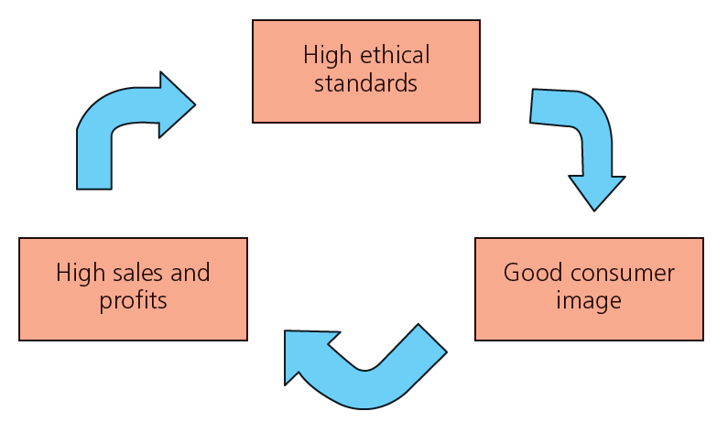
Possible trade-offs with ethics and profit
Businesses may be seen as naturally ethical as they aim to sell products and services that require high standards of quality and service.
Often this comes down to what is called a trade-off.
A trade-off is how having more of one thing may force you to have less of another; for example, higher ethical standards may mean less profits.
The diagram shows that businesses have to balance high ethical standards, with good customer service and high sales and profits.

Slide 8
Go ethical!
Many businesses are increasingly seeing the benefits of being ethical. Oil company BP is investing heavily in renewable technology, even though such technology is not yet profitable.
Other businesses have made a competitive advantage out of being ethical.
Example: The electric car maker Tesla has created the world’s biggest battery-making factory in the US, which is totally carbon neutral.
Carbon neutral means the factory will make no harmful greenhouse gasses, as it gets all its energy from wind and solar sources.
Tesla

Slide 9
What is a pressure group?
Pressure groups are organisations that try and influence business in terms of their ethical behaviour.
For example, Friends of the Earth and Greenpeace are concerned with the environmental impact of businesses, such as oil exploration in areas of wildlife.
Example: the breast cancer fund put pressure on the cosmetic manufacturer Revlon to change how their makeup was made.
They successfully argued that Revlon used cancer-causing chemicals.
Revlon now publishes all its ingredients in its products and has removed all those related that pose a health risk.
Revlon

Slide 10
Pressure groups and the marketing mix
Businesses, particularly multinational companies, will need to respond to issues raised by pressure groups.
Product changes may need to be made, as seen with Revlon.
Price changes may also need to be made if changes to the product mean additional costs. Sometimes costs actually reduce costs.
Example: United Biscuits, the makers of digestive biscuits, has reduced fuel costs in its lorries by using waste oil to run them.
Place may change what is distributed to consumers and how this distribution happens.
Promotion has become essential for businesses to either work with pressure groups or at least be transparent with their customers about their ethical behaviour.
United Biscuits

Slide 11
Summary questions
Write down or discuss the answers to these questions.
What are ethics?
Name one business that you believe acts ethically. Explain why.
What may businesses have to sacrifice if they wish to act ethically?
What is fair trade coffee?
Name a pressure group.
State one way a pressure group could force a business to act more ethically.

