Slide 1
External influences on business

Slide 2
External influences on business
This section covers the following:
What external influences on business are
Responses to changes in technology
Responses to changes in legislation
Responses to changes in the economic climate

Slide 3
Key word
Economic climate
Like the weather, the economy can run cold or hot. The economic climate is a measurement of the current economic outlook, which might be promising or worrying.

Slide 4
External influences and business decisions
Organisations can face problems from external factors which can affect products, people and profits
Business cannot control all external influences, but it can try and make decisions that respond effectively to each change
Decisions need to cover changes in technology, legislation and the economic climate.

Slide 5
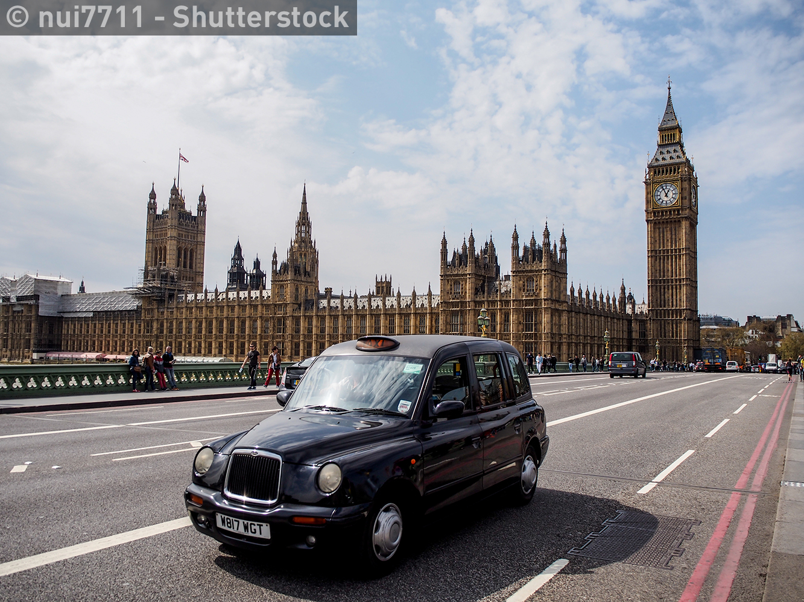
Responses to changes in technology
Technology can affect businesses in many ways,
both positive and negative.
Some technology can alter the way customers purchase a product that the business has to make massive changes to survive. The Uber taxi app has made taxi drivers introduce new services such as
Wi-Fi in cabs to regain a competitive advantage.
When businesses fail to innovate enough when technology changes, it can mean the business fails. The video rental business Blockbuster failed to see the change to downloading films that Netflix embraced. Ever heard of Blockbuster?
Other businesses make a virtue out of embracing technology, seeing it as a way to remain competitive. Amazon has been testing drones to carry parcel deliveries.

Slide 6
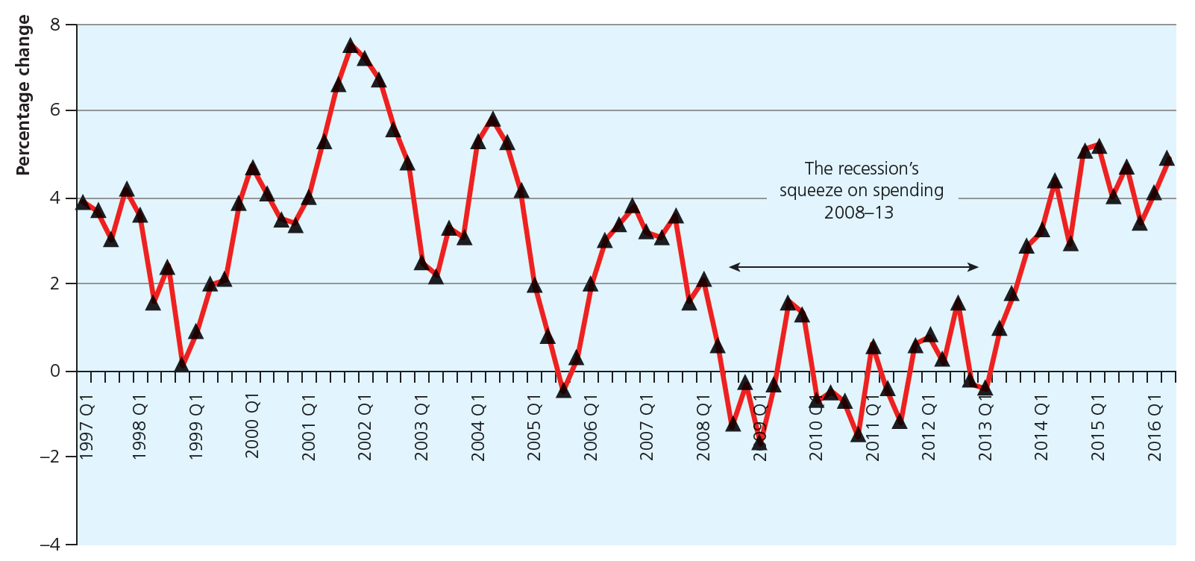
Changing level of consumer income
Consumer income is the amount households have available to spend after income taxes have been deducted.
The graph shows changes in spending by consumers.
As the economy grows consumers tend to feel more confident and spend more on luxury goods such as jewellery
When the economy goes into recession consumer spending reduces
Some businesses have increased
consumer spending even in
times of overall reduction.
UK cinema sales reached an
all-time high of £1bn in 2009.

Slide 7
Responses to changes in legislation
Some types of legislation can offer business opportunities.
Example: The government has introduced
targets to meet at least 15% of our energy
needs through renewable sources such as
wind and solar power.
This has led to a rapid increase in businesses who specialise in building wind turbines and those that install solar panels on home owners’ roofs.
Other legislation restricts business opportunity, such as tougher rules on banks before they lend money for mortgages, reducing profits.
Renewable energy targets

Slide 8
Responses to changes in economic climate
When the economy is doing well businesses tend to hire more staff and grow.
The key to success is planning for future economic change.
To meet the challenges of changes in the economy businesses need to plan for the longer term.
Example: Coca Cola has been introducing
new brands, such as Coke Life, with the goal
of reducing sugar in all its drinks by 2025.
This is in response to countries starting to impose sugar taxes.
Coca Cola and soda tax

Slide 9
Summary questions
Write down or discuss the answers to these questions.
True or false? A business can control external influences completely.
Give an example of a change in technology that has had an effect on taxi drivers.
Give an example of a change in legislation opening up a business opportunity.
Give one reason why business should make long-term plans about the economic climate.

