Slide 1
Finance for growth

Slide 2
Finance for growth
This section covers the following:
Internal sources of finance
External sources of finance
Public limited companies (plcs)
Stock market flotation
Risks and business expansion

Slide 3
Internal finance sources – retained profit
Retained profit is a good way of expanding the business.
The business has no extra costs incurred from using it e.g. interest payable on a loan.
The problem with retained profits is that newer businesses tend to have little available so growth would be slow.
Example: Apple is the first company in the world to have $200bn in retained profits, enough to pay cash for Disney.
Apple

Slide 4
Internal finance sources – selling assets
An asset is something a business owns, such as a building or machine.
The benefit of selling assets is similar to retained profit. The business has no extra costs and keeps control of funding growth.
The drawbacks are that there may be no assets to sell if the business needs it.

Slide 5
External finance sources – loan capital
A business can ask for a loan from a bank or other financial institution to fund growth.
70% of expansion plans in 2015 were funded by bank loans.
The benefit of a loan is that the business does not have to use assets or retained profits to fund expansion.
The drawbacks are that banks charge interest on loans, so there is an extra cost and the loans are often secured on business assets.
A major problem for new businesses is getting a loan as there is no proven track record.

Slide 6
Key words
Flotation
Listing company shares on the stock market, allowing anyone to buy the shares. This means the price can float freely (up and down).
Public limited company (plc)
A company with at least £50,000 of share capital that can advertise its shares to outsiders and is, therefore, allowed to float its shares on the stock market
Stock market flotation
Where shares in a company are openly traded through an exchange open to the public. Shares are now mainly traded via the internet.

Slide 7
External finance sources – share capital
Share capital is the shares issued by a company.
A private limited company cannot advertise shares for sale, so they are normally sold to family and friends. This is one way of gaining funds for expansion.
A drawback is that it relies on those buying the shares having a large amount of money to invest.
A public limited company (plc) is a company with at least £50,000 of share capital that can advertise its shares to outsiders and is, therefore, allowed to float its shares on the stock market.
Flotation means listing company shares on the stock market, allowing anyone to buy the shares. This means the price can float freely (up and down).

Slide 8
Public limited companies (plcs)
Plc shares are normally shown on the stock market, where shares can be bought and sold by the public.
Shareholders in plcs such as Tesco number in the thousands – Tesco has over 8 million shares.
All shareholders have a right to attend an annual general meeting to question company directors.
Those shareholders with the highest number of shares can appoint people to run the company by being directors. One of Tesco’s biggest
shareholders is the Central bank of Norway, with 5.96% of shares.
London Stock Exchange
Tesco shareholders

Slide 9
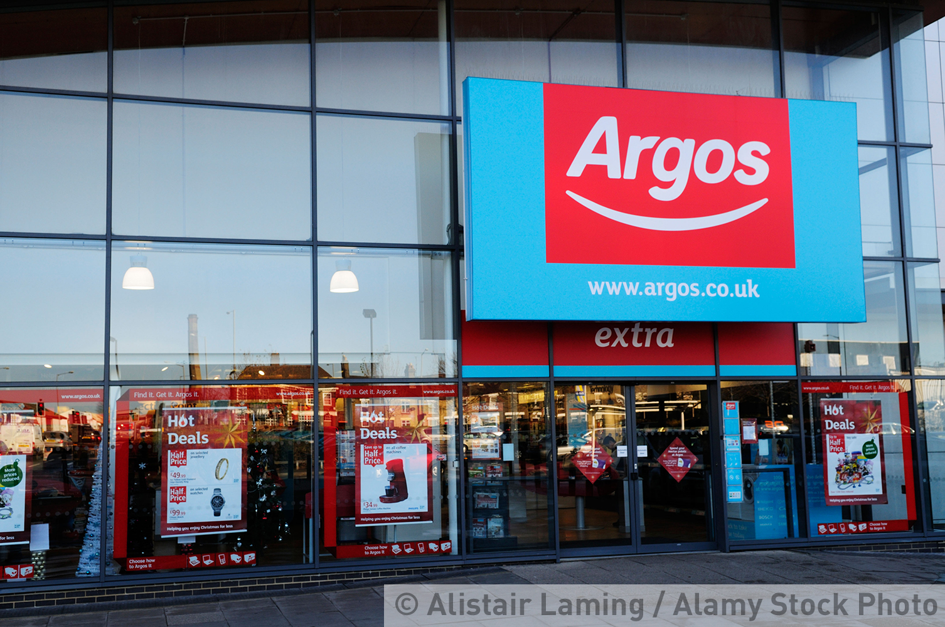
Plcs – benefits and drawbacks
Plcs can raise huge amounts of money for growth and expansion via the sales of shares and other financial methods.
Plcs can also perform mergers and takeovers of other plcs more easily due to their size and financial muscle. US media giant Fox is currently taking over Sky broadcasting for $11bn.
A drawback of a plc is that anyone can buy shares so they are more vulnerable to being taken over.
Example: Sainsbury’s has taken over Argos for £1.4bn in 2016.

Slide 10
What is stock market flotation?
A stock market flotation is where shares in a company are openly traded through an exchange open to the public
Shares are now mainly traded via the internet
Example: Steve Smith started Poundland with one shop in Burton on Trent in 1990. The business has recently been floated on the stock market with shares worth £375m to fund further expansion
The table shows the advantages and disadvantages of a stock market flotation.
Advantages | Disadvantages
Provides a sudden, possibly huge, injection of share capital into the business. An excellent source of capital for a rapidly expanding business (safer than big bank borrowings). ‘Going public’ raises the profile of the business (perhaps making to easier to win big contracts from big companies). | A sudden injection of a lot of money can tempt managers to be too ambitious, e.g. SuperGroup plc, which grew too fast after its 2010 flotation. Suddenly selling so many shares means the founder’s holding may fall below 50 per cent, therefore losing control. The higher profile means shareholders and the media critique each quarter’s results – perhaps encouraging short-term decision making.

Slide 11
Risks and business expansion
When growing fast, there are lots of cash outgoings and perhaps not enough cash coming into the business.
A source of finance is needed to fills this gap.
If the wrong type of finance is used the business has higher risks.
Shares can be less risky for funding growth, as borrowing requires interest payments but shares do not.
Borrowed money requires repayment whereas shares do not have to be repaid. The owner has to sell them on.

Slide 12
Summary questions
Write down or discuss the answers to these questions.
Name one example of an internal source of finance.
Give one benefit of using internal sources of finance for expansion.
What is a difference between a private and public limited company?
Give a benefit of a public limited company in financing expansion.
Give a drawback of being a plc.

