Slide 1
Business Calculations

Slide 2
Business Calculations
This section covers the following:
Why business calculations are important
Gross profit margin
Net profit margin
Average rate of return
Speed and efficiency of service

Slide 3
Key words
Average rate of return (ARR)
Average yearly profit as a percentage of the sum invested. This shows profitability and can be compared with the interest rates available on bank deposit accounts.
Gross profit margin
Gross profit as a percentage of sales revenue (or, for an individual item, gross profit as a percentage of the selling price)
Net profit margin
Net profit as a percentage of sales revenue (or, for an individual item, net profit as a percentage of the selling price)
Sum invested
The cash put at risk when investing in new equipment or a new product

Slide 4
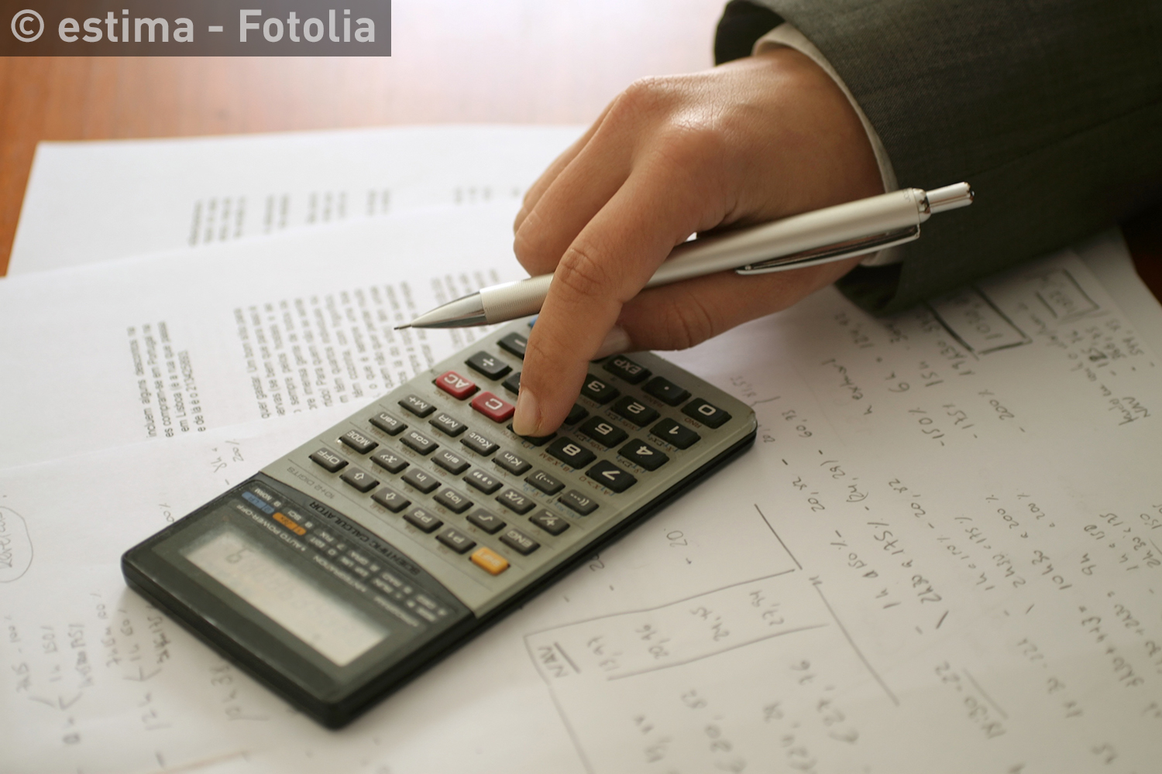
Why are business calculations important?
Business calculations are important to allow financial risks to be considered in a methodical and objective way.
The calculations are used across business and financial institutions to help assess the financial health of the business and any risks.

Slide 5
What is gross profit margin?
Gross profit margin is gross profit as a percentage of sales revenue.
Or, for an individual item, gross profit as a percentage of the selling price.
It is the difference between the selling price and how much it cost.
The gross profit margin formula is:
Example: If a Superdry jacket’s gross profit is £65 with £100 selling price, what is the gross profit?
gross profit margin = gross profit × 100
revenue
gross profit margin = £65 × 100
£100
gross profit margin = 65%

Slide 6
Gross profit margin
At what time(s) of the year might Superdry’s selling price be lower for a jacket?
One time is the January sales, so that the gross profit margin for all Superdry’s products will be a different percentage.
Look at the table comparing Superdry, Ted Baker and French Connection.
Who has the best and the worst gross profit margin?
Increasing the selling price can improve gross profit margin as long as customers will pay.
Cutting the price paid to suppliers can have the same effect, e.g. buying in bulk so supplier costs lower or getting a cheaper supplier.
 | SuperGroup plc (Superdry) Year end 30/04/16 | Ted Baker plc (Ted Baker clothing) Year end 30/01/16 | French Connection plc (French Connection) Year end 31/01/16
Sales revenue | £598 million | £470 million | £164 million
Minus cost of sales | £230 million | £183 million | £88 million
Equals gross profit | £368 million | £287 million | £76 million
Gross profit margin | £368 million × 100 = 61.5% £598 million | £287 million × 100 = 61.1% £470 million | £76 million × 100 = 46.3% £164 million

Slide 7
What is net profit margin?
Net profit is what is left after taking all fixed costs away, e.g. rent
Net profit margin is net profit as a percentage of sales revenue
Or, for an individual item, net profit as a percentage of the selling price.
The formula is:
For example the fixed costs for the Superdry jacket such as renting the store may be £50 when the gross profit is £65 and the selling price £100. Net profit is £65 – £50 = £15.
net profit margin = net profit × 100
revenue
net profit margin = £15 × 100
£100
net profit margin = 15%

Slide 8
Net profit margin
The net profit margin will be different for the business depending on factors such as sales.
Look at the table with net profit margin. Who has the highest percentage? Why?
To improve net profit margin, it is raise gross profit or cut fixed running costs, e.g. smaller retail stores.
Fixed costs could also be cut by having fewer layers of managers, so there are less staff costs
Or cutting back on expensive sponsorship deals such stopping Suderdry sponsoring the Rugby team Leeds Rhinos.
 | SuperGroup plc (Superdry) Year end 30/04/16 | Ted Baker plc (Ted Baker clothing) Year end 30/01/16 | French Connection plc (French Connection) Year end 31/01/16
Gross profit | £368 million | £287 million | £76 million
Minus fixed running costs | £296 million | £228 million | £81 million
Equals net profit | £72 million | £59 million | –£5 million
Net profit margin | £72 million × 100 = 61.5% £598 million | £59 million × 100 = 61.1% £470 million | £5 million × 100 = 46.3% £164 million

Slide 9
Average rate of return (ARR)
Average rate of return (ARR) is the average yearly profit as a percentage of the sum invested.
This shows the profitability of a business and can be compared with the interest rates available on bank deposit accounts.
For example, if a business wants to know the ARR of an investment of £50,000 in a for lift truck which results an extra £5,000 per year.
The 10% ARR can then be compared to other investments, or even just leaving the money in the bank
The higher the percentage the better the profitability.
ARR = £5,000 × 100
£50,000
ARR = 10% per year

Slide 10
ARR – exams
In the exam you may see a table with some data in it – like this example.
The table shows the initial outlay for a Krispy Kreme franchise.
It also shows the estimate of the net yearly cash inflows and outflows generated by the investment.
Finally it shows a column for accumulated cash flow totals per year.
The bottom right hand corner is the important figure as it is the total amount the investment will make during its lifetime.
What is the average profit per year based on the 4th year total of £48,000?
Time period | Yearly profit | Accumulated profit
NOW: the initial investment | –£80,000 | –£80,000
Year 1 | +£10,000 | –£70,000
Year 2 | +£35,000 | –£35,000
Year 3 | +£45,000 | +£10,000
Year 4 | +£38,000 | +£48,000

Slide 11
ARR – exams
Time period | Yearly profit | Accumulated profit
NOW: the initial investment | –£80,000 | –£80,000
Year 1 | +£10,000 | –£70,000
Year 2 | +£35,000 | –£35,000
Year 3 | +£45,000 | +£10,000
Year 4 | +£38,000 | +£48,000
The average profit per year is £48,000 divided by 4 = £12,000.
The ARR formula is:
The ARR for the Krispy Kreme franchise is calculated as follows:
The business would compare this with other investment or the interest on a bank account to help decide if it is a worthwhile investment
The higher the percentage the better the profitability.
However, the risks of investment also need to be considered, i.e., predictions are not very accurate.
ARR = average yearly profit × 100
initial investment
ARR = £12,000 × 100 = 15%
£80,000

Slide 12
Summary questions
Write down or discuss the answers to these questions.
What is gross profit margin?
What is the formula for gross profit margin?
What is net profit margin?
What is the formula for net profit margin?
What is average rate of return?
What is the formula for ARR?

