Slide 1
What can impact the growth of this flower?

Slide 2
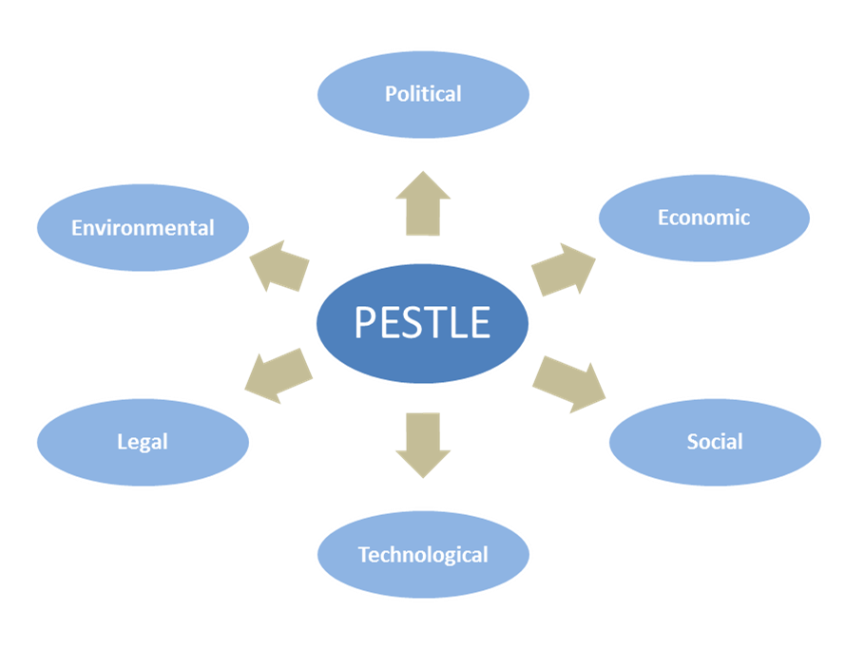

Slide 3
Competition
Competition between businesses can occur at national and international level (Apple and Samsung), local and national level (Sainsbury's and Asda) or in a single town (two local independent hairdressers). It usually occurs between businesses offering the same product, but it can be broader. For example British Gas compete with companies offering other types of fuel or another example is The Guardian newspaper which will compete with other newspapers but also with other news sources such as the internet, television and radio. The demand for a firm's goods and services will be influenced by the strategies of its competitors. If a competitor reduces their prices, introduces new products or runs a successful marketing campaign, then this will lead to a fall in demand for your products or services. The reverse will also apply if your competitors remain inactive. Competition is generally good for the consumer as it leads to cheaper prices or improved quality as firms look to compete. This usually means firms will try to improve the:
efficiency of their operations
cost-effectiveness of their operations
quality of goods or services they provide
​There can be disadvantages of competition though:
quality can be sacrificed in order to compete
businesses may use unethical practices in order to keep costs down (e.g. Nike)
the resources used to promote the business could be better spent on product development
can force other competitors out of the market leading to redundancies and unemployment
larger businesses can merge or takeover smaller ones leading to less choice or rising prices

Slide 4
 | Investment in new equipment and technology | Improvements to operational procedures | Effectiveness of the marketing mix | Innovation through investment in research and development
What does this mean?
What impact will this have on costs?
What impact will this have on demand?
Business example

Slide 5
 | Financial planning and control | Incentive schemes for staff | Quality procedures | Staff skills, education and training | Enterprise
What does this mean?
What impact will this have on costs?
What impact will this have on demand?
Business example

