Slide 1
Franchising

Slide 2
Franchising
This section covers the following:
Why entrepreneurs franchise
Starting a franchise
Benefits of a franchise
Drawbacks of a franchise

Slide 3
Key words
Franchising
Paying a franchise owner for the right to use an established business name, branding and business methods.
Royalties
Percentage of the sales revenue to be paid to the overall franchise owner.
Entrepreneur
A person who sets up a business and takes on financial risks in the hope of profit.

Slide 4
Why franchise?
Franchising means paying a franchise owner for the right to use an established business name, branding and business methods e.g. McDonalds or Burger King.
Businesses franchise because:
they can expand sales quickly before competitors fill the market
a franchise owner gets an amount of money for the franchise plus a share of the profits, e.g. Subway receive 8% of each stores profits
the franchise owner can concentrate on developing new products.

Slide 5
Starting a franchise
Instead of a business having to plan, create and make a new product, they can buy into a product that has already become well established.
Risks of failure therefore become much smaller
Example: A McDonald’s franchise in 2015 cost up to £400,000.
Average profits for a franchised restaurant are £400,000 per year.
In other words you get your money back after one year.
Fast food owners
Fast food profit

Slide 6
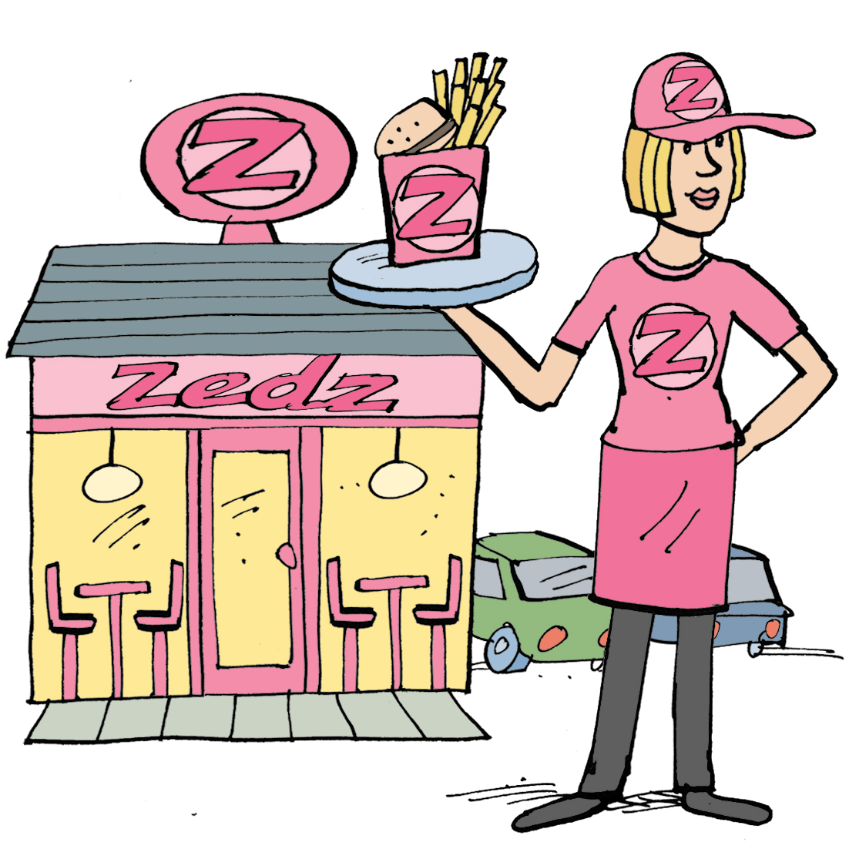
Benefits of franchising
The person buying the franchise gains all the benefits of the image, along with training and equipment on how to produce the product.
As part of a large brand the owner can benefit from big advertising campaigns they could not otherwise afford
The products and methods have already proved to be successful so risks are smaller.
As a result franchises are very popular

Slide 7
What are the drawbacks of franchising?
Royalties are percentage of profits that have to be paid to the owner of the franchise.
A royalty has to be paid each year even if sales and profits are falling.
The entrepreneur taking the franchise will fi have less control over the business and the way it operates. Domino’s cannot suddenly decide to sell steak simply because local customers want this option.
Not all franchises are a good business investment. Krispy Kreme donuts franchised stores too close together, meaning little profit for those buying the franchise.
Franchise risks

Slide 8
Summary questions
Write down or discuss the answers to these questions.
Name a business that is franchised.
Give one benefit to the owner of the franchise of franchising.
Give one drawback to the owner of the franchise of franchising.
State one reason a new business may want to buy a franchise.
State one reason a new business may not want to buy a franchise.

