Slide 1
Globalisation

Slide 2
Globalisation
This section covers the following:
What globalisation is
The impact of globalisation on businesses
Barriers to international trade
How businesses compete internationally

Slide 3
Key words
Globalisation
The increasing tendency for countries to trade with each other and to buy global goods, such as Coca-Cola, or services, such as Costa Coffee

Slide 4
What is globalisation?
Globalisation is where countries trade with each other to buy global goods, such as Coca-Cola, or Costa Coffee.
As a small island like the UK has always had to trade with other nations, such as selling cars to China and India.

Slide 5
Key words
Competing internationally
Finding a way to succeed against rivals from overseas
Imports
Goods or services bought from overseas

Slide 6
Imports
Imports are goods or services bought from overseas.
There are three types of imports:
goods that we do not grow or make, e.g. coffee
goods that require a lot of low skilled labour, e.g. clothes
goods that are made in the UK and abroad using high technology and highly skilled labour, e.g. cars.

Slide 7
Competition from overseas
Competition can be from products that are also produced in the UK.
Cars such as German BMWs compete with UK produced cars, such as Ford and Jaguar.
Businesses will use technology and the marketing mix to try and gain a competitive advantage, such as Jaguar introducing an electric luxury saloon car.
Jaguar electric saloon

Slide 8
Buying from overseas
There are many consumer products that come from overseas. Most products in Poundland are made in China to keep costs very low.
Producers of goods in the UK may also get their raw materials from overseas.

Slide 9
Key words
Free trade
Trade between countries with no barriers, for example no tariffs
Tariffs
Taxes charged only on imports
Trade blocs
A group of countries that have agreed to have free trade within external tariff walls

Slide 10
Exports
Exports are UK produced goods or services bought by an overseas customer.
Sales of exports help to pay for purchases of imports.
Exporters need to keep costs low to charge low prices
Exporters need to produce well-designed, unique goods and services. JCB is a large UK business that exports construction equipment worldwide, with 3% of its turnover always being spent on R&D.
Exporters need to deliver on time and to a high quality.
JCB exports

Slide 11
Changing business location
Businesses may decide where they manufacture or are based for many reasons:
To reduce tariffs to gain local competitive advantage, e.g. Jaguar Land Rover setting up factories in China
To reduce costs – e.g. factory workers in China get paid significantly less than the UK
To gain skills unavailable in their current location – e.g. in 2017 Snapchat announced they were moving location to London due to the high level of creative talent available there

Slide 12
Barriers to global growth – tariffs
Tariffs are taxes charged on imports.
The effect of a tariff includes:
protecting home producers
encouraging local consumers to buy local products as a way of protecting and growing local businesses.
Example: The UK steel industry has been struggling to compete against very cheap Chinese imports, so 73% tariffs were placed on such imports in 2016 to try and protect jobs.

Slide 13
Barriers to global growth – trade blocs
Trade blocs are groups of countries that have agreed to have free trade within external tariff walls.
Currently the UK is a member of the European Union (EU) which allows members to trade without any tariffs across all member states.
However, cars from the US have a tariff applied to them so makes it more difficult for the cars to be priced competitively.
Which country do you think US car manufacturers have moved production to in the NAFTA trade bloc?

Slide 14
Use of the internet and e-commerce
For small businesses in particular, e-commerce has allowed them to compete globally.
Example: Kevin Flood created the website Shopow, which allows users to compare stores around the world. Even Justin Bieber has YouTube to thank for his ride to fame!
Large businesses have been able to harness the power of the internet to promote and sell products. EBay is the world’s number one auction site but Chinese competitor Alibaba is expanding rapidly.
Internet successes

Slide 15
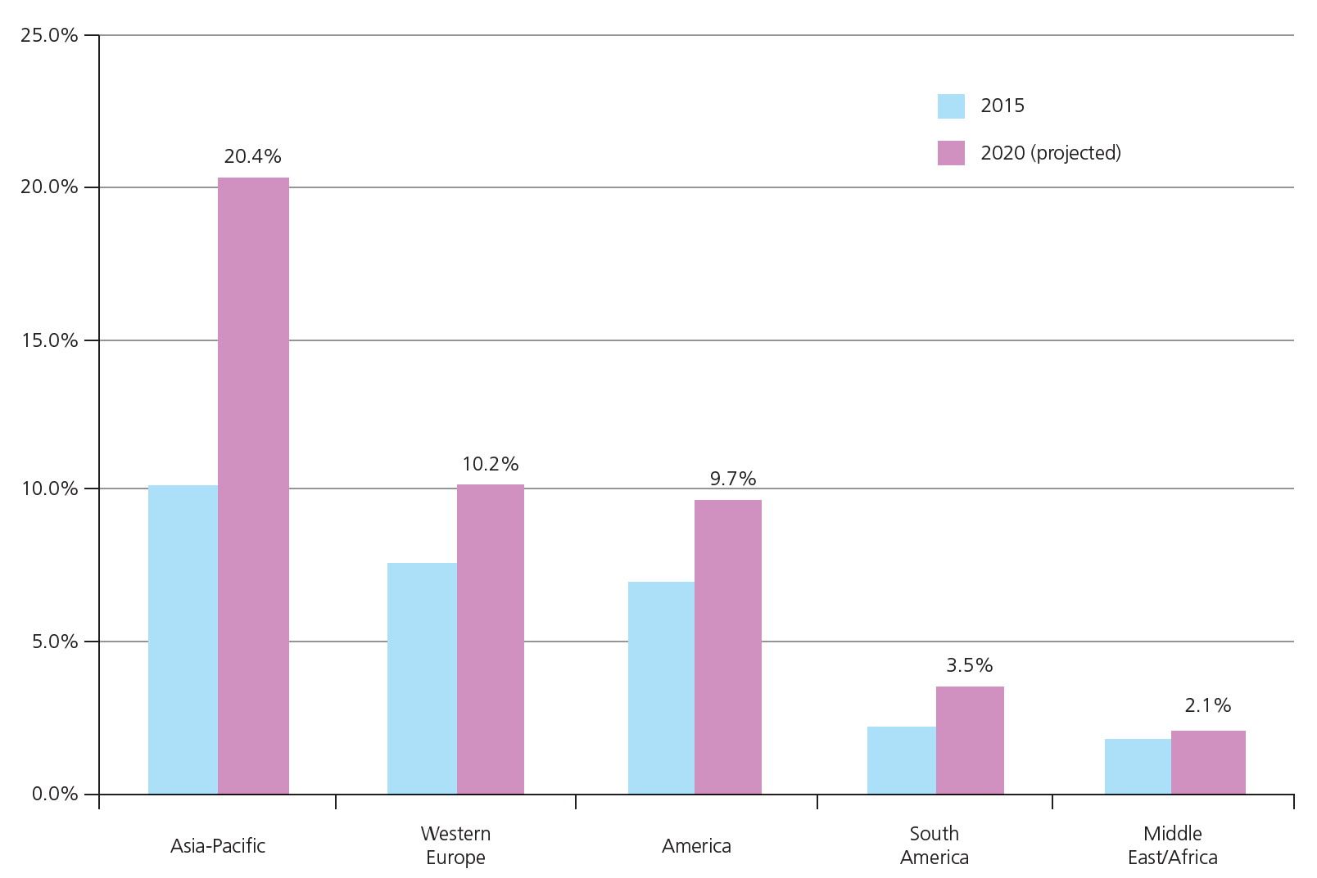
Changing the marketing mix
Product: the costs of different features required in different countries are built into the global price of the product. Nissan builds left-hand and right-hand drive cars
Price: a product may be seen as having a higher premium in one country than another. Jaguar cars have a premium price in the US where they are a valued brand – perhaps more than the UK.
Promotion: businesses often need to advertise their products to different local markets, taking into account cultural and social differences
Place: countries have varying levels of development, such as access to the internet
The bar chart shows the level of e-commerce sales in different parts of the world.
Which has the lowest level of e-commerce? Why?

Slide 16
Summary questions
Write down or discuss the answers to these questions.
What is free trade?
What is globalisation?
Give a drawback to UK businesses who have to compete with overseas businesses.
What is a tariff?
What is a benefit for a business of being a member of a trade bloc?
What is a drawback for a business of being a member of a trade bloc?

