Slide 1
9.1 Assessing a change in scale
How to manage and overcome the problems of growth and retrenchment

Slide 2
Learning outcomes
You should be able to understand:
How to manage the challenges and assess the impact of growth or retrenchment.

Slide 3
Overview of key concepts
Business change their size and scale throughout their lives.
This can bring them advantages and disadvantages.
The aim is to grow to become more competitive.

Slide 4
Greiner’s growth model
Fast growth can cause problems. As workloads grow, so do spans of control, as well as stress levels for all.
Greiner’s model explains the problems businesses encounter during the stages of growth, the crises that can occur and how businesses can survive.
The longer each phase lasts for a business, the harder it is to make the transition to the next phase. The business (like people) gets stuck in its ways.

Slide 5
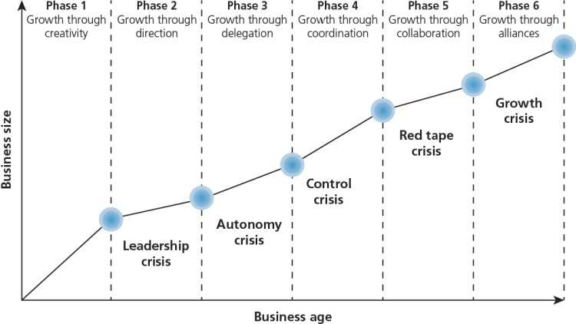
Greiner’s model of growth
Draw this across the top half of your A3 sheet

Slide 6
Phase 1: growth through creativity
Entrepreneurs are busy creating product and opening up new markets.
There are few staff, so communication is informal.
Long work hours are rewarded with profit share or stock options.
As production increases, capital is invested and there needs to be more formal communication.
There occurs a leadership crisis because professional management skills are needed. Founders may change their style to take on this role, or bring in someone from outside.

Slide 7
Phase 2: growth through direction
Formal communications are continued, with a clearer focus on budgets and separate activities like marketing and production.
Incentive schemes (non-financial methods of motivation) are introduced.
Managers cannot know about every aspect of the business (as in Phase 1).
Ends in an autonomy crisis where new structures based on delegation are needed.

Slide 8
Phase 3: growth through delegation
Top management concentrate on monitoring and developing strategies (possibly external growth).
Middle managers can react fast to opportunities in new markets or products.
Many businesses struggle here, as entrepreneurs who understood the entire business in Phase 1 struggle to delegate. Middle managers can also struggle to understand their role as leaders.
Phase ends with control crisis – more sophisticated functions and structure are required; the separate parts of the business have to work together

Slide 9
Phase 4: growth through coordination and monitoring
Business reorganises itself into product or service groups.
Finance is controlled by the HQ, and ROI (return on investment) is critical, not just profit.
Incentives are through a company-wide profit share scheme and are aligned to corporate aims.
Increasing amounts of bureaucracy: growth is stifled.
Phase ends in ‘red tape crisis’ – a new culture and structure must be introduced.

Slide 10
Phase 5: growth through collaboration
The formal controls introduced during Phases 1–4 are replaced by professional staff.
A matrix structure, supported by sophisticated information systems.
Financial rewards are team-based.
Phase ends with internal growth: further growth can only come by developing partnerships with complementary organisations.

Slide 11
Phase 6: growth through extra-organisational solutions
This phase was added after Greiner first proposed the model.
Growth continues through external growth.
Growth includes finding solutions involving other companies.
There are clear links through this model to all of the previous units: managing people, choosing a strategic direction, setting corporate objectives, managing the separate functions.

Slide 14
Issues involved with managing growth

Slide 15
Economies of scale
Economies of scale can reduce the unit cost of production, but can cause issues with growth.
As businesses grow, they can benefit from economies of scale, such as:
Large businesses can invest heavily in technology to improve, while this is not always possible for small businesses.
Large-scale businesses can purchase in bulk and benefit from discounts. They may also be able to buy directly from manufacturers (instead of wholesalers) and ensure that they supply the business’s exact needs.
Large-scale businesses can hire specialist managers for different functions: this can lead to better planning.

Slide 20
Economies of scope
This refers to the average cost for a firm in producing two or more products.
As businesses grow, they can benefit from economies of scope because the risk is spread across several products.
Consider Dyson – their range has increased considerably over the years from just one or two vacuums to a vast selection of stand-up, hose and even hand-held vacuums.

Slide 22
Economies of scope (economies of diversification)
Examples of economies of scope include:
Extending product range to benefit from the value of existing brands
Using a specialist expertise or competency to benefit a range of different products (graphic designers in large company)
Using current equipment to make a range of products
Using the same storage space (fast food)
Branches offering multiple services
Flexible manufacturing
Same products sold to different types of companies (Kleenex)

Slide 23
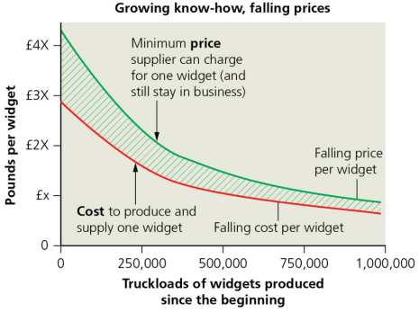
The experience curve
Also know as the learning curve.
As the business produces more products (widgets in the graph), the unit cost is reduced, which enables the business to charge a lower price.
Think about how quickly you can now do simple business calculations – you should have improved and got quicker (hopefully more accurate) since the beginning of the course!
Growth is an important part of reducing the unit cost and making the business more efficient.

Slide 24
Synergy
The concept that the value and performance of two companies combined will be greater than the sum of the separate individual businesses.
Businesses look for synergy when going through external growth: mergers and acquisitions.
Problems can occur when the promised synergy does not occur.

Slide 25
Overtrading
When growth happens quickly, the business may face problems associated with overtrading.
This means it is engaged in more business than can be supported by either the market or the funds which are available.
Rapidly growing businesses may take on orders they cannot fulfil.
Small businesses may have poor credit control (money owing from customers may not be collected efficiently) – this leads to cash flow problems.
Overtrading can therefore cause major liquidity problems for expanding businesses.

