Slide 1
10.3 Managing strategic implementation
Implementing Strategy

Slide 2
Learning outcomes
You should be able to understand:
How to implement a strategy effectively.
The value of leadership, communication, organisational structure and network analysis to implementing an effective strategy.

Slide 3
Overview of key concepts
A strategic plan has to be planned correctly. If resources are identified – especially the people who should carry out the plan – then it is more likely to succeed.
The organisation’s structure, leadership and communication will influence the way the plan is carried out.
The planning can take the form of a diagram that also identifies the critical path analysis.

Slide 4
Strategic implementation
Definition:
The process of allocating resources to support the chosen strategies.
Resources can be people, money or equipment. These resources would have to be monitored to ensure that the strategy was implemented effectively.

Slide 5
Corporate planning process
Mission statement/aims
Objectives
Internal environment
External environment
SWOT analysis
Strategic choice
A map of the corporate planning process. Once managers have taken all things into consideration and made their strategic choice it is time to implement it.
Strategic implementation
Control and evaluation

Slide 10
The value of leadership
It is the leader’s responsibility to pick the right team for the job of implementing the strategy. A team structure is created with group leaders who are accountable and responsible for their team to meet their deadlines. Good leaders will take care over this process.
Leaders will have to explain and educate about the need for change – why is it important and what is wrong with the way things are done now?
Leaders have to monitor the implementation process so that they can ensure the change is happening to agreed timescales and budgets. The leader would create this monitoring system.
If a suitable leader is not in place to guide a change then the chances of success are minimal.

Slide 11
Types of leadership styles and influences on these
McGregor X – workers lazy and need close supervision.
McGregor Y – workers self motivated and as such can solve problems.
Authoritarian – close controls, direct supervision.
Laissez-faire – power to make decisions given to subordinates.
Paternalistic – parental figure caring for workforce.
Democratic – sharing decision making through groups.
Bureaucratic – must follow rules and procedures.
Tannenbaum Schmidt continuum – boss or worker centred.
Blake Mouton grid – greater concern for people or the production.

Slide 12
Leadership and change management
The leadership style will affect how the change is managed within a team.
Bureaucratic or production oriented style will lead to a process driven approach to the change.
Whereas a democratic or people orientated style will lead to a team based people approach to the change.
Both styles are valid in the right situation – it just depends on the change, the type of workers and the type of work.

Slide 13
The value of communication
As with all change management the strategic plan then needs to be communicated to the key stakeholder for it to be implemented effectively.
Managers need to:
Communicate the objectives of the plan.
Communicate the team’s roles and responsibilities for the plan.
Evaluate and communicate the performance measures.
Communicate the review of the outcome of the plan.

Slide 14
Communicate objectives of the plan
So that all team members can get on board any change then they must understand:
The plan’s contents
The purpose of the change
The objectives of the plan.
If managers can communicate with key stakeholders throughout the process then they have more ownership of the change.
The objectives must have a realistic time frame so that they can be implemented successfully.
See Unit 10.1 Kotter and Schlesinger’s six ways of overcoming resistance to change.

Slide 15
Communicate the team’s roles and responsibilities for the plan
The team which is given the responsibility of carrying out the plan needs to have employees’ designated responsibility for implementing the key aspects of the plan.
This will avoid duplicating efforts or completely neglecting tasks.
The leader of the project or plan should take overall responsibility for the plan and then define the roles needed and the employees who will take on those roles.
The responsibilities – who will do what – should be communicated to the team so that everybody knows exactly what they should do.

Slide 16
Organisational structure
The organisational structure of a business affects how successful the implementation of a plan will be.
If the structure is very formal (like the traditional functional or product based structures), then the rules and procedures which give the business its culture will also dominate how it implements its plan. These structures tend to be more formal with more layers of hierarchy and autocratic style of leaderships.
If the structure is less formal (a flatter structure with a wide span of control for managers) then the rules and procedures will be less formal as well. This may lead to more innovations and employees having a flexible approach to roles.

Slide 17
Organisational structure
How centralised the decision making is in a business will also affect its implementation of strategic plans.
If the business has a centralised structure where decisions are made by a few top managers and delegated then it may take time for decisions to be made, innovation may be lost and this may cause costs to increase.
If the business is decentralised (for example, into functional areas or regional areas) then decision making is dispersed throughout the business. This means more ideas are produced and the managers feel empowered to implement plans in their own way.

Slide 18
Organisational structure
The degree of specialisation within a business can affect how effective the implementation of a strategy is.
A matrix structure is an example – a group of specialists will be brought together to implement a change. These specialists are given the autonomy to make decisions and decide how the implementation should proceed, which can speed up the change process.
The opposite is a generalist structure: managers here will be typically low in specific knowledge – the manager may have to guide the team members through the tasks, and this may slow any implementation of a strategy.

Slide 19
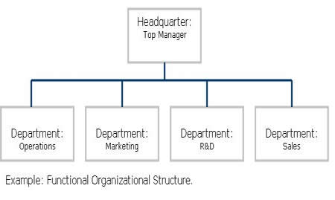
Organisational structures
Functional – consists of activities like coordination, supervision and task allocation, i.e. HR, finance, marketing, etc.

Slide 20
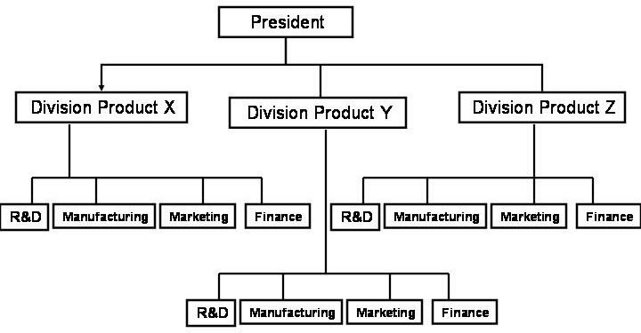
Organisational structures
Product – built around the product portfolio of a business, e.g. Coca-Cola has different divisions for each product they manufacture.

Slide 21
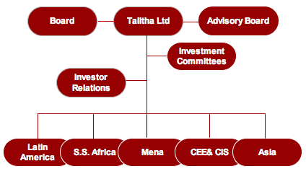
Organisational structures
Regional – allows the business to organise itself into different regions of a country, i.e. a national business may have a northern office and a southern office.

Slide 22
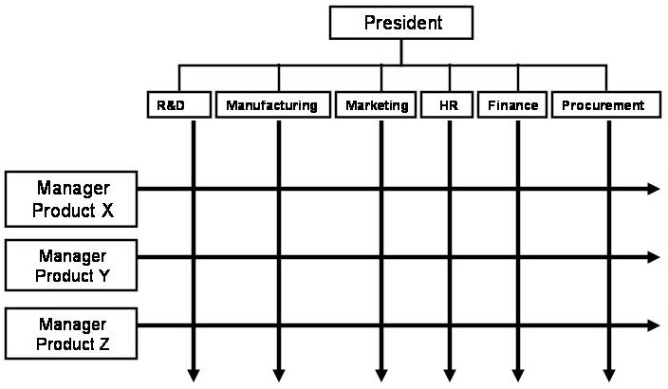
Organisational structures
Matrix – allows for a horizontal flow of skills and expertise to facilitate a project or implement a plan, e.g. bringing a team together to extend a factory.

