Slide 1
The importance of cash

Slide 2
The importance of cash
This section covers the following:
Why cash matters to a business
How cash should be managed
Cash flow problems and business failure
The difference between cash and profit

Slide 3
Key words
Cash
The money the firm holds in notes and coins, and in its bank accounts

Slide 4
The importance of cash to a business
Cash is critical to a business to help pay for its bills, e.g. staff wages, raw materials, rent.
Cash includes bank notes but also money deposited in a bank account, e.g. payments using Apple pay or Android pay.
Main payments of day-to-day cash include:
suppliers
employees
bills called overheads, e.g. gas and electric, salaries, rent and rates.

Slide 5
Key words
Cash flow
The movement of money into and out of the firm’s bank account

Slide 6
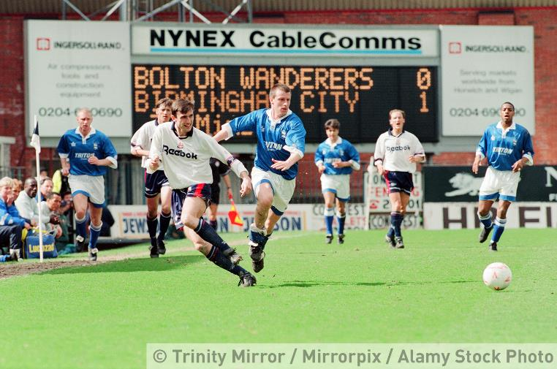
Thinking about cash flow
Cash flow is the movement of money into and out of a business.
Cash flow can be a problem when a business starts up and has to invest a lot of money into hiring staff, building premises, equipment and training.
It can also be a problem when a business grows rapidly, e.g. more sites, staff and training.
Example cash flow problem: In 2015/16 Bolton football club paid their players’ salaries late as they had no cash.
Name a risk to Bolton Football club paying players late.
The Bolton Wanderers squad

Slide 7
Key words
Overdraft
The amount of the agreed overdraft facility that the business uses
Overdraft facility
An agreed maximum level of overdraft

Slide 8
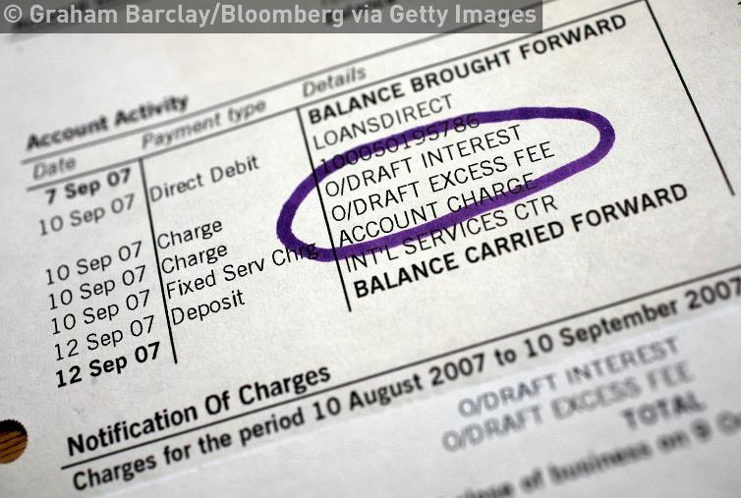
How should cash be managed?
A business must take into account all possible future business costs.
Then create a prediction of cash flowing in an out of the business, known as a forecast.
A flexible way to borrow money from a bank, called an overdraft, will allow the business to cover any cash shortfalls.
Costs need to be kept under control, e.g. staff costs, expenses or mobile phone bills.
Keep customers paying for goods. Businesses often have to wait up to 120 days for payment which means a lack of cash.
An overdraft is a flexible way to borrow money

Slide 9
Key words
Insolvency
When a business lacks the cash to pay its debts

Slide 10
Cash flow problems and business failure
If a business has less cash coming in than it needs to pay out then it is at risk of failing.
In the short term it can try and renegotiate what it owes with suppliers and banks.
If it cannot do this it means it is unable to pay its bills, which is called insolvency.
Example: The large department store BHS was on most British high streets, starting in 1928.
BHS had 11,000 employees and 164 stores when it found it could not pay its creditors.
BHS became insolvent in April 2016, owing £1.5bn. It had to close all its stores. Cash is critical for success.
BHS case study

Slide 11
The difference between cash and profit
Profit is how much money a business is making once all expenses have been deducted.
Cash is the money a business holds in notes and in its bank accounts.
A business can have a profit but no cash.
Example: A business may have sold 10 products at a £10 each, making a profit of £5 per product, i.e. £50.
However, customers may not have paid for the products yet so the business has not got the cash.
The table shows examples of other differences.
Transaction | Effect on cash position | Effect on profit
Borrow £50,000 on a three-year loan | +£50,000 | 0
Sell £30,000 of goods for £40,000, giving the customer three months’ credit | 0 | +£10,000
Pay a supplier £10,000 for goods bought on credit two months’ ago | –£10,000 | 0
Sell £2,000 of fruit bought for £800 cash this morning | +£1,200 | +£1,200
How different financial actions affect cash flow and profit

Slide 12
Summary questions
Write down or discuss the answers to these questions.
Why does cash matter to a business?
Give one example of when cash flow can be a problem to a business.
Give one way of managing cash for a business.
Give an example of cash flow problems leading to business failure.
Explain the difference between cash and profit.

