Slide 1
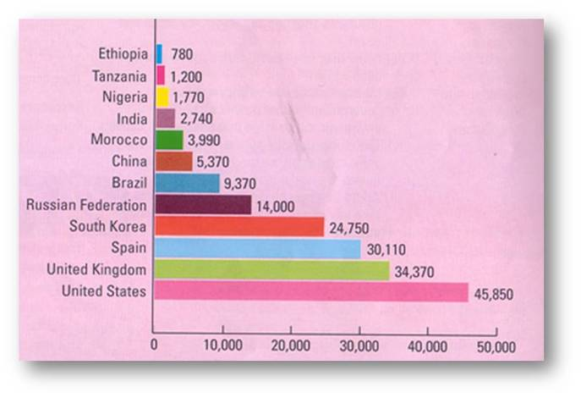
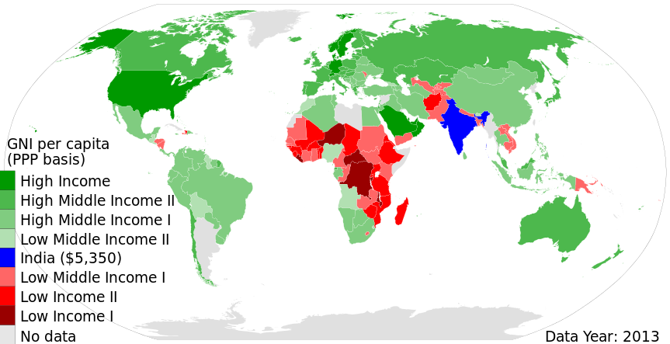
What conclusions can we draw from the above data? (Use the terms: average income per person, developing countries, NICs and developing countries in your answer AND give examples.

