Slide 1
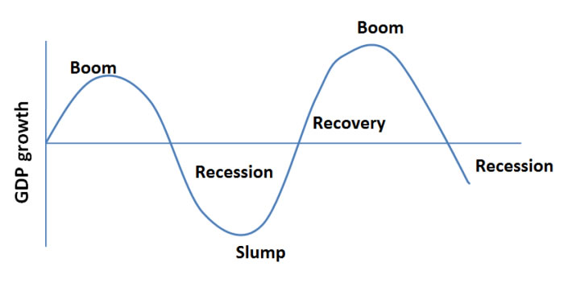
What will be happening to income here and why?
What will be happening to employment here and why?
What will be happening to employment here and why?
What will be happening to income here and why?

Slide 2
Changing levels of income on business costs
If the economy grows and national minimum wage increases, then business costs will increase. This is because wages and salaries are a major element of business costs. If a business judges that it can maintain its profit margin and pass the increased costs on to customers, the price of goods may rise. Where a business judges that by increasing prices, demand may fall too much, it may keep its prices stable and reduce its profit margin.
Wages can be called 'sticky' in that there is usually severe resistance to any attempts to cut them. But during a recession when demand is falling, firms are closing and unemployment is rising, average incomes are likely to fall. A fall in incomes, while having a negative effect on demand, may enable firms to cut their wage bills because employees may be willing to work for less.
Effect of rising income on demand
As consumers' incomes increase, their overall demand for products is likely to rise and the pattern for different products is likely to change.
As demand for goods and services increases, businesses may need to employ more people to meet demand. The labour market is said to 'tighten' because less people are looking for work. This gives more bargaining power to existing workers and potential applicants meaning businesses may have to increase wages or offer higher wages to attract new staff. This could lead to increased costs and potential price increases which may affect demand and competitiveness.
Effect of falling income on demand
When demand falls, excess stock may lead to reduced prices and the business may need to reduce output. This may lead to falling profits or even losses and potentially redundancies or business closures. Businesses producing inferior goods however, may prosper. As demand falls, cost-saving strategies may be introduced. Businesses may cut their training budgets or consider rationalisation. This means reorganising a business to improve efficiency and might mean removing layers of management, closing certain sites or outsourcing work to cheaper countries.

Slide 3
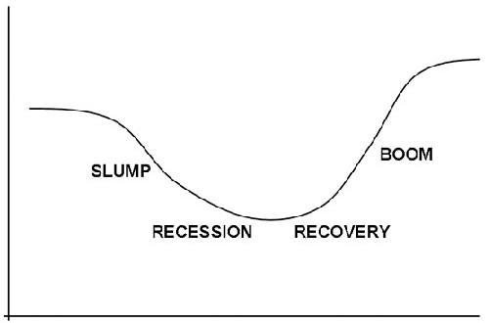
What will happen here to the demand for luxury, essential and inferior goods and why? What other impacts may there be on a business here?
What will happen to business costs here and why?
What will happen here to the demand for luxury, essential and inferior goods and why? What other impacts may there be on a business here?
What will happen to business costs here and why?

Slide 4
Effect of interest rates on business costs
Changes in interest rates affect business costs because interest payments are an element of most business's fixed costs. A fall in interest rates is likely to lead to a fall in business costs. A fall in the interest payments on loans will have a beneficial impact on firms that are highly geared (a firm with extensive long-term loan commitments - a high proportion of capital employed in the form of long-term loans) because fixed costs for these firms will fall. This will reduce unit costs and make it easier to break even. This could lead to businesses reducing prices and becoming more competitive, or leaving prices the same and raising profit margins Demand for products will tend to increase due to falling interest as it becomes less attractive to save money for consumers. This means businesses could expand production. As a consequence, more employees may be needed, leading to increased competition in the labour market - potentially creating skills shortages and an increase in wage costs. A rise in interest rates is likely to lead to a rise in business costs. This means interest payments on loans will increase (for highly geared firms) meaning fixed costs will rise. This increases unit costs and the level of sales needed to break even. Prices may have to rise leading to a fall in demand.
Effect of interest rates on demand
Changes in interest rates will affect demand as the cost of borrowing money will change, affecting people's ability to buy products, especially expensive products such as property, cars and white goods. It also affects their spending on other products as it affects discretionary income.
A fall in interest rates is likely to lead to an increase in demand for consumer and capital goods. saving money is less attractive
mortgage payments and other loan and credit payments will fall - leading to more discretionary income
the cost of goods bought on credit will fall
capital goods bought on credit will become cheaper so businesses will bring forward planned investment, meaning return on projects may exceed interest payments
A rise in interest rates is likely to lead in a fall in demand for goods and services. saving money becomes more attractive
mortgage payments and other loan and credit payments rise
cost of goods bought on credit will rise
capital equipment becomes more expensive to buy on credit meaning return on investment won't be higher than interest payments

Slide 5
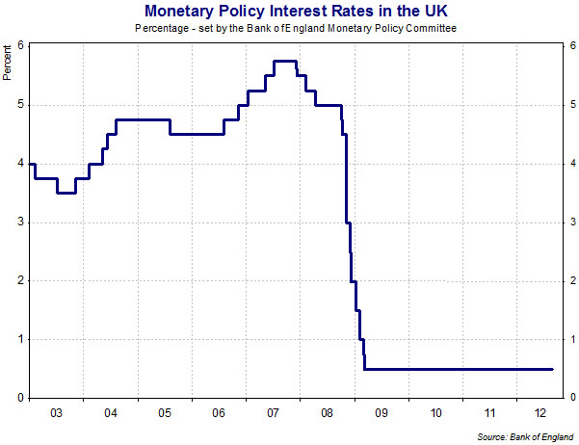
What will happen to business costs here and why?
What will happen to business costs here and why?
What will happen to demand here and why?
What will happen to demand here and why?

Slide 6
