Slide 1
Introduction to the economy
This section covers the following:
What the economy is
What makes the economy go up or down
What business people need to know about the economy

Slide 2
Key words
Economy
The collection of business transactions that takes place throughout the country, in any given year
Consumer spending
The total spent by all shoppers throughout the country
Exports
Goods produced in one country but sold overseas, for example a British-made Mini sold in France
Recession
A downturn in sales and output throughout the economy, often leading to rising unemployment

Slide 3
What is the economy?
The economy is the collection of business transactions that takes place throughout the country, in any given year.
The economy is made up of businesses buying and selling products and services both to each other, customers and the government.
The economy is connected.
This means many businesses make various products and deliver various services to create other products.

Slide 4
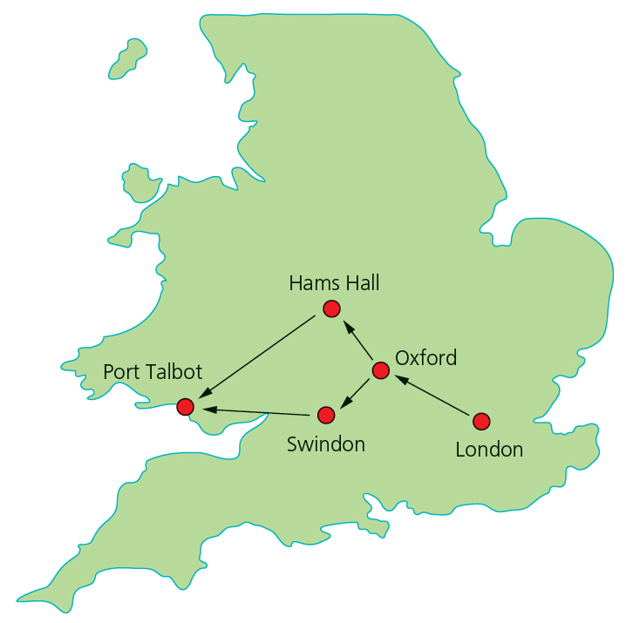
Connected loops and the Mini Cooper
Look at the map showing different places all starting off in Oxford with the creation of a Mini Cooper at the factory.
In Swindon the steel body is made for the mini.
In Hams Hall the engine for the Mini is made.
In Port Talbot the steel is made.
There are over 2,000 businesses involved in making the Mini Cooper.

Slide 5
What makes the economy go up or down?
Trade of Mini Coopers takes place in the UK and, more importantly, with other countries – this is called exports
Exports are goods produced in one country but sold overseas.
The more demand for Minis, and other goods and services, the more jobs for workers and the more profit for businesses.
The opposite occurs, leading to a recession, if there is less demand – see the diagram.
A recession is a downturn in sales and output throughout the economy, often leading to rising unemployment.
The last UK recession was in 2008, the worst for 50 years.

Slide 6
The way interest rates can change
An interest rate is the amount a lender, such as a bank, charges someone per year for money they have borrowed.
Example: If I borrow £100 at a 10% interest rate per year, I will pay £10 interest for the first year of borrowing.
The lower the interest rates, the more likely businesses are to borrow money.
Interest rate are very low in 2017, 0.25%, though loans to businesses are higher.
If a business borrows money when interest rates are low, they can finance growth much more cheaply, have less costs and possibly more profits.

Slide 7
The way exchange rates can change
An exchange rate is the value of the pound measured by how much foreign currency can be bought per pound.
For example, on 11th January 2017, £1 would buy $1.21. £100 would by $121.
Go back to 11th January 2016, and £1 was worth $1.45. £100 would buy $145, an extra $21.
The value of the pound has therefore fallen.
Businesses that export become more profitable. For example, Rolls-Royce cars became cheaper to US buyers.
Businesses that import become less profitable.

Slide 8
The threat of recession
When the economy starts to downturn, demand for goods and services reduces, and consumer spending goes down.
Businesses have to reduce the number of products or services they create to survive.
They have to reduce costs, possibly by cutting a number of employees.
Not doing this quickly enough can result in a business failing.
Well-run businesses have a range of products that can be purchased when consumers have less money, such as Samsung’s cheaper mobiles.
Some business flourish in a recession, like discount shops such as Aldi and Poundland.

Slide 9
Summary questions
Write down or discuss the answers to these questions.
What is the economy?
Give an example of a UK business that exports products.
If the £ buys more US$, which type of business does this benefit?
Thinking about interest rates, when is the best time for a business to borrow money from a bank?
Give an example of a business that will benefit from a recession.

