Slide 1
4.5 Managing inventory and supply chains

Slide 2
Learning outcomes
What you need to know:
Influences on the amounts of inventory held and the choice of suppliers
The management of effective and efficient supply chain including the value of outsourcing.

Slide 3
Overview of key concepts
Managing inventory is part of the lean production approach to operations management.
It involved managing stock levels, which includes raw material, work in progress as well as finished goods.
Manufacturers have to work closely with suppliers to ensure that all stock arrives on time and is of the correct quality for them to manufacture their products efficiently.
Managing inventory is also about matching supply and demand – making enough goods for customers but not too much as that would waste resources.

Slide 4
Influences on the amount of inventory held
Inventories can take 3 different forms
Raw materials
Work in progress
Finished goods
Inventory control is a method that can be used to ensure production matches demand. By holding high inventory levels, a business is able to release additional products onto the market when demand increases. During periods of low demand, the level of inventory can be replenished by producing more than is being demanded
The ideal level of inventory therefore depends on certain circumstances:
Low inventory levels are sensible if a company is located in an area with high rents, or if they have a perishable product and suffers from cash flow problems
High inventory levels would suit a business that gains large cost savings by bulk buying and that has unpredictable peaks in demand

Slide 6
Inventory control chart
Stock control charts show:
Lead times – the time it takes between the order being placed with the supplier and the stock arriving at the factory
Re-order levels – when stock falls to this point then it is re-ordered
Buffer level of inventory – the amount of stock held as a contingency (just in case)
Re-order quantities – the quantity of stock which is re-ordered once stock falls to re-order levels

Slide 7
Buffer level of inventory
As forms try to save costs by minimising storage costs, it is becoming common for suppliers to make smaller but more regular deliveries of inventory, so buffer inventory levels are falling. However, high inventory levels are still maintained in some organisations e.g. hospitals and vaccines

Slide 8
Re-order level
Both the re-order level and the re-order quantity will depend upon:
Supplier’s lead time – how long the supplier takes to deliver once an order has been placed
Demand for the product – the higher the demand, the higher the re-order level must be
Consequences of running out of inventory – if customers can easily switch to a competitor, then it is vital to keep high levels of inventory

Slide 9
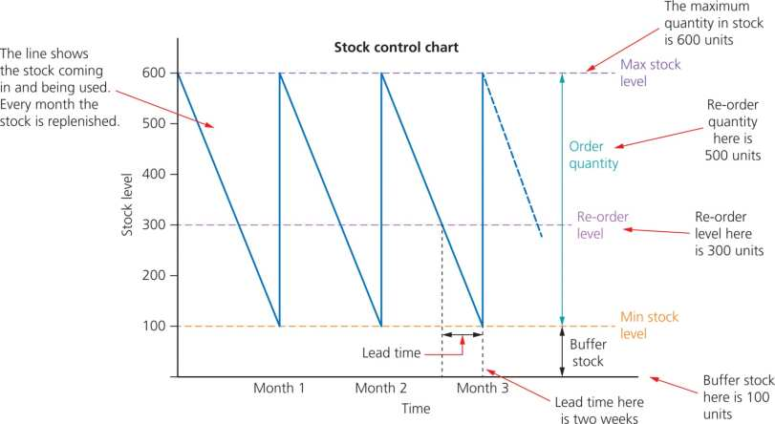
Stock control chart

Slide 10
Inventory wastage
There are a number of causes of inventory wastage:
Raw materials being wasted during storage and production
Defects in production
Pilferage or theft
Damage to inventories during storage and production
Obsolescence – (products becoming outmoded or being kept beyond their sell-by date)
Under inventory rotation, warehouses are designed to make sure that new inventory is not placed in a position where it blocks access to older inventory.

Slide 11
Activity
Please complete the stock control graph.

Slide 12
Improving the efficiency of inventory control
Many firms now realise how vital inventory management is in their operations. Traditionally, businesses kept high inventory levels ‘just in case’ they were needed. However, this lead to the need to sell off unwanted inventory in ‘sales’ at the end of the year. Japanese firms led the way in challenging this idea, arguing that it was a waste of space and inventory , costing the company money. This lead to the introduction of ‘just-in-time’ measures.

Slide 13
Stock control and lean production
With the lean production techniques discussed in Unit 4.3 the stock control should be as follows:
Lead times from the order being placed with the supplier to arriving at the factory would be as short as possible.
The buffer stock should be almost zero to reduce warehousing costs.
The re-order level should be almost zero and the order quantity should only be what is needed. This way stock costs are greatly reduced.
This can only happen if manufacturers work very closely with their suppliers to ensure reliability and consistency.

Slide 14
Just-in-time inventory control
This form of inventory control has a number of implications:
Costs of raw materials are likely to be higher, as smaller but more frequent orders are placed – fewer EoS
Problems may be experienced in getting raw materials on time – delays can halt production and lead to disappointed customers
Costs of storage and insurance fall
Less likelihood of inventory perishing
Production areas are less cluttered

Slide 15
Choosing effective suppliers
What would you look for when considering suppliers?
Prices
Payment terms
Quality
Capacity
Reliability
Flexibility

Slide 16
Price: Value for money – the cheapest is not always the best
Benefits of low prices
Can reduce final selling price gaining competitive advantage
Keep selling price the same but keep the additional profit.
Reasons to be cautious
May be poor quality because of deficiencies
Unreliable in terms of delivery
Not flexible enough to meet changes in demand

Slide 17
Payment terms – credit
Suppliers might offer beneficial payment terms in giving customers a longer time to pay their invoices to win the business.
Helps cash flow – having longer to pay for goods helps ease cash flow problems.
Activity:
In groups discuss the advantages or disadvantages of having a longer credit term from suppliers.
Now consider the advantages or disadvantages of giving longer credit terms to customers.

Slide 18
Quality
The suppliers must be delivering a consistent level of quality all the time.
As manufacturers carry almost no buffer stock if the quality is not there, there is nothing to replace it on the production line.

Slide 19
Capacity
Capacity is really important if the supplier is providing a unique product for the organisation as they may have nowhere else to source it from.
Many organisations would prefer to spread risk; to have two suppliers rather than rely heavily on one supplier.
This is a problem for smaller farms or food manufacturers trying to get into supermarkets.

Slide 20
Reliability
Measures of reliability:
The percentage of deliveries made on time – This is important because if businesses are producing goods to order or operating JIT then deliveries being made on time is vital, otherwise the production line could stop.
How much the supplier meets its terms of contract – The contract is the binding agreement between the customer (the business) and the supplier. If the supplier does not meet the terms, like supplying responsible quality goods, then the reputation of the customer could be at stake, as well as increasing costs.

Slide 21
Flexibility
When flexibility is needed:
If a vital supplier goes under leaving the business short
If there is negative publicity over ingredients or components
If there are transport difficulties so deliveries are delayed
Sudden changes in demand for a product

Slide 22
How to manage the supply chain effectively and efficiently
The effectiveness and efficiency of a supply chain can be measured by its contribution towards the achievement of the firm’s operational objectives:
Low costs
High quality
Speed of response
Flexibility
Dependability
Environmental objectives
Added value

Slide 23
Traditional approach to supply chain managament
Viking – (‘volume is king’)
A term used to describe the policy of buying huge quantities in order to get the lowest possible price
The business would try to ensure that supplies were sourced as cheaply as possible and have sufficient quality
Few attempts were made to intervene in the management of other businesses in the supply chain – however, some businesses did try to manage the whole chain by buying up other businesses within the supply chain

Slide 24
Vertical integration
This is a method where businesses can guarantee the reliability, quality and flexibility of their suppliers:
They buy their suppliers!!!
Buying up the supply chain means they are in charge of what happens.
Pepsi and KFC

Slide 25
Modern approach to supply chain management
More organisations have moved towards buying smaller quantities from a number of different suppliers
This alternative approach provides more flexibility and may create competition between suppliers, resulting in improvements in quality
These changes have been a response to shifts in consumers’ priorities, from price to quality and flexibility

Slide 26
Porter’s value chain and suppliers
Porter states that a business can gain a competitive advantage in one of two ways:
Cost advantage
Differentiation
Working with suppliers, a business can achieve both of these benefits
It can gain a cost advantage if it is able to find a supplier offering the lowest possible prices
If a supplier is able to provide a unique product or material, then differentiation can also be achieved
A supply chain based on just-in-time methods can provide speed of response, flexibility and dependability
A well-managed supply chain can prioritise quality at every stage

Slide 27
Summary
To enable lean production techniques to be as effective as possible, thereby ensuring the business is as efficient as possible, manufacturers have to work very closely with suppliers as well as understanding customer needs.
Matching the supply of goods coming into the factory with demand for goods going out of the factory is a complex management technique with many variables.
The key is to work as closely as possible with reliable suppliers who will give you the best payment terms.

