Slide 1
Legislation and business

Slide 2
Legislation and business
This section covers the following:
The purpose of legislation
Consumer protection legislation
Other key Acts
Employment legislation
The impact of legislation on businesses

Slide 3
Key words
Legislation
Laws passed by acts of parliament. Breaking these laws may result in a fine or even a prison sentence.
Consumer law
Acts of parliament that are intended to protect customers from misleading or dangerous practices by companies
Consumer rights
Laws that empower the consumer to demand certain minimum standards from every business supplier
Red tape
The term given to laws that (some people say) tie the hands of businesspeople, making it hard to act entrepreneurially

Slide 4
What is the purpose of legislation?
Legislation is law created by parliament. A type of legislation that affects a business is called an Act.
Rights created by an Act of parliament try and protect groups of people, such as consumers or workers.
Obligations created by an Act of parliament try and force businesses to do the right thing in a given situation, e.g. pay workers a fair amount per hour.

Slide 5
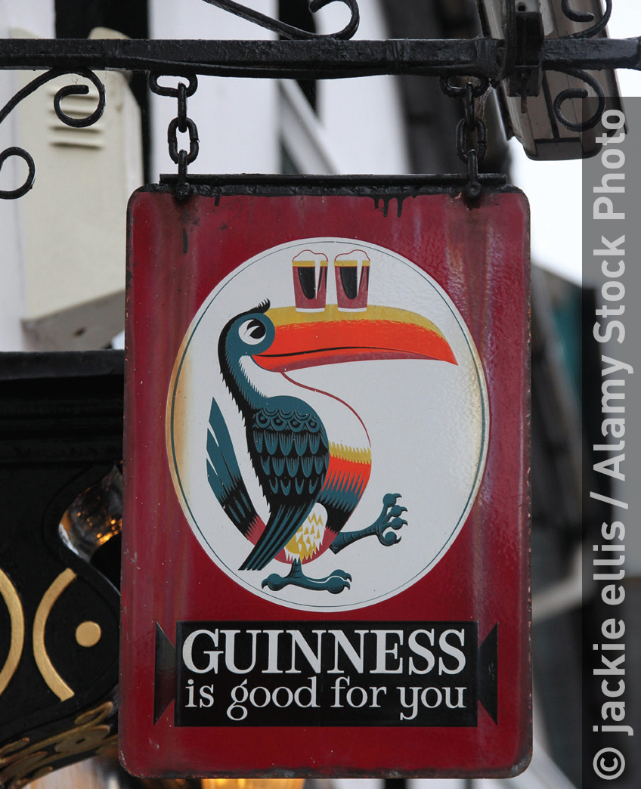
What is consumer protection legislation?
Consumer laws are acts of parliament that protect customers from misleading or dangerous practices by companies.
Consumer laws try to protect consumers from being harmed. For example, tobacco companies knew the risks of smoking long before the public did.
Consumer laws try and stop businesses making false statements about their products – such as this Guinness advert.
Consumer laws try and prevent the selling of unsafe food or other products.

Slide 6
Consumer Rights Act 2015
This Act gives consumers various rights, including the right to return a faulty product.
Goods must be fit for purpose and be free from defects, and be safe and long lasting in keeping with the type of product.
The consumer has the right to a refund or repair at the businesses expense if the good is not fit for purpose.
It is the seller of the product, not the manufacturer, who must correct any problem.

Slide 7
Trade Descriptions Act 1968
This Act forces businesses to ensure any claims made about products are ‘demonstrably true’, i.e. evidence is available.
It is an offence for businesses to use false or misleading statements, or to misleadingly label goods or services
A business found guilty of an offence is committing a crime and can be punished
Banned advertisements

Slide 8
Other key Acts
Consumer Credit Act 1974: Every item sold on credit must have clear annual percentage interest rate charged shown.
Weights and Measures Act 1985: The weight shown on packaging must be the weight of the product
Food Safety Act 1990: To stop customers becoming ill from eating prepared food, staff must have hygiene training.

Slide 9
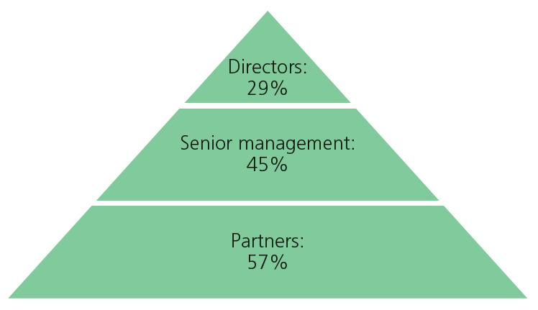
Employment legislation
Equality Act 2010: This helps prevent discrimination when businesses recruit new staff – a business cannot discriminate based on gender, ethnicity and those with disabilities.
Equal Pay Act: This Act ensurse workers doing the same job are paid the same money, e.g. in 2015 average pay for men is 20% more than that for women in full time work.
Discrimination: Legislation exists to try and prevent some forms of discrimination.
However, look at the chart for John Lewis.
Where are males more dominant than females?

Slide 10
The impact of legislation on businesses
Many businesses believe all these laws mean too much time and money spent on government rules rather than competing with foreign companies.
Rules may restrict creativity and innovation.
Businesses particularly object to red tape.
However, consumers need protection from businesses that have poor moral values.
Sometimes the rules can actually make businesses more creative, e.g. ways to pay the minimum wage whilst still making a profit.

Slide 11
Summary questions
Write down or discuss the answers to these questions.
What is legislation?
According to the Consumer Rights Act goods must be f___ for p_______?
Name one right under the Consumer Rights Act.
Name one thing the Trade Description Act stops businesses doing.
What type of discrimination still seems to exist within certain businesses?
Give one reason why legislation may be seen as bad for businesses.

